Slide 1



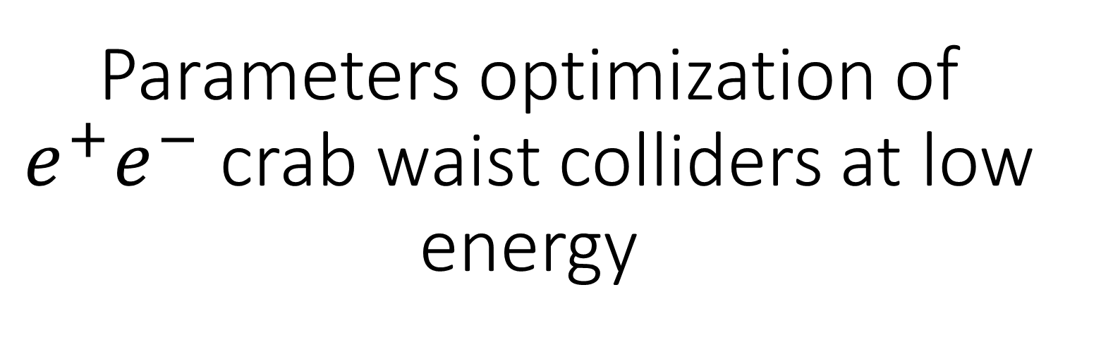
Parameters optimization of $e^{+}e^{−}$ crab waist colliders at low energy
A. Bogomyagkov
BINP, Russia
The 7th International Workshop on Future Tau Charm Facilities,
Huangshan, China
November 23-27, 2025
Budker Institute of
Nuclear Physics
SRF «SKIF»

Slide 2
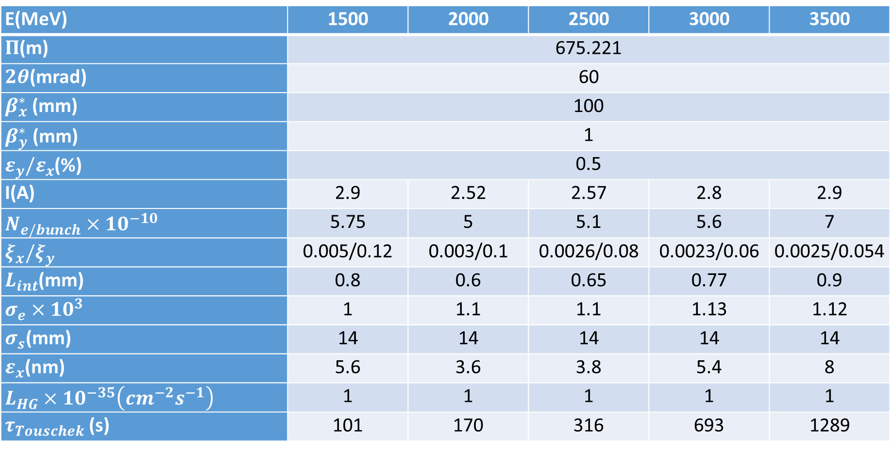

Design parameters for $ℒ=1×{10}^{35}$
E(MeV) | 1500 | 2000 | 2500 | 3000 | 3500
$Π$(m) | 675.221
$2θ$(mrad) | 60
$β_{x}^{∗}$ (mm) | 100
$β_{y}^{∗}$ (mm) | 1
$ε_{y}/ε_{x}$(%) | 0.5
I(A) | 2.9 | 2.52 | 2.57 | 2.8 | 2.9
$N_{e/bunch}×{10}^{−10}$ | 5.75 | 5 | 5.1 | 5.6 | 7
$ξ_{x}/ξ_{y}$ | 0.005/0.12 | 0.003/0.1 | 0.0026/0.08 | 0.0023/0.06 | 0.0025/0.054
$L_{int}$(mm) | 0.8 | 0.6 | 0.65 | 0.77 | 0.9
$σ_{e}×{10}^{3}$ | 1 | 1.1 | 1.1 | 1.13 | 1.12
$σ_{s}$(mm) | 14 | 14 | 14 | 14 | 14
$ε_{x}$(nm) | 5.6 | 3.6 | 3.8 | 5.4 | 8
$L_{HG}×{10}^{−35}\left(cm^{−2}s^{−1}\right)$ | 1 | 1 | 1 | 1 | 1
$τ_{Touschek}$ (s) | 101 | 170 | 316 | 693 | 1289
$β_{y}^{∗}>L_{int}$ Why?
Notes:
71, I(e+)=3.2 A PEPII, I(e-)=2.45A DAFNE, L=5.1e34 SuperKEKB

Slide 3
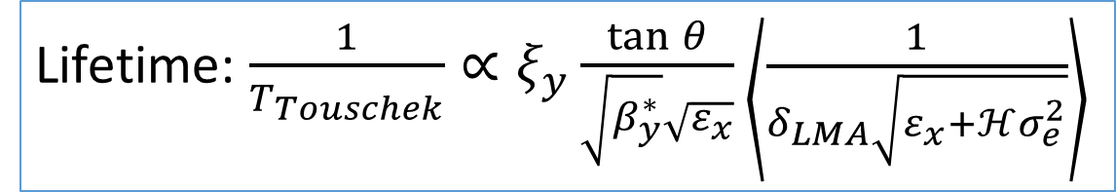
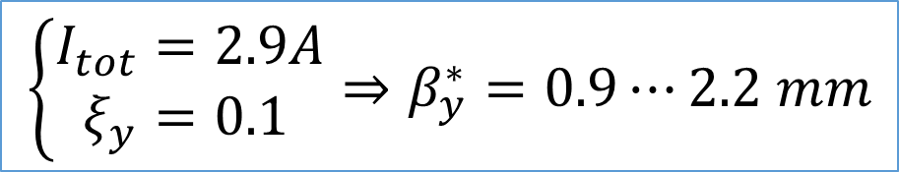
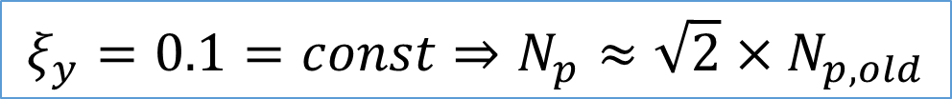
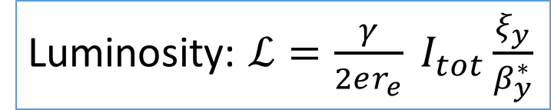
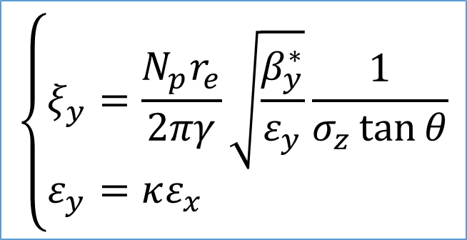

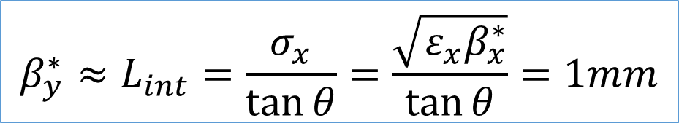
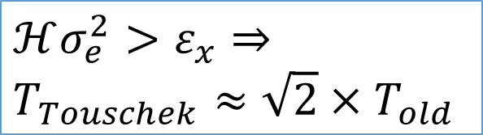
The main principles
Luminosity: $ℒ=\frac{γ}{2er_{e}} I_{tot}\frac{ξ_{y}}{β_{y}^{∗}}$
$$\left\{\begin{aligned}I_{tot}&=2.9A \\ ξ_{y}&=0.1\end{aligned}\right.⇒β_{y}^{∗}=0.9⋯2.2 mm$$
$$β_{y}^{∗}≈L_{int}=\frac{σ_{x}}{\tan{θ}}=\frac{\sqrt{ε_{x}β_{x}^{∗}}}{\tan{θ}}=1mm$$
$$⇒ε_{x}≈10nm≈2×ε_{x,old}$$
$$\left\{\begin{aligned}ξ_{y}&=\frac{N_{p}r_{e}}{2πγ}\sqrt{\frac{β_{y}^{∗}}{ε_{y}}}\frac{1}{σ_{z}\tan{θ}} \\ ε_{y}&=κε_{x}\end{aligned}\right.$$
$$ξ_{y}=0.1=const⇒N_{p}≈\sqrt{2}×N_{p,old}$$
Lifetime: $\frac{1}{T_{Touschek}}∝ξ_{y}\frac{\tan{θ}}{\sqrt{β_{y}^{∗}}\sqrt{ε_{x}}}\left\langle \frac{1}{δ_{LMA}\sqrt{ε_{x}+ℋσ_{e}^{2}}}\right\rangle$
$$ℋσ_{e}^{2}>ε_{x}⇒$$
$$T_{Touschek}≈\sqrt{2}×T_{old}$$

Slide 4
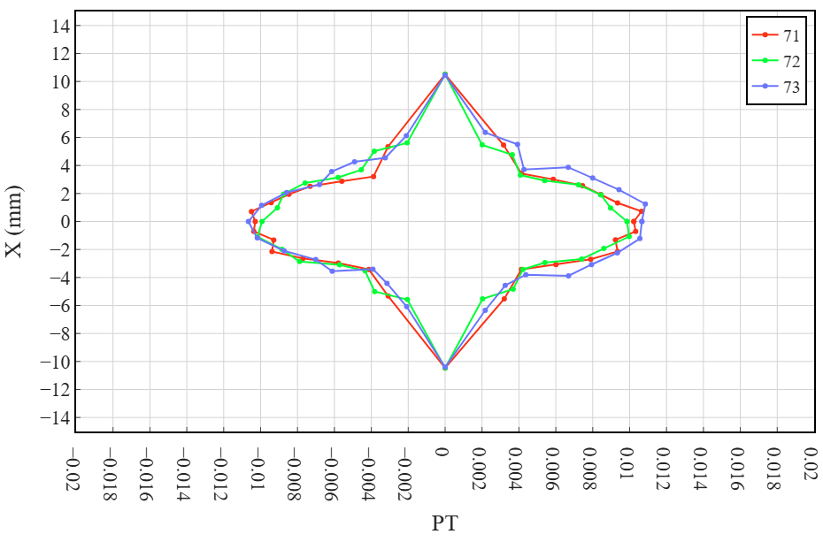
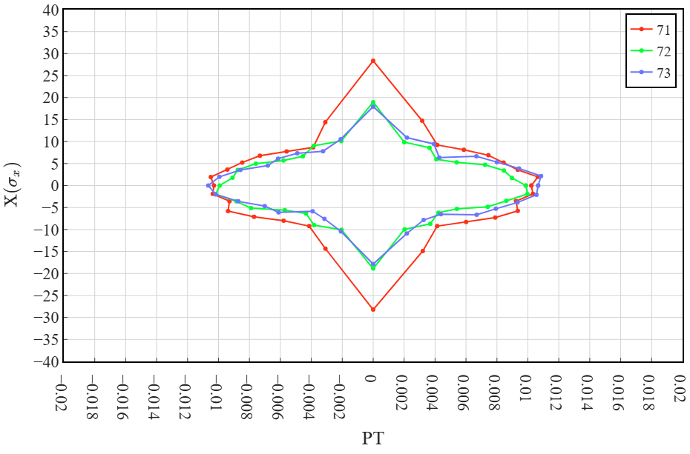
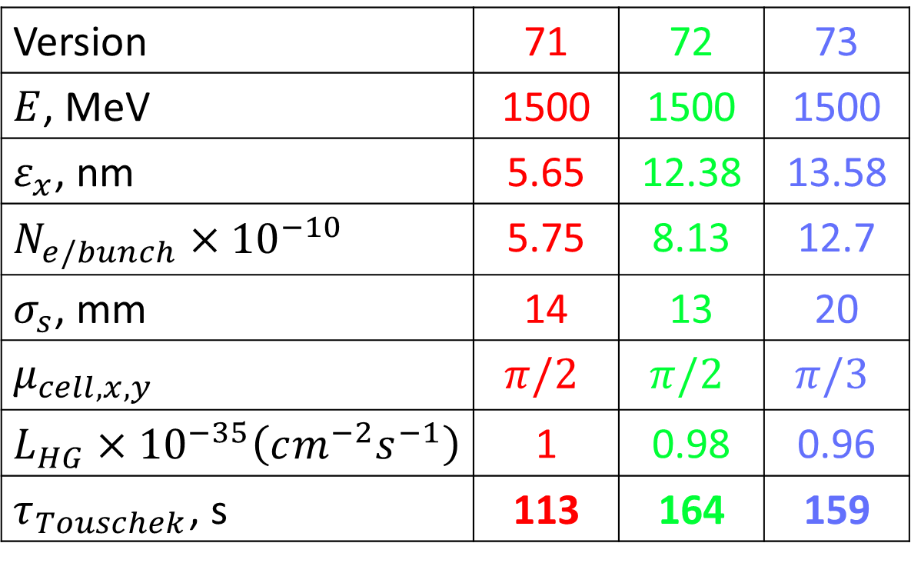
The test at $E=1500$ MeV
Version | 71 | 72 | 73
$E$, MeV | 1500 | 1500 | 1500
$ε_{x}$, nm | 5.65 | 12.38 | 13.58
$$N_{e/bunch}×{10}^{−10}$$ | 5.75 | 8.13 | 12.7
$σ_{s}$, mm | 14 | 13 | 20
$μ_{cell,x,y}$ | $$π/2$$ | $$π/2$$ | $$π/3$$
$$L_{HG}×{10}^{−35}\left(cm^{−2}s^{−1}\right)$$ | 1 | 0.98 | 0.96
$τ_{Touschek}$, s | 113 | 164 | 159

Slide 5
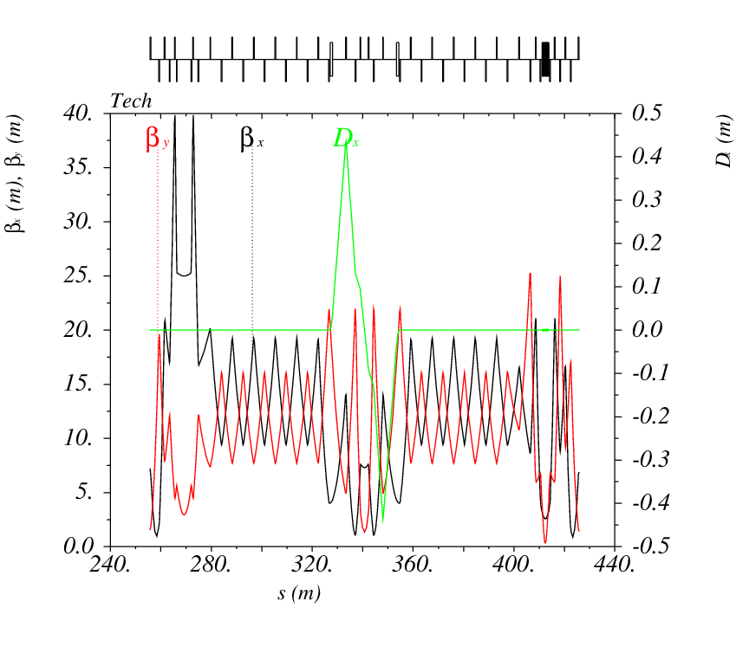
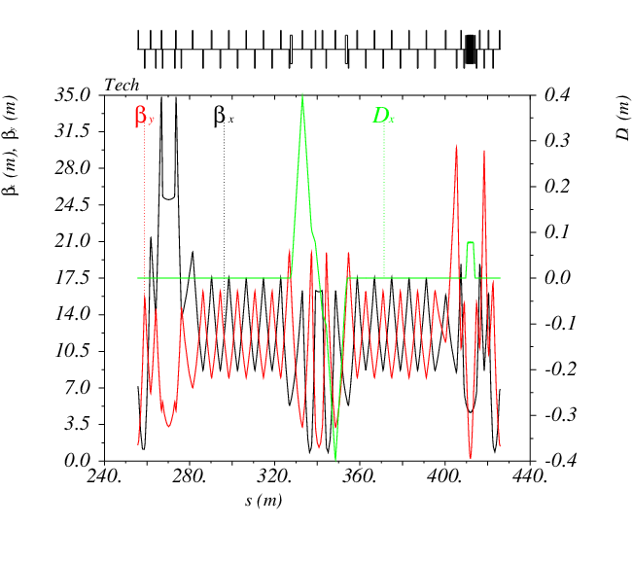
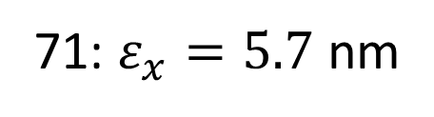
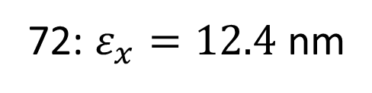
Emittance increase of 72 vs 71
71: $ε_{x}=5.7$ nm
72: $ε_{x}=12.4$ nm
Dispersion
in wiggler

Slide 6
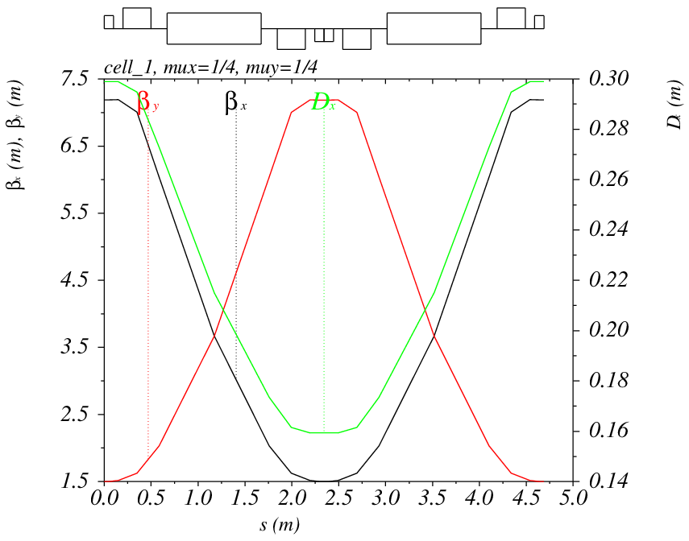
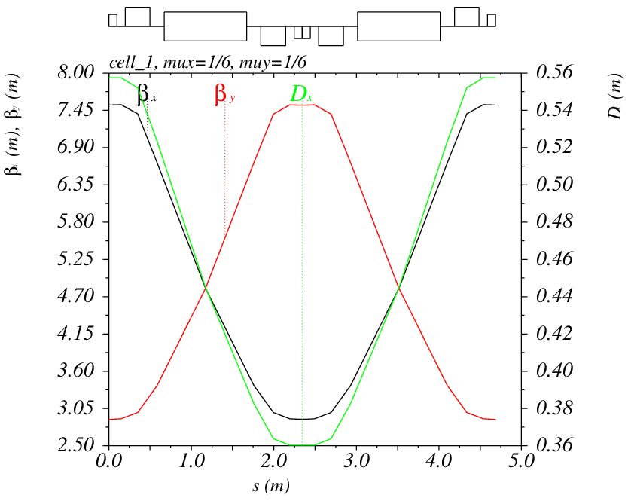
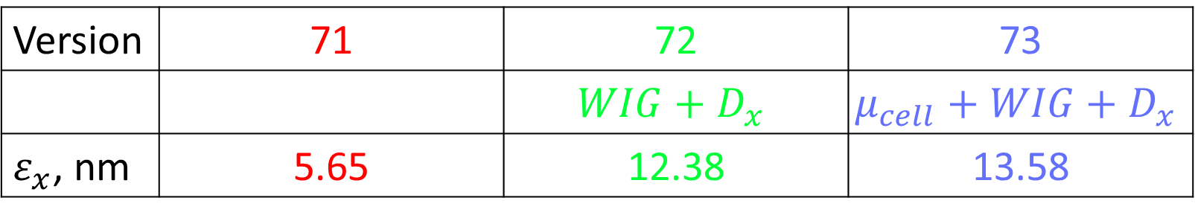


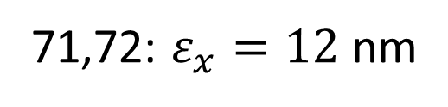
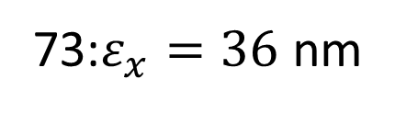
Emittance increase of 73 vs 71,72
71,72: $ε_{x}=12$ nm
73:$ε_{x}=36$ nm
$$μ_{x,y}=\frac{π}{2}$$
$$μ_{x,y}=\frac{π}{3}$$
Version | 71 | 72 | 73
 |  | $$WIG+D_{x}$$ | $$μ_{cell}+WIG+D_{x}$$
$ε_{x}$, nm | 5.65 | 12.38 | 13.58

Slide 7
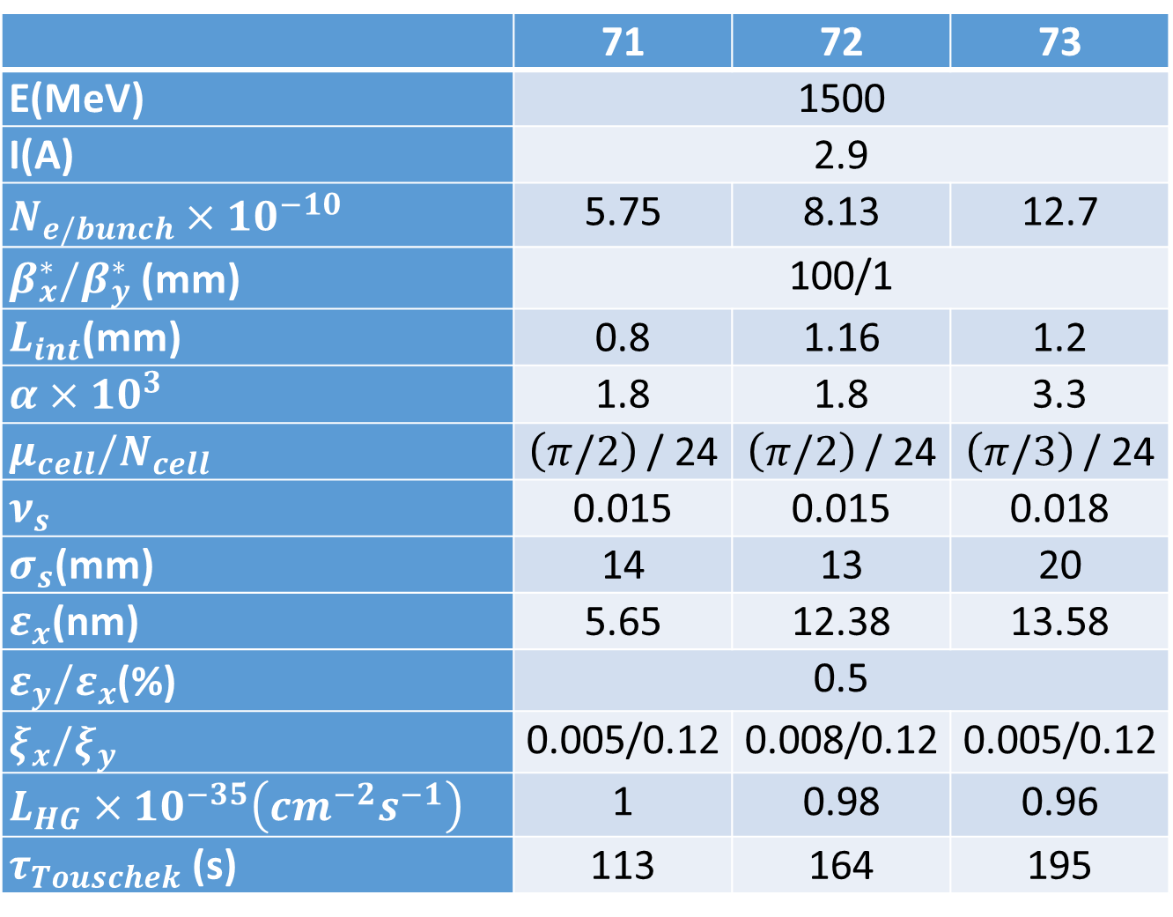
Comparison
 | 71 | 72 | 73
E(MeV) | 1500
I(A) | 2.9
$N_{e/bunch}×{10}^{−10}$ | 5.75 | 8.13 | 12.7
$β_{x}^{∗}/β_{y}^{∗}$ (mm) | 100/1
$L_{int}$(mm) | 0.8 | 1.16 | 1.2
$α×10^{3}$ | 1.8 | 1.8 | 3.3
$μ_{cell}/N_{cell}$ | $\left(π/2\right)$ / 24 | $\left(π/2\right)$ / 24 | $\left(π/3\right)$ / 24
$ν_{s}$ | 0.015 | 0.015 | 0.018
$σ_{s}$(mm) | 14 | 13 | 20
$ε_{x}$(nm) | 5.65 | 12.38 | 13.58
$ε_{y}/ε_{x}$(%) | 0.5
$ξ_{x}/ξ_{y}$ | 0.005/0.12 | 0.008/0.12 | 0.005/0.12
$L_{HG}×{10}^{−35}\left(cm^{−2}s^{−1}\right)$ | 1 | 0.98 | 0.96
$τ_{Touschek}$ (s) | 113 | 164 | 195
+for weaker sextupoles
+for beam-beam
+for collective
+for operation
Notes:
I(e+)=3.2 A PEPII, I(e-)=2.45A DAFNE, L=5.1e34 SuperKEKB

Slide 8
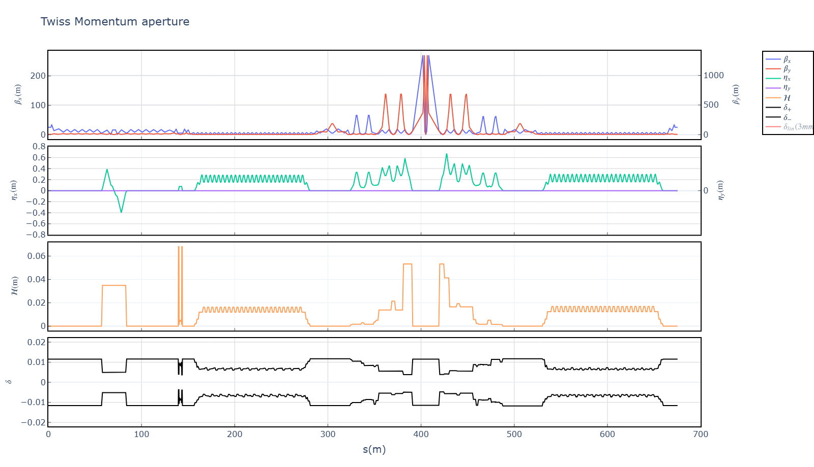

LMA: 72
$$ℋ≈0.02$$
+0.6%
-0.6%
Notes:
LMA-2-2024.09.09-12.33.00_1.0crab_sextupole-1.5GeV_wig-2-8cav-1.5MV.png

Slide 9
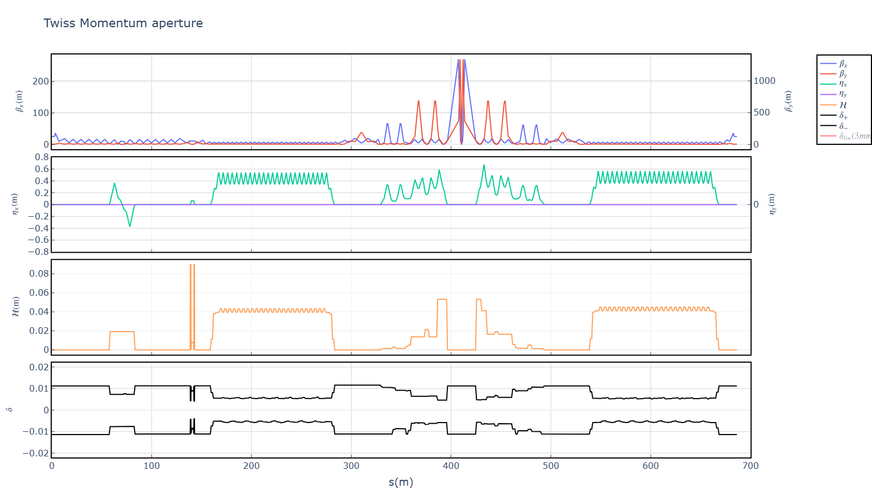

LMA: 73
$ℋ≈0.0$4
+0.5%
-0.5%
Notes:
LMA_2-2025.10.22-12.52.22_1.0crab_1.5GeV_wig-1-8cav.png

Slide 10
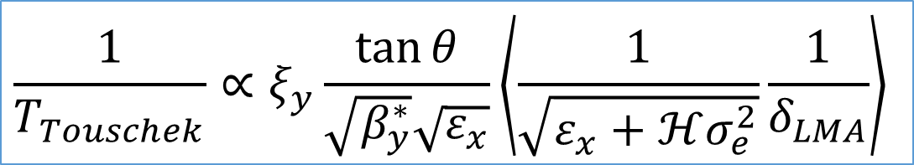
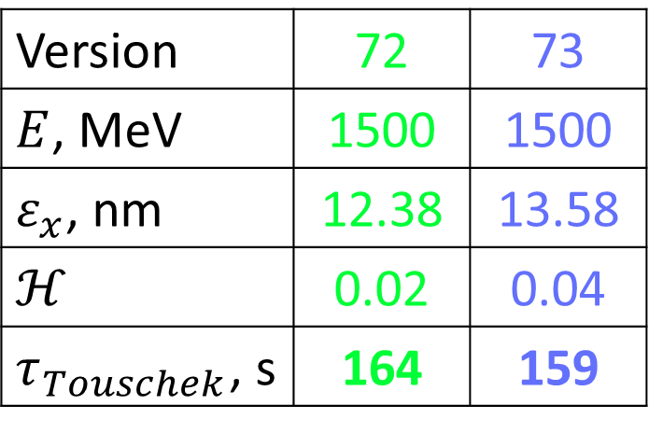
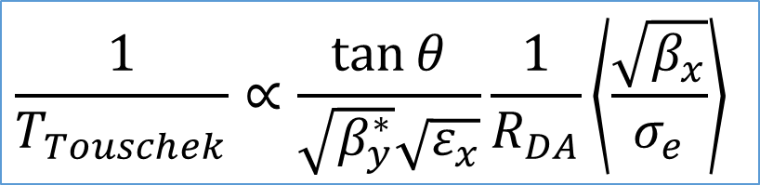
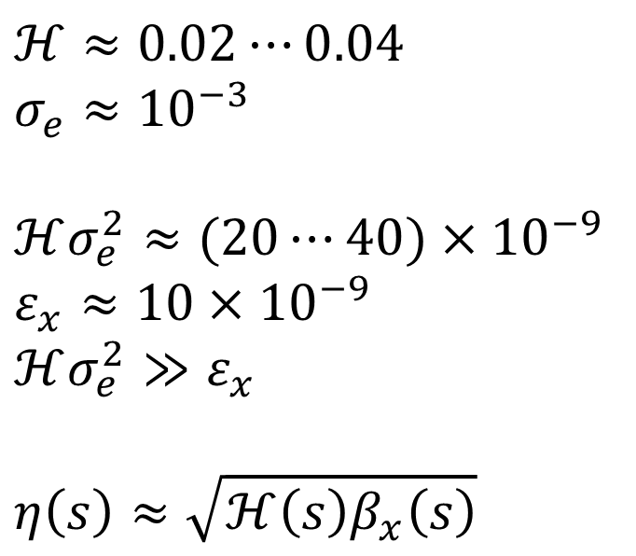
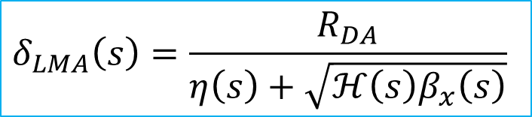
Why $T_{Touschek}$ is independent of $ℋ$?
$$\frac{1}{T_{Touschek}}∝ξ_{y}\frac{\tan{θ}}{\sqrt{β_{y}^{∗}}\sqrt{ε_{x}}}\left\langle \frac{1}{\sqrt{ε_{x}+ℋσ_{e}^{2}}}\frac{1}{δ_{LMA}}\right\rangle$$
Version | 72 | 73
$E$, MeV | 1500 | 1500
$ε_{x}$, nm | 12.38 | 13.58
$$ℋ$$ | 0.02 | 0.04
$τ_{Touschek}$, s | 164 | 159
$ℋ≈0.02⋯0.04$
$$σ_{e}≈{10}^{−3}$$
$ℋσ_{e}^{2}≈(20⋯40)×{10}^{−9}$
$ε_{x}≈10×{10}^{−9}$
$ℋσ_{e}^{2}≫ε_{x}$
$$η\left(s\right)≈\sqrt{ℋ\left(s\right)β_{x}\left(s\right)}$$
$$δ_{LMA}\left(s\right)=\frac{R_{DA}}{η\left(s\right)+\sqrt{ℋ\left(s\right)β_{x}\left(s\right)}}$$
$$\frac{1}{T_{Touschek}}∝\frac{\tan{θ}}{\sqrt{β_{y}^{∗}}\sqrt{ε_{x}}}\frac{1}{R_{DA}}\left\langle \frac{\sqrt{β_{x}}}{σ_{e}}\right\rangle$$

Slide 11
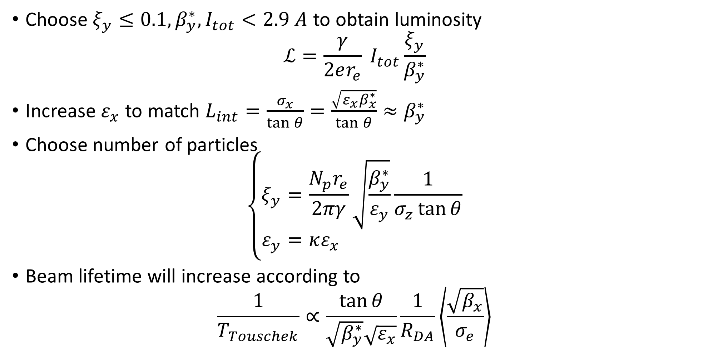
Conclusion 1
Choose $ξ_{y}≤0.1, β_{y}^{∗}, I_{tot}<2.9 A$ to obtain luminosity $ℒ=\frac{γ}{2er_{e}} I_{tot}\frac{ξ_{y}}{β_{y}^{∗}}$
Increase $ε_{x}$ to match $L_{int}=\frac{σ_{x}}{\tan{θ}}=\frac{\sqrt{ε_{x}β_{x}^{∗}}}{\tan{θ}}≈β_{y}^{∗}$
Choose number of particles $\left\{\begin{aligned}ξ_{y}&=\frac{N_{p}r_{e}}{2πγ}\sqrt{\frac{β_{y}^{∗}}{ε_{y}}}\frac{1}{σ_{z}\tan{θ}} \\ ε_{y}&=κε_{x}\end{aligned}\right.$
Beam lifetime will increase according to $\frac{1}{T_{Touschek}}∝\frac{\tan{θ}}{\sqrt{β_{y}^{∗}}\sqrt{ε_{x}}}\frac{1}{R_{DA}}\left\langle \frac{\sqrt{β_{x}}}{σ_{e}}\right\rangle$

Slide 12
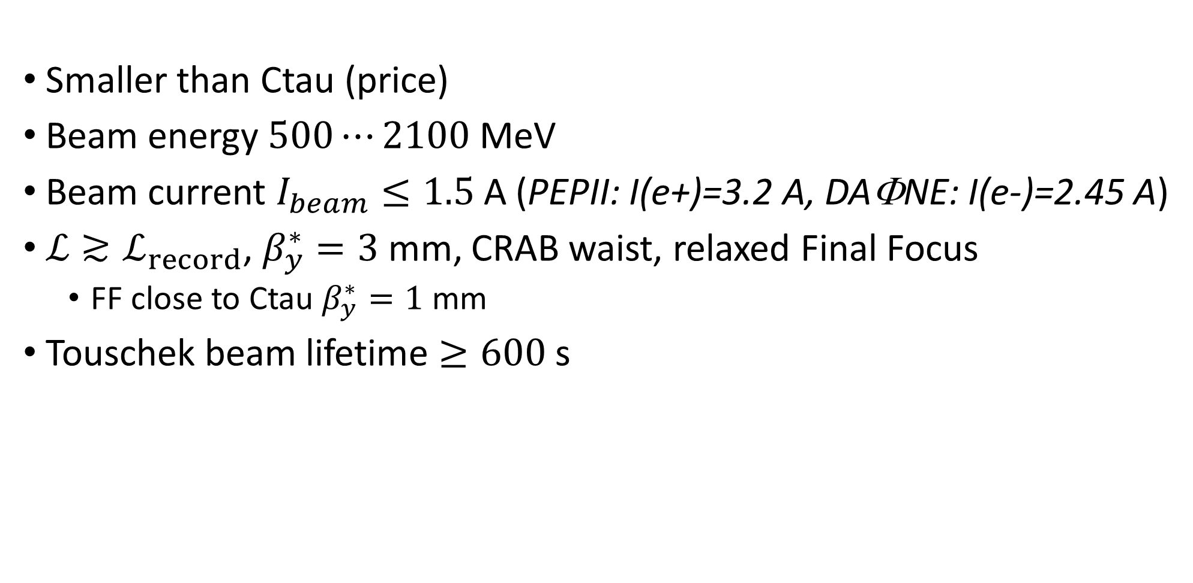
VEPP-6
Smaller than Ctau (price)
Beam energy $500⋯2100$ MeV
Beam current $I_{beam}≤1.5$ A (PEPII: I(e+)=3.2 A, DAΦNE: I(e-)=2.45 A)
$ℒ≳ℒ_{record}$, $β_{y}^{∗}=3$ mm, CRAB waist, relaxed Final Focus
FF close to Ctau $β_{y}^{∗}=1$ mm
Touschek beam lifetime $≥600$ s

Slide 13
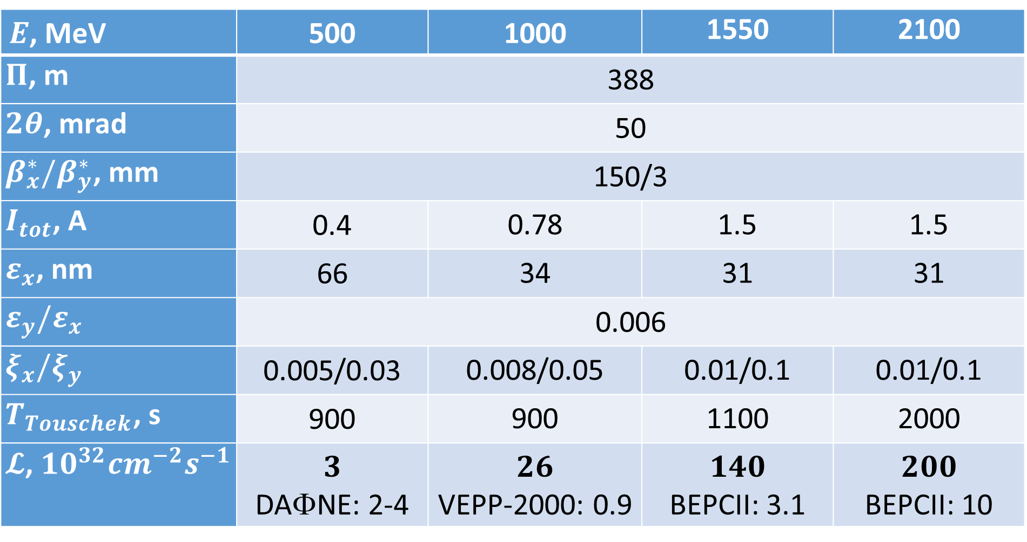
VEPP-6
$E$, MeV | 500 | 1000 | 1550 | 2100
$Π$, m | 388
$2θ$, mrad | 50
$β_{x}^{∗}/β_{y}^{∗}$, mm | 150/3
$I_{tot}$, А | 0.4 | 0.78 | 1.5 | 1.5
$ε_{x}$, nm | 66 | 34 | 31 | 31
$ε_{y}/ε_{x}$ | 0.006
$ξ_{x}/ξ_{y}$ | 0.005/0.03 | 0.008/0.05 | 0.01/0.1 | 0.01/0.1
$T_{Touschek}$, s | 900 | 900 | 1100 | 2000
$𝓛$, ${10}^{32}{cm}^{−2}s^{−1}$ | $$3$$ DAΦNE: 2-4 | $$26$$ VEPP-2000: 0.9 | $$140$$ BEPCII: 3.1 | $$200$$ BEPCII: 10

Slide 14
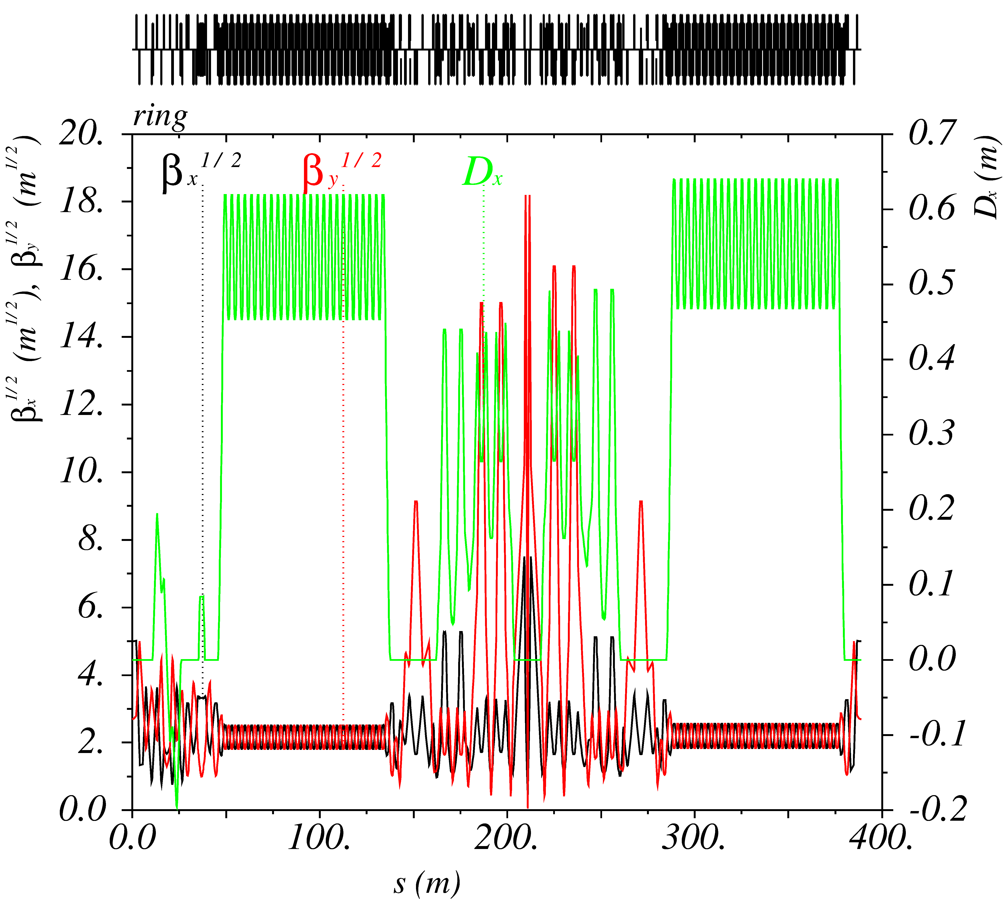
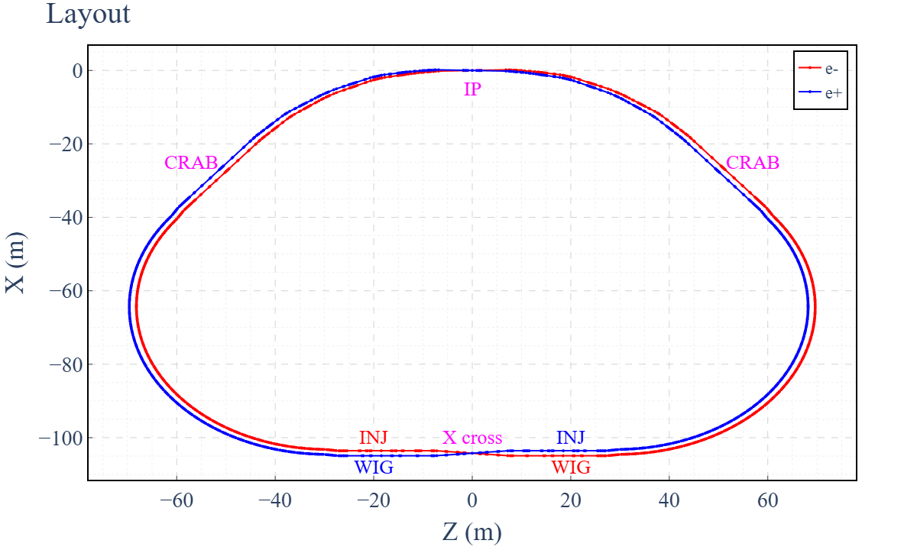
VEPP-6

Slide 15
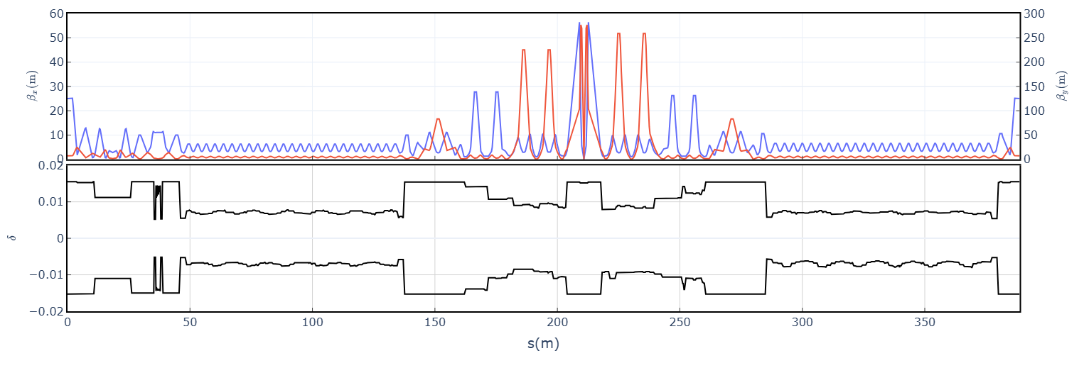
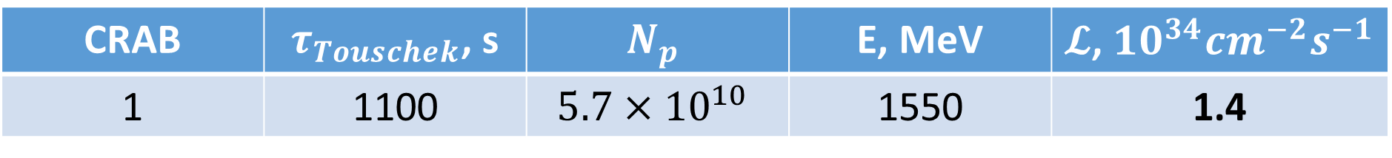
VEPP-6: LMA
CRAB | $τ_{Touschek}$, s | $$N_{p}$$ | E, MeV | $𝓛$, ${10}^{34}{cm}^{−2}s^{−1}$
1 | 1100 | $$5.7×{10}^{10}$$ | 1550 | 1.4

Slide 16
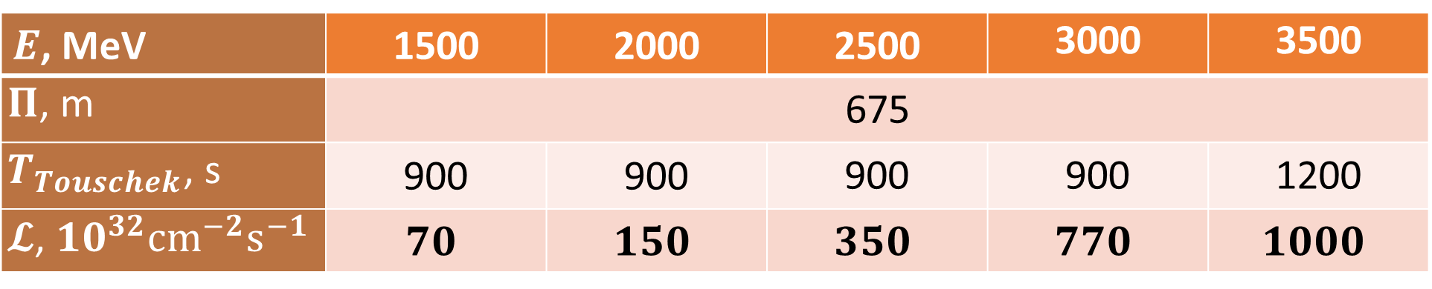
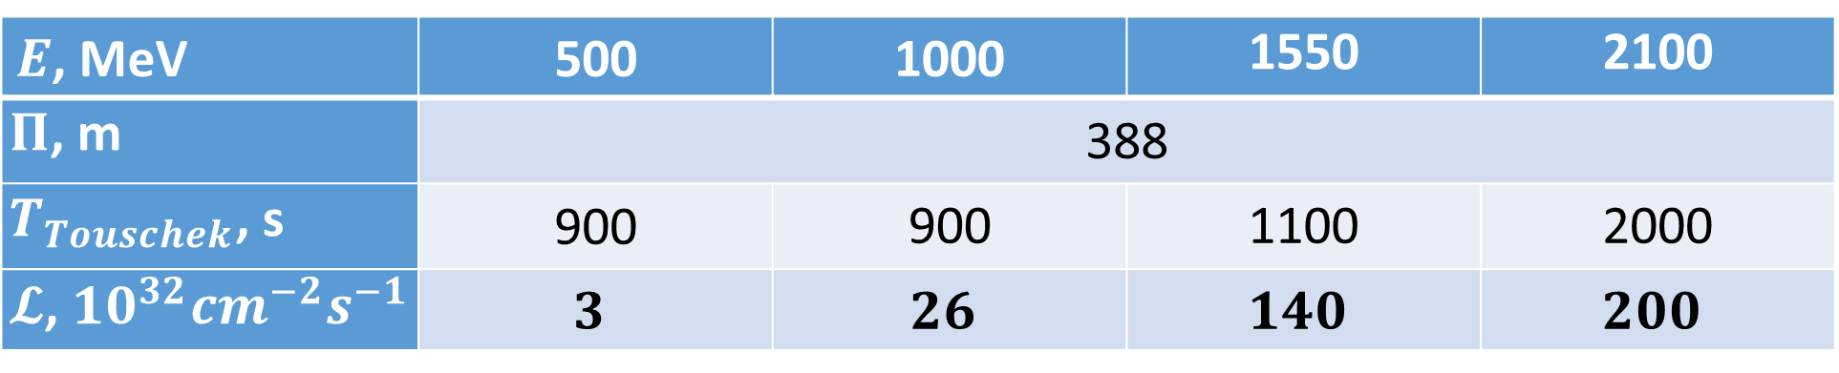
VEPP-6 versus Super Charm Tau Factory
VEPP-6
$E$, MeV | 500 | 1000 | 1550 | 2100
$Π$, m | 388
$T_{Touschek}$, s | 900 | 900 | 1100 | 2000
$𝓛$, ${10}^{32}{cm}^{−2}s^{−1}$ | $$3$$ | $$26$$ | $$140$$ | $$200$$
Super Charm Tau Factory
$E$, MeV | 1500 | 2000 | 2500 | 3000 | 3500
$Π$, m | 675
$T_{Touschek}$, s | 900 | 900 | 900 | 900 | 1200
$𝓛$, ${10}^{32}{cm}^{−2}s^{−1}$ | $$70$$ | $$150$$ | $$350$$ | $$770$$ | $$1000$$

Slide 17
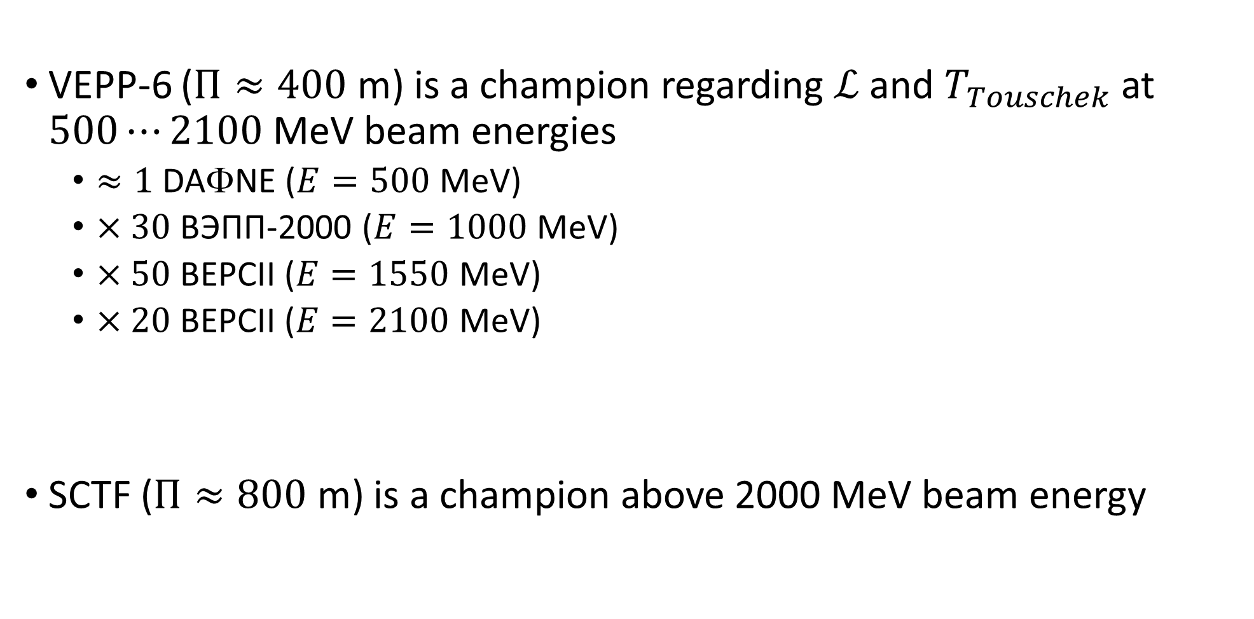
Conclusion 2
VEPP-6 ($Π≈400$ m) is a champion regarding $ℒ$ and $T_{Touschek}$ at $500⋯2100$ MeV beam energies
$≈1$ DAΦNE ($E=500$ MeV)
$×30$ ВЭПП-2000 ($E=1000$ MeV)
$×50$ BEPCII ($E=1550$ MeV)
$×20$ BEPCII ($E=2100$ MeV)
SCTF ($Π≈800$ m) is a champion above 2000 MeV beam energy

Slide 18
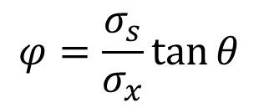
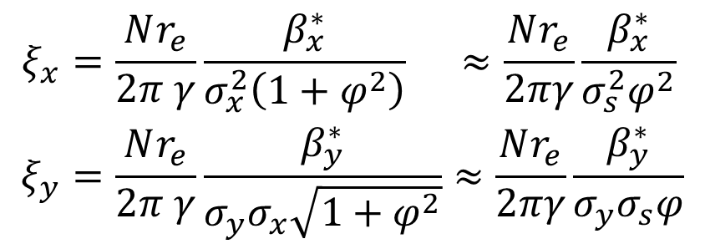
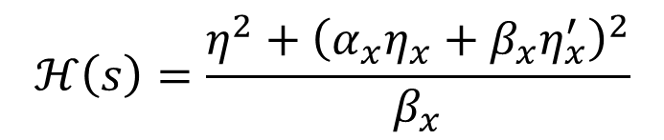
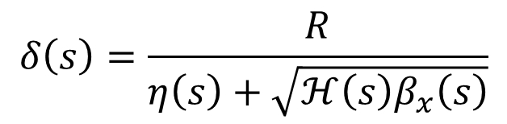
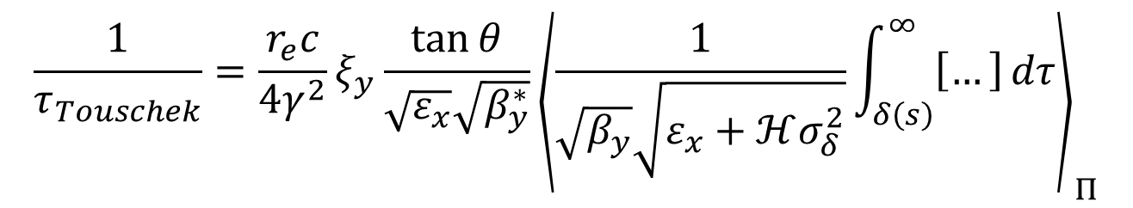
Spare
$$\begin{aligned}ξ_{x}&=\frac{Nr_{e}}{2π γ}\frac{β_{x}^{∗}}{σ_{x}^{2}\left(1+φ^{2}\right)}&≈\frac{Nr_{e}}{2πγ}\frac{β_{x}^{∗}}{σ_{s}^{2}φ^{2}} \\ ξ_{y}&=\frac{Nr_{e}}{2π γ}\frac{β_{y}^{∗}}{σ_{y}σ_{x}\sqrt{1+φ^{2}}}&≈\frac{Nr_{e}}{2πγ}\frac{β_{y}^{∗}}{σ_{y}σ_{s}φ}\end{aligned}$$
$$φ=\frac{σ_{s}}{σ_{x}}\tan{θ}$$
$$\frac{1}{τ_{Touschek}}=\frac{r_{e}c}{4γ^{2}}ξ_{y}\frac{\tan{θ}}{\sqrt{ε_{x}}\sqrt{β_{y}^{∗}}}{\left\langle \frac{1}{\sqrt{β_{y}}\sqrt{ε_{x}+ℋσ_{δ}^{2}}}\int_{δ\left(s\right)}^{∞}{\left[…\right]}dτ\right\rangle }_{Π}$$
$$ℋ\left(s\right)=\frac{η^{2}+{\left(α_{x}η_{x}+β_{x}η_{x}^{′}\right)}^{2}}{β_{x}}$$
Maximum Wiggler field: Bwig=3.5 T
Period: lambda=0.15 m
Length: 35*lambda/2 = 2.625 m
$$δ\left(s\right)=\frac{R}{η\left(s\right)+\sqrt{ℋ\left(s\right)β_{x}\left(s\right)}}$$

Slide 19
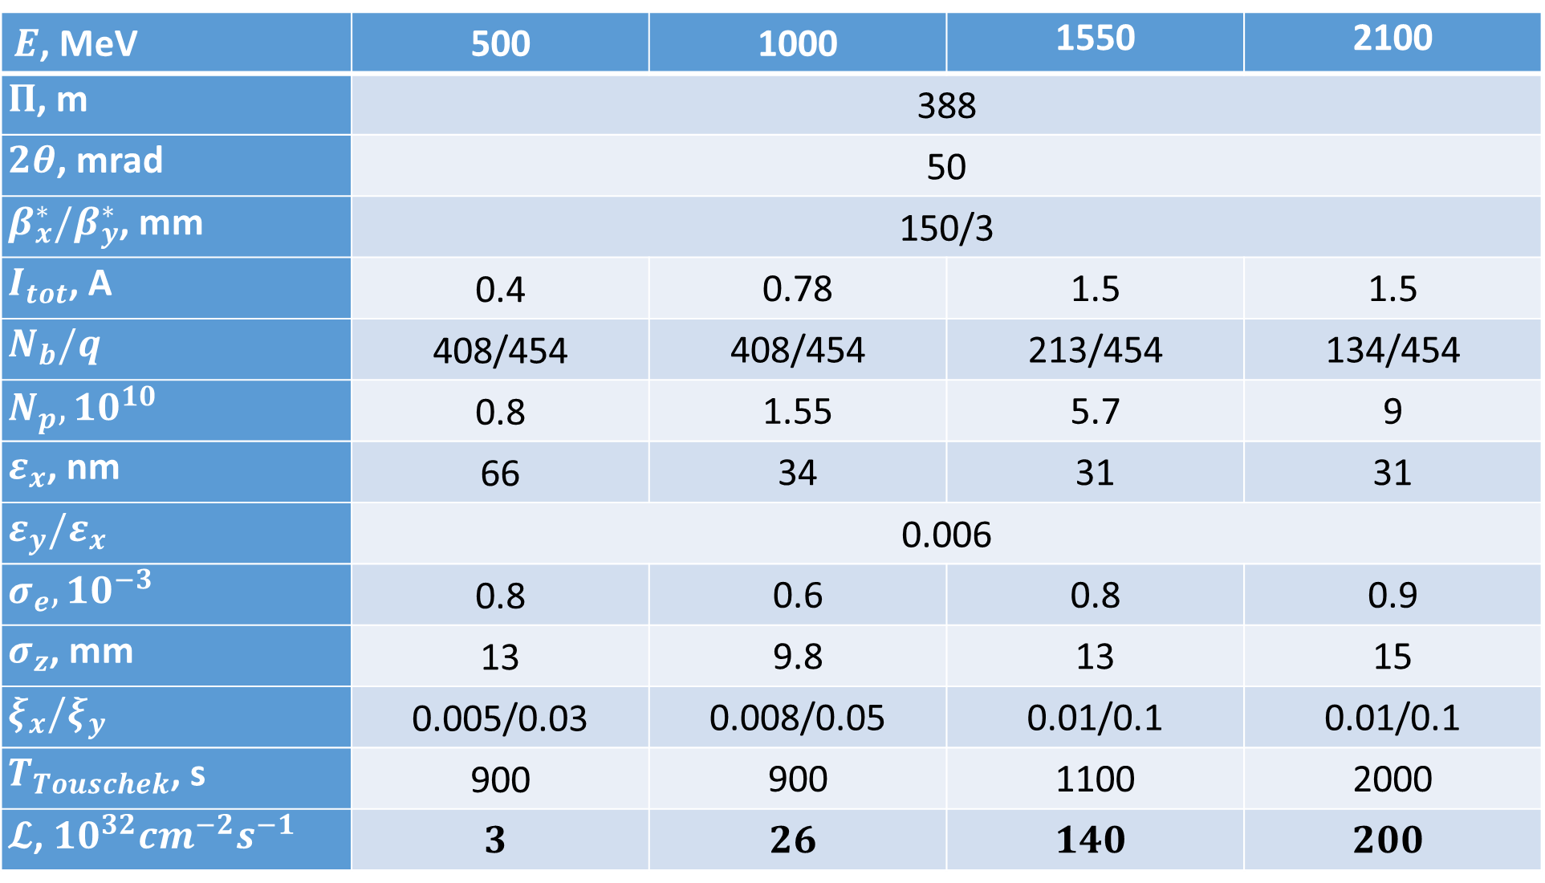
VEPP-6
$E$, MeV | 500 | 1000 | 1550 | 2100
$Π$, m | 388
$2θ$, mrad | 50
$β_{x}^{∗}/β_{y}^{∗}$, mm | 150/3
$I_{tot}$, A | 0.4 | 0.78 | 1.5 | 1.5
$$N_{b}/q$$ | 408/454 | 408/454 | 213/454 | 134/454
$$N_{p}, 10^{10}$$ | 0.8 | 1.55 | 5.7 | 9
$ε_{x}$, nm | 66 | 34 | 31 | 31
$$ε_{y}/ε_{x}$$ | 0.006
$$σ_{e}, 10^{−3}$$ | 0.8 | 0.6 | 0.8 | 0.9
$σ_{z}$, mm | 13 | 9.8 | 13 | 15
$$ξ_{x}/ξ_{y}$$ | 0.005/0.03 | 0.008/0.05 | 0.01/0.1 | 0.01/0.1
$T_{Touschek}$, s | 900 | 900 | 1100 | 2000
$𝓛$, ${10}^{32}{cm}^{−2}s^{−1}$ | $$3$$ | $$26$$ | $$140$$ | $$200$$

Slide 20
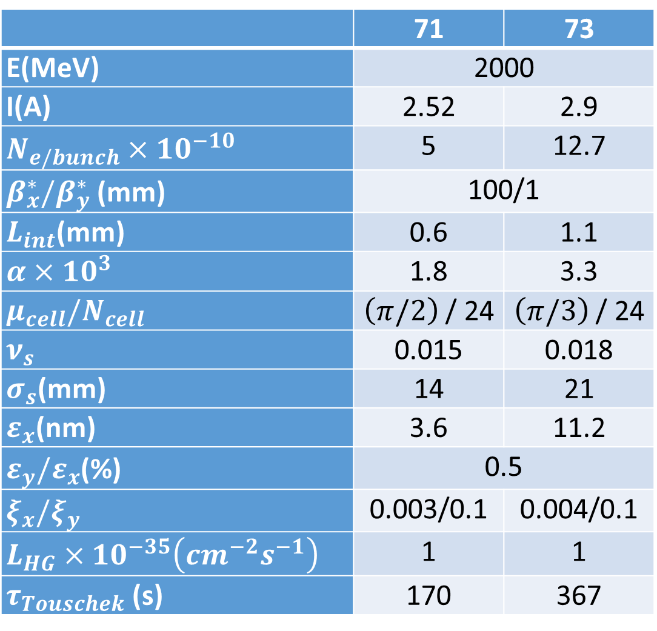
Comparison SCTF at 2000 GeV
 | 71 | 73
E(MeV) | 2000
I(A) | 2.52 | 2.9
$N_{e/bunch}×{10}^{−10}$ | 5 | 12.7
$β_{x}^{∗}/β_{y}^{∗}$ (mm) | 100/1
$L_{int}$(mm) | 0.6 | 1.1
$α×10^{3}$ | 1.8 | 3.3
$μ_{cell}/N_{cell}$ | $\left(π/2\right)$ / 24 | $\left(π/3\right)$ / 24
$ν_{s}$ | 0.015 | 0.018
$σ_{s}$(mm) | 14 | 21
$ε_{x}$(nm) | 3.6 | 11.2
$ε_{y}/ε_{x}$(%) | 0.5
$ξ_{x}/ξ_{y}$ | 0.003/0.1 | 0.004/0.1
$L_{HG}×{10}^{−35}\left(cm^{−2}s^{−1}\right)$ | 1 | 1
$τ_{Touschek}$ (s) | 170 | 367
Notes:
I(e+)=3.2 A PEPII, I(e-)=2.45A DAFNE, L=5.1e34 SuperKEKB

Slide 21
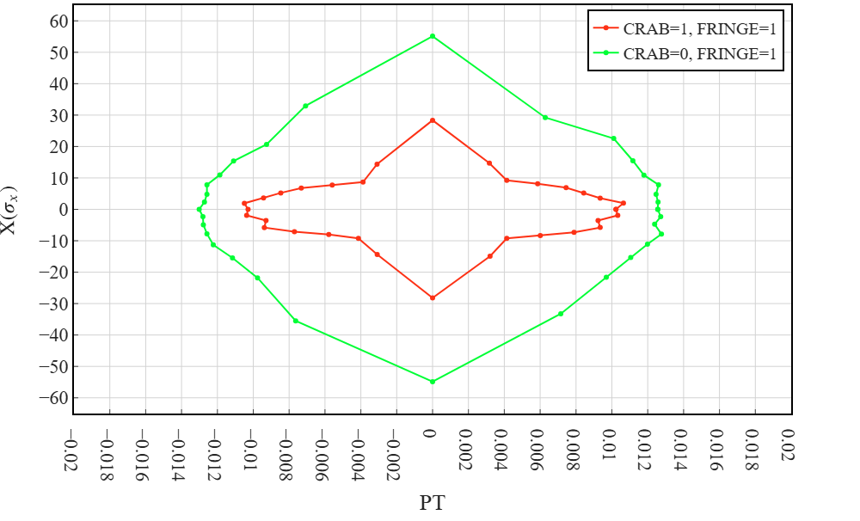
LMA, CRAB is ON (v.71)
$$δ\left(s\right)=\frac{R}{η\left(s\right)+\sqrt{ℋ\left(s\right)β_{x}\left(s\right)}}$$
$$R=η\left(s\right)δ+δ\sqrt{ℋ\left(s\right)β_{x}\left(s\right)}$$
 | $$τ_{Touschek}$$
CRAB = 1 | 101 s
CRAB = 0 | 293
Notes:
v.71 2024

