Slide 1

Emittance optimization in CW colliders for Touschek lifetime enhancement
Budker Institute of
Nuclear Physics
Mikhail Skamarokha
Budker Institute of Nuclear Physics (BINP SB RAS), Novosibirsk, Russia
November 25th 2025

Slide 2
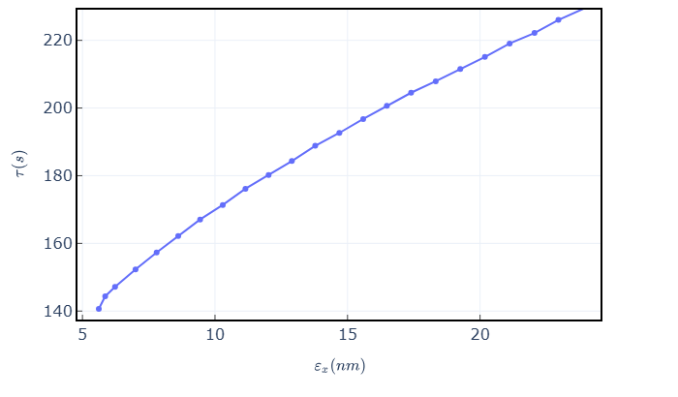
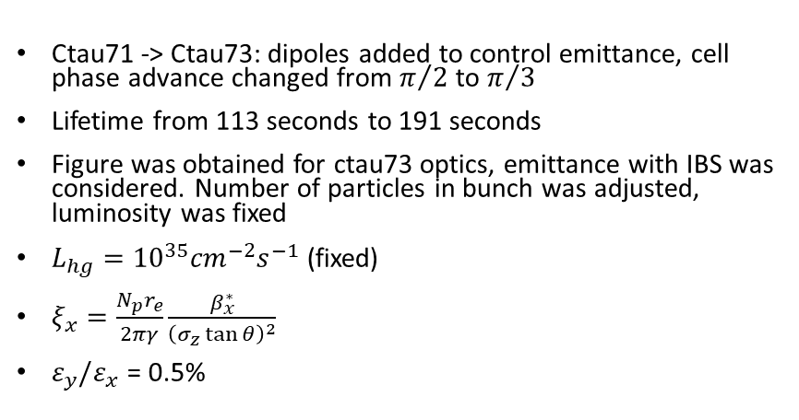
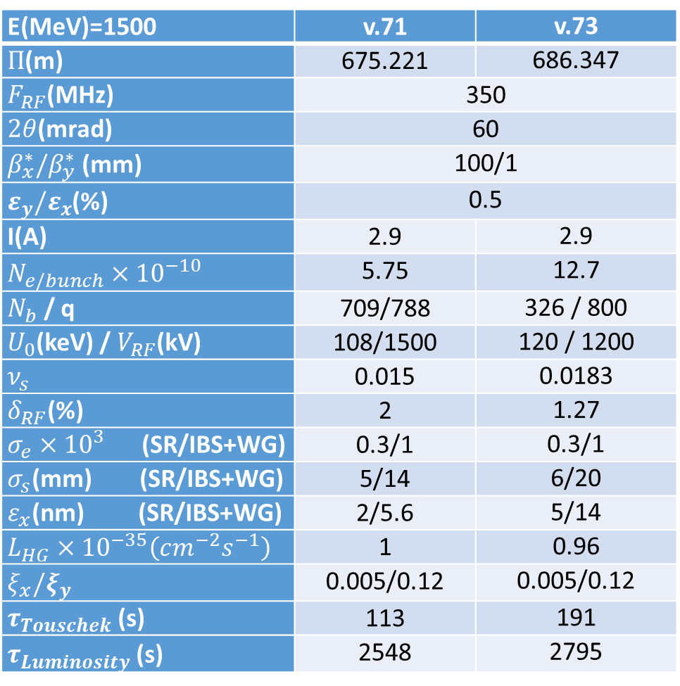


Dependence of lifetime on emittance for Siberian SCTF
E(MeV)=1500 | v.71 | v.73
$Π$(m) | 675.221 | 686.347
$F_{RF}$(MHz) | 350
$2θ$(mrad) | 60
$β_{x}^{∗}/β_{y}^{∗}$ (mm) | 100/1
$ε_{y}/ε_{x}$(%) | 0.5
I(A) | 2.9 | 2.9
$N_{e/bunch}×{10}^{−10}$ | 5.75 | 12.7
$N_{b}$ / q | 709/788 | 326 / 800
$U_{0}$(keV) / $V_{RF}$(kV) | 108/1500 | 120 / 1200
$ν_{s}$ | 0.015 | 0.0183
$δ_{RF}$(%) | 2 | 1.27
$σ_{e}×{10}^{3}$ (SR/IBS+WG) | 0.3/1 | 0.3/1
$σ_{s}$(mm) (SR/IBS+WG) | 5/14 | 6/20
$ε_{x}$(nm) (SR/IBS+WG) | 2/5.6 | 5/14
$L_{HG}×{10}^{−35}\left(cm^{−2}s^{−1}\right)$ | 1 | 0.96
$ξ_{x}/ξ_{y}$ | 0.005/0.12 | 0.005/0.12
$τ_{Touschek}$ (s) | 113 | 191
$τ_{Luminosity}$ (s) | 2548 | 2795
Ctau71 -> Ctau73: dipoles added to control emittance, cell phase advance changed from $π/2$ to $π/3$
Lifetime from 113 seconds to 191 seconds
Figure was obtained for ctau73 optics, emittance with IBS was considered. Number of particles in bunch was adjusted, luminosity was fixed
$L_{hg}={10}^{35}{cm}^{−2}s^{−1}$ (fixed)
$ξ_{x}=\frac{N_{p}r_{e}}{2πγ}\frac{β_{x}^{∗}}{{\left(σ_{z}\tan{θ}\right)}^{2}}$
$ε_{y}/ε_{x}$ = 0.5%
ctau73
ctau71
$$\frac{ν_{s}}{ξ_{x}}>3$$
$$\frac{ν_{s}}{ξ_{x}}<3$$

Slide 3
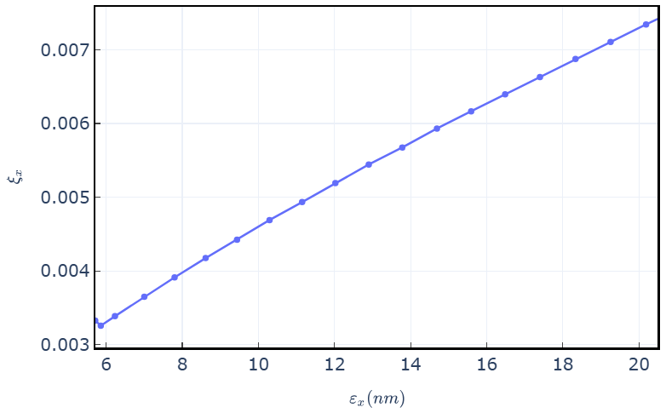
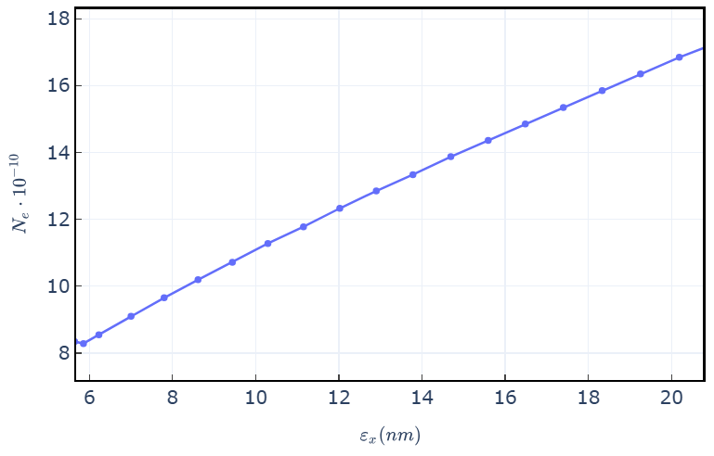
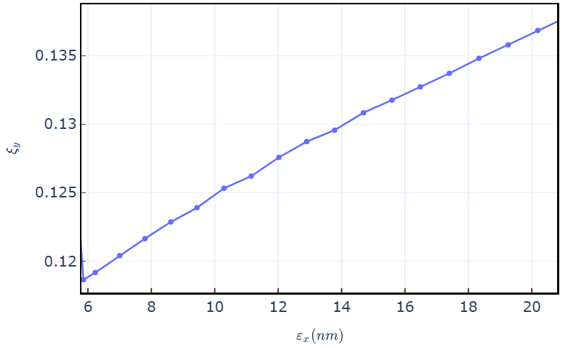
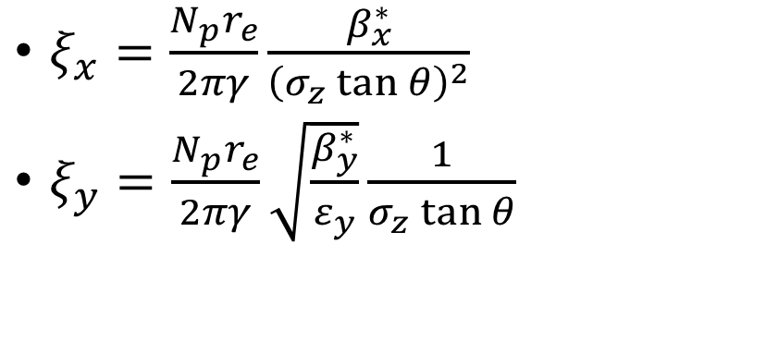

$ξ_{x}=\frac{N_{p}r_{e}}{2πγ}\frac{β_{x}^{∗}}{{\left(σ_{z}\tan{θ}\right)}^{2}}$
$ξ_{y}=\frac{N_{p}r_{e}}{2πγ}\sqrt{\frac{β_{y}^{∗}}{ε_{y}}}\frac{1}{σ_{z}\tan{θ}}$
$$∝\sqrt{ε_{x}}$$

Slide 4
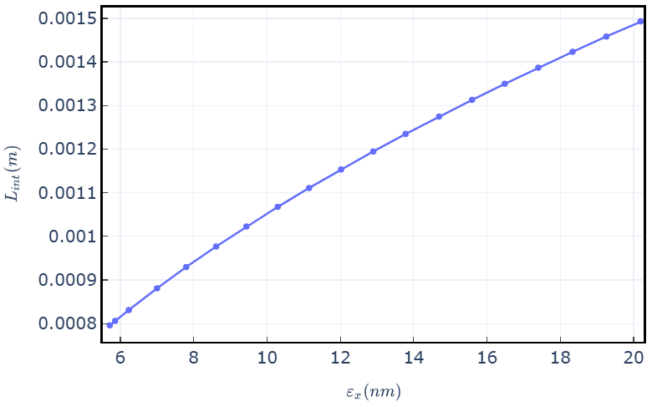
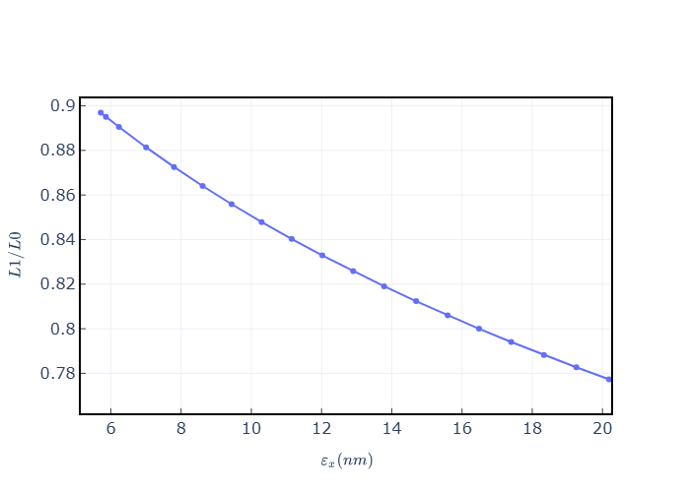
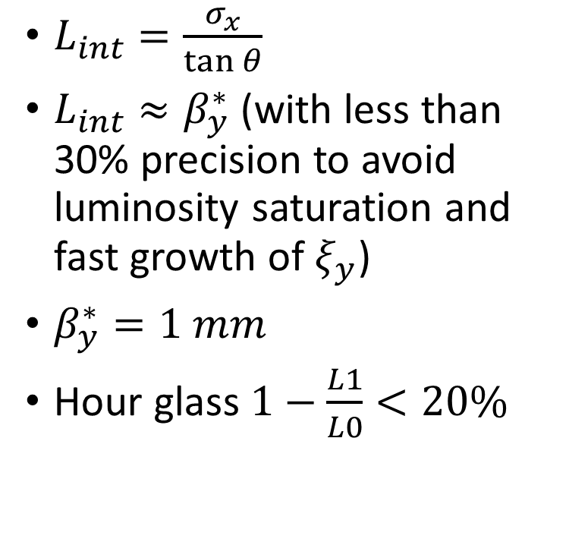


ctau73
$L_{int}=\frac{σ_{x}}{\tan{θ}}$
$L_{int}≈β_{y}^{∗}$ (with less than 30% precision to avoid luminosity saturation and fast growth of $ξ_{y}$)
$β_{y}^{∗}=1 mm$
Hour glass $1−\frac{L1}{L0}<20\%$
$$L_{int}≈β_{y}^{∗}$$
$$L_{int}>β_{y}^{∗}$$
ctau73

Slide 5
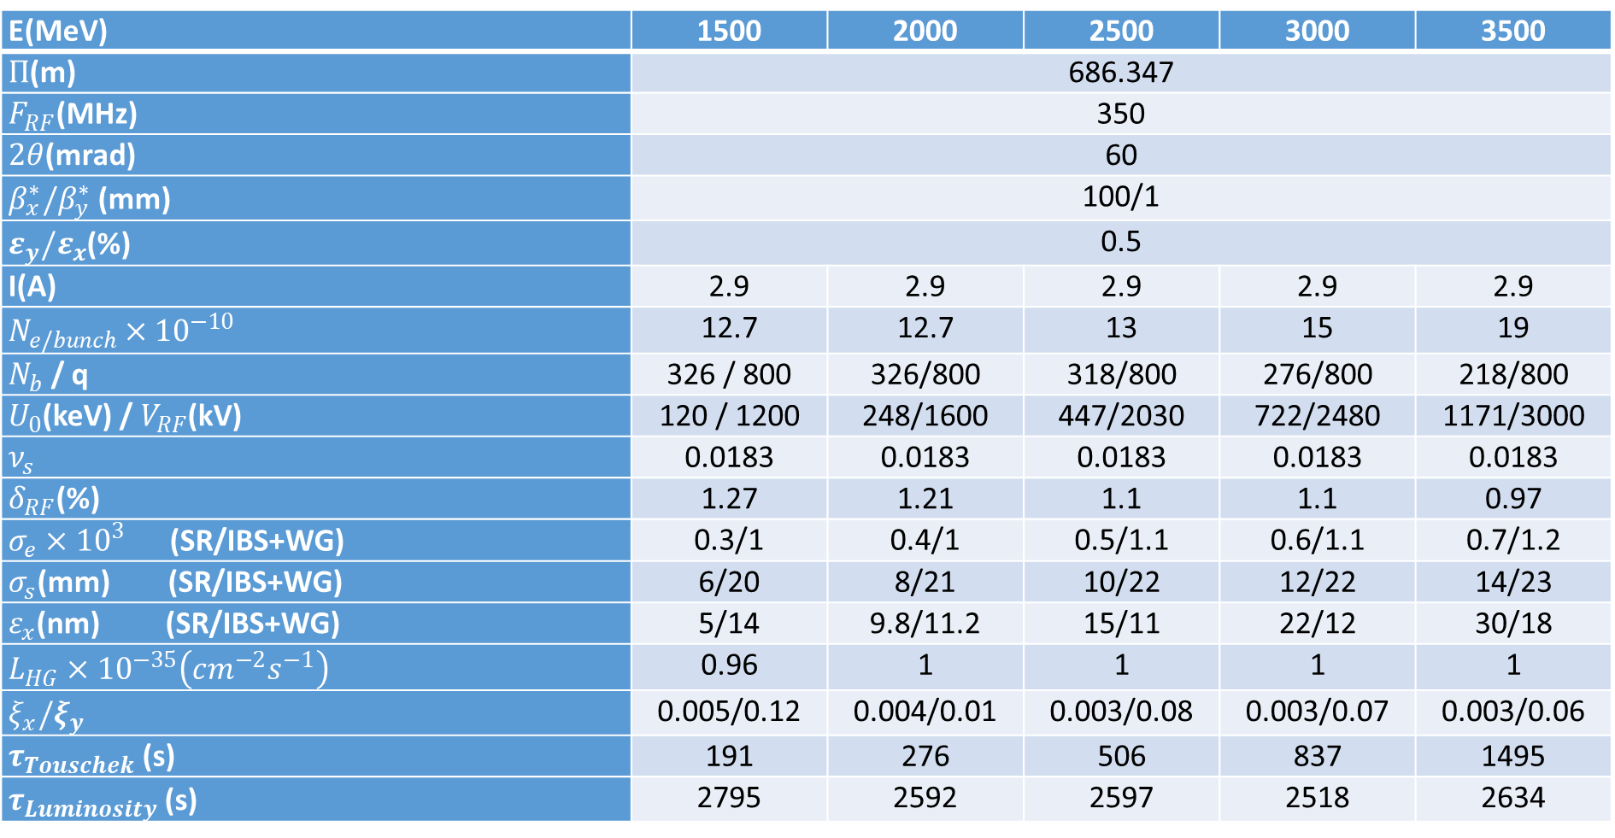

SCTF (v.73), $L={10}^{35}{cm}^{−2}s^{−1}$
E(MeV) | 1500 | 2000 | 2500 | 3000 | 3500
$Π$(m) | 686.347
$F_{RF}$(MHz) | 350
$2θ$(mrad) | 60
$β_{x}^{∗}/β_{y}^{∗}$ (mm) | 100/1
$ε_{y}/ε_{x}$(%) | 0.5
I(A) | 2.9 | 2.9 | 2.9 | 2.9 | 2.9
$N_{e/bunch}×{10}^{−10}$ | 12.7 | 12.7 | 13 | 15 | 19
$N_{b}$ / q | 326 / 800 | 326/800 | 318/800 | 276/800 | 218/800
$U_{0}$(keV) / $V_{RF}$(kV) | 120 / 1200 | 248/1600 | 447/2030 | 722/2480 | 1171/3000
$ν_{s}$ | 0.0183 | 0.0183 | 0.0183 | 0.0183 | 0.0183
$δ_{RF}$(%) | 1.27 | 1.21 | 1.1 | 1.1 | 0.97
$σ_{e}×{10}^{3}$ (SR/IBS+WG) | 0.3/1 | 0.4/1 | 0.5/1.1 | 0.6/1.1 | 0.7/1.2
$σ_{s}$(mm) (SR/IBS+WG) | 6/20 | 8/21 | 10/22 | 12/22 | 14/23
$ε_{x}$(nm) (SR/IBS+WG) | 5/14 | 9.8/11.2 | 15/11 | 22/12 | 30/18
$L_{HG}×{10}^{−35}\left(cm^{−2}s^{−1}\right)$ | 0.96 | 1 | 1 | 1 | 1
$ξ_{x}/ξ_{y}$ | 0.005/0.12 | 0.004/0.01 | 0.003/0.08 | 0.003/0.07 | 0.003/0.06
$τ_{Touschek}$ (s) | 191 | 276 | 506 | 837 | 1495
$τ_{Luminosity}$ (s) | 2795 | 2592 | 2597 | 2518 | 2634
Courtesy of A. Bogomyagkov

Slide 6
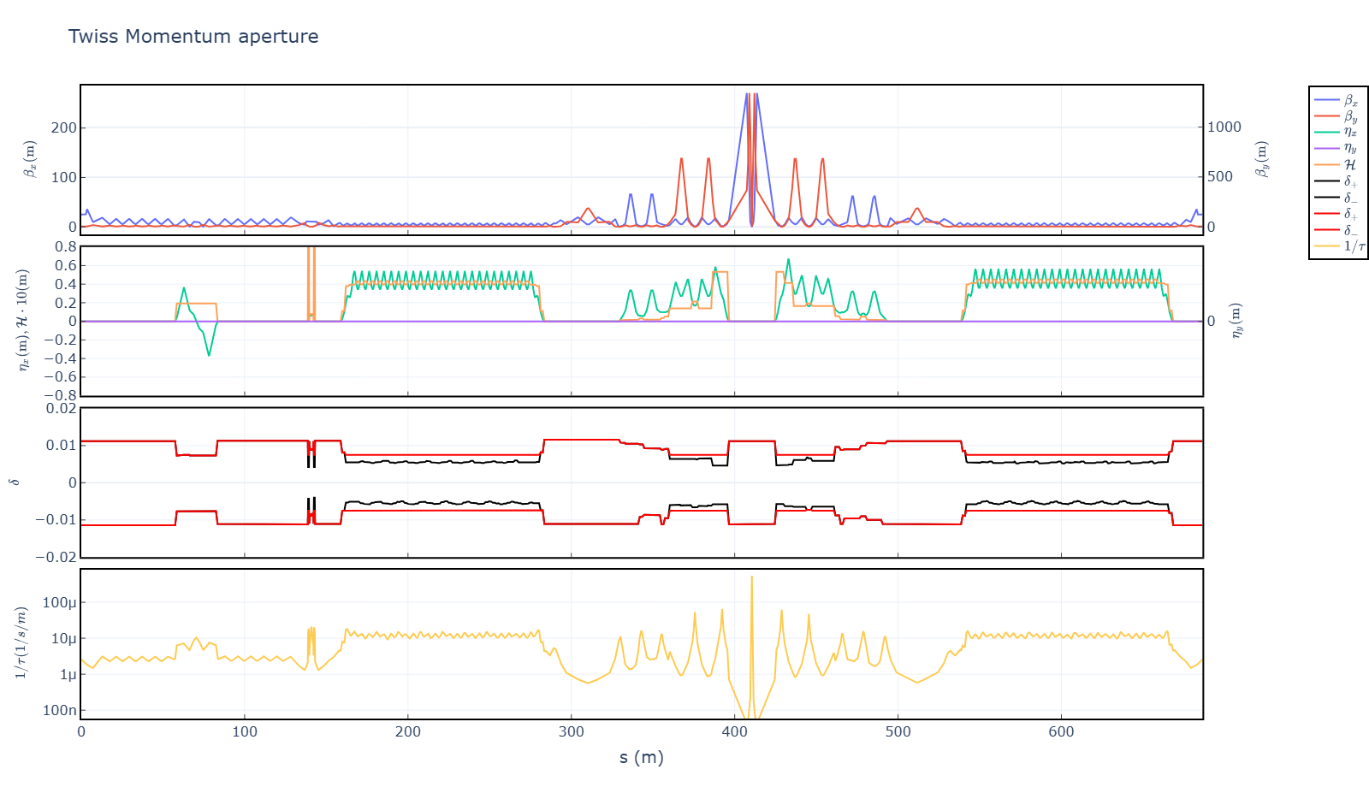
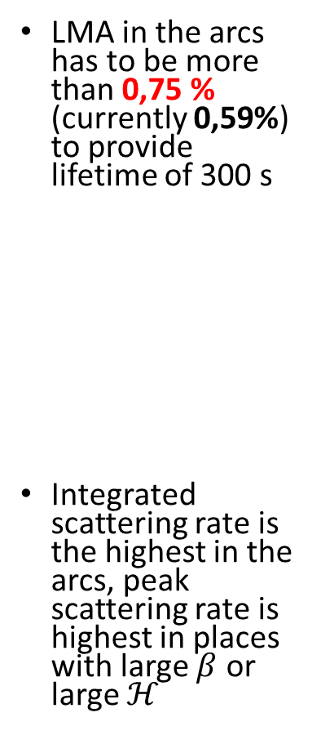

Required LMA for lifetime of 300 sec at 1500 MeV
LMA in the arcs has to be more than 0,75 % (currently 0,59%) to provide lifetime of 300 s
Integrated scattering rate is the highest in the arcs, peak scattering rate is highest in places with large $β$ or large $ℋ$
$$δ_{LMA}≥0,75\%$$

Slide 7
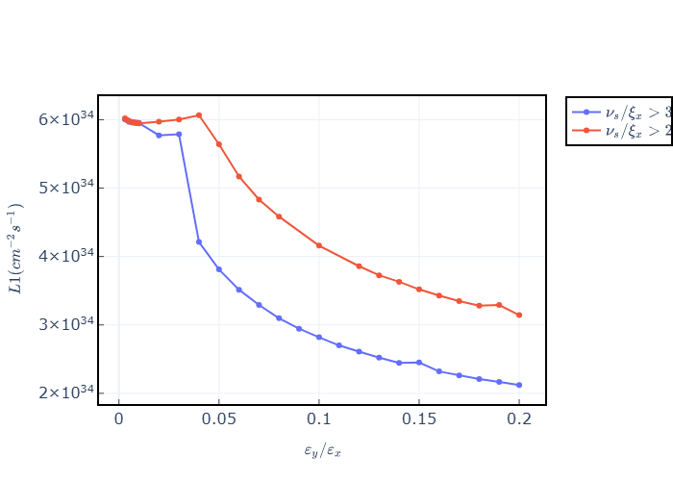
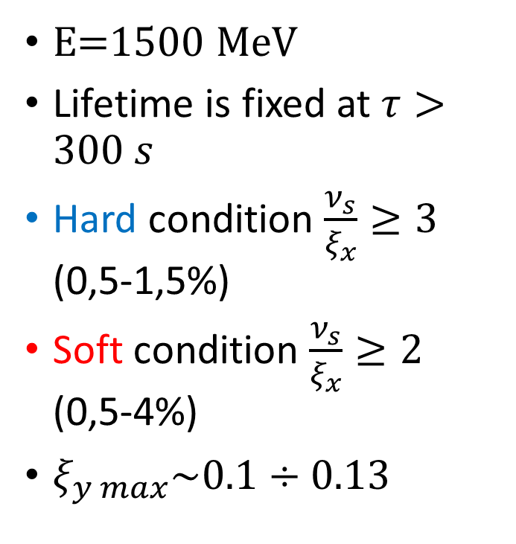
Dependence of luminosity on emittance ratio
E=1500 MeV
Lifetime is fixed at $τ>300 s$
Hard condition $\frac{ν_{s}}{ξ_{x}}≥3$ (0,5-1,5%)
Soft condition $\frac{ν_{s}}{ξ_{x}}≥2$ (0,5-4%)
$ξ_{y max}\sim 0.1÷0.13$

Slide 8
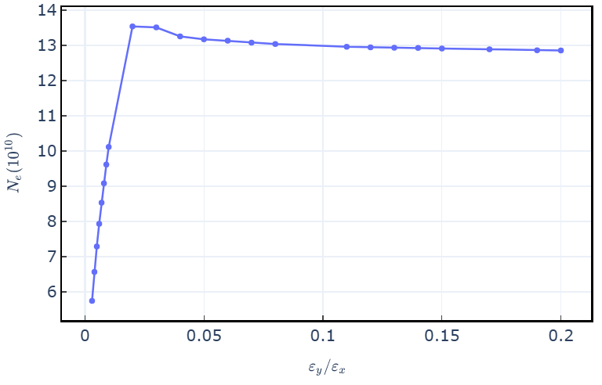
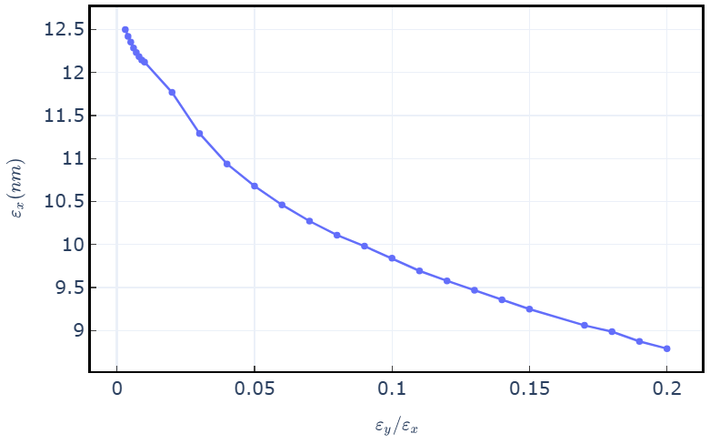
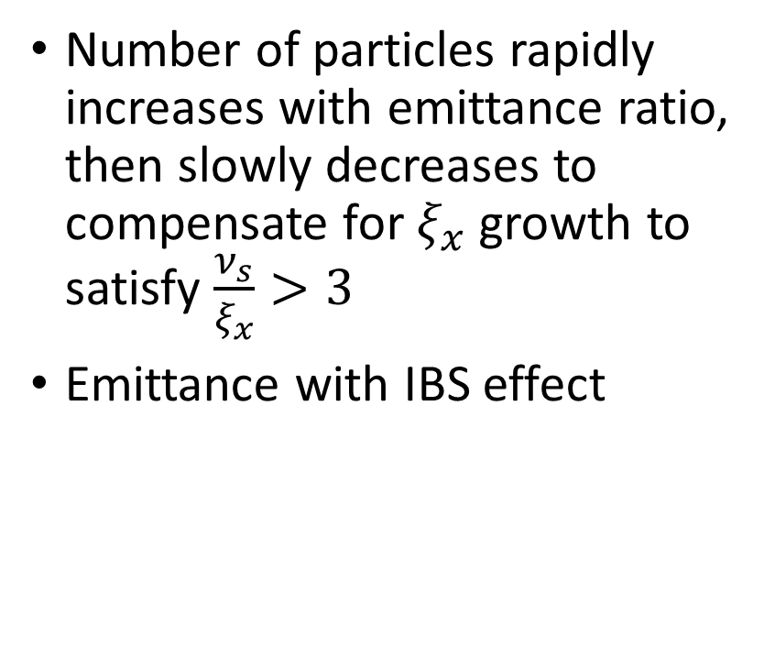
Number of particles rapidly increases with emittance ratio, then slowly decreases to compensate for $ξ_{x}$ growth to satisfy $\frac{ν_{s}}{ξ_{x}}>3$
Emittance with IBS effect

Slide 9
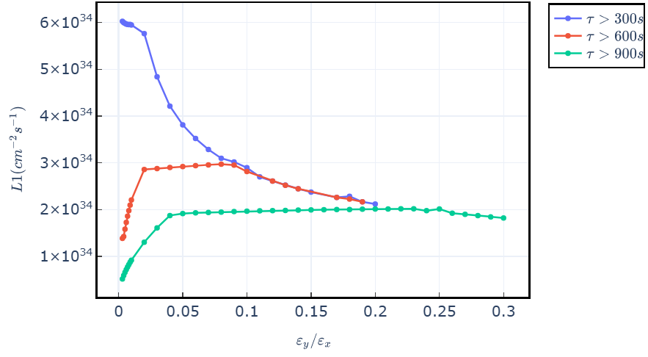
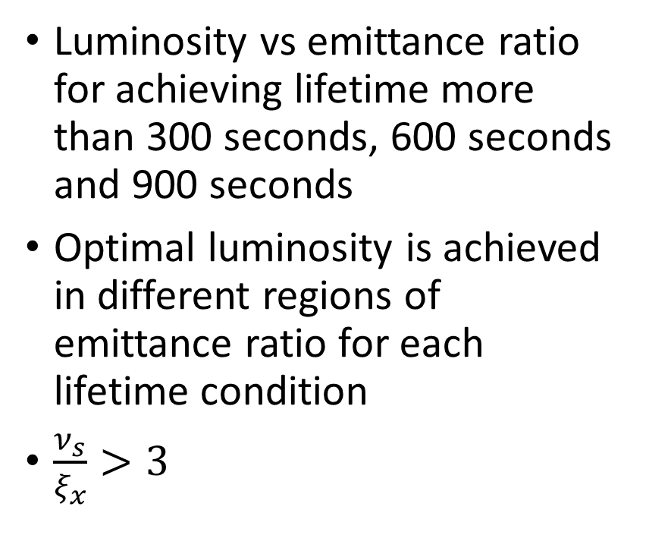
Luminosity vs emittance ratio for achieving lifetime more than 300 seconds, 600 seconds and 900 seconds
Optimal luminosity is achieved in different regions of emittance ratio for each lifetime condition
$\frac{ν_{s}}{ξ_{x}}>3$

Slide 10
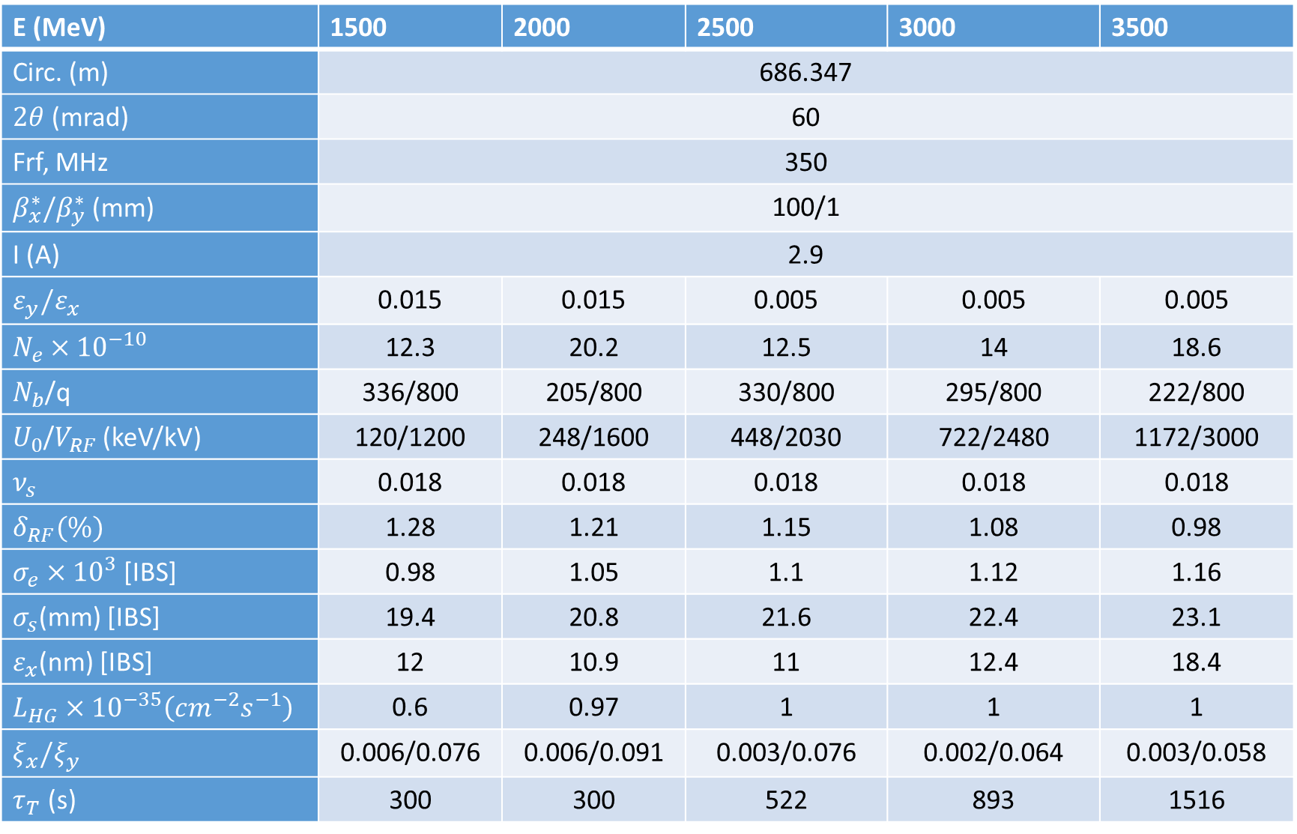
Design parameters of SCTF (v.73)
E (MeV) | 1500 | 2000 | 2500 | 3000 | 3500
Circ. (m) | 686.347
$2θ$ (mrad) | 60
Frf, MHz | 350
$β_{x}^{∗}/β_{y}^{∗}$ (mm) | 100/1
I (A) | 2.9
$$ε_{y}/ε_{x}$$ | 0.015 | 0.015 | 0.005 | 0.005 | 0.005
$$N_{e}×{10}^{−10}$$ | 12.3 | 20.2 | 12.5 | 14 | 18.6
$N_{b}$/q | 336/800 | 205/800 | 330/800 | 295/800 | 222/800
$U_{0}$/$V_{RF}$ (keV/kV) | 120/1200 | 248/1600 | 448/2030 | 722/2480 | 1172/3000
$ν_{s}$ | 0.018 | 0.018 | 0.018 | 0.018 | 0.018
$δ_{RF}(\%)$ | 1.28 | 1.21 | 1.15 | 1.08 | 0.98
$σ_{e}×{10}^{3}$ [IBS] | 0.98 | 1.05 | 1.1 | 1.12 | 1.16
$σ_{s}$(mm) [IBS] | 19.4 | 20.8 | 21.6 | 22.4 | 23.1
$ε_{x}$(nm) [IBS] | 12 | 10.9 | 11 | 12.4 | 18.4
$L_{HG}×{10}^{−35}\left(cm^{−2}s^{−1}\right)$ | 0.6 | 0.97 | 1 | 1 | 1
$ξ_{x}/ξ_{y}$ | 0.006/0.076 | 0.006/0.091 | 0.003/0.076 | 0.002/0.064 | 0.003/0.058
$τ_{T}$ (s) | 300 | 300 | 522 | 893 | 1516

Slide 11
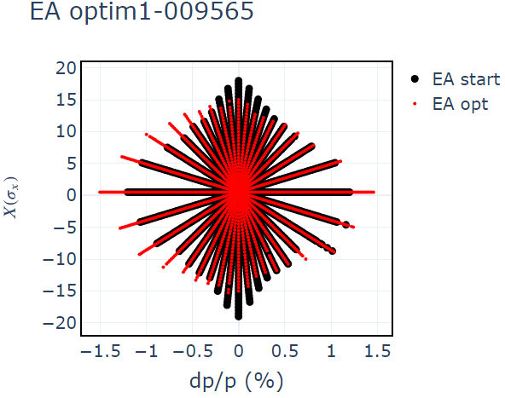
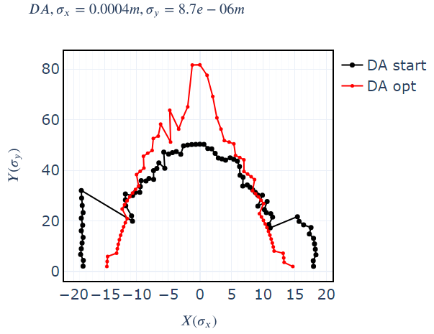
Touschek lifetime optimization summary
Methods of lifetime optimization
  Optimization of LMA with MOGA (3-7 days on cluster)
  Optimization of X vs dP/P area (days on cluster, failure)
  Optimization of X vs dP/P length of rays from center outward/optimization of ellipse radius (1-3 days on PC)
Optimization can provide up to 20-40% Touschek lifetime increase (ctau68: 145 sec to 218 sec)
LMA is increased at the expense of X-Y DA
High number of variables is required, works better for synchrotron light sources
LMA optimization is time consuming
X vs dP/P lengths of lines optimization is faster

Slide 12
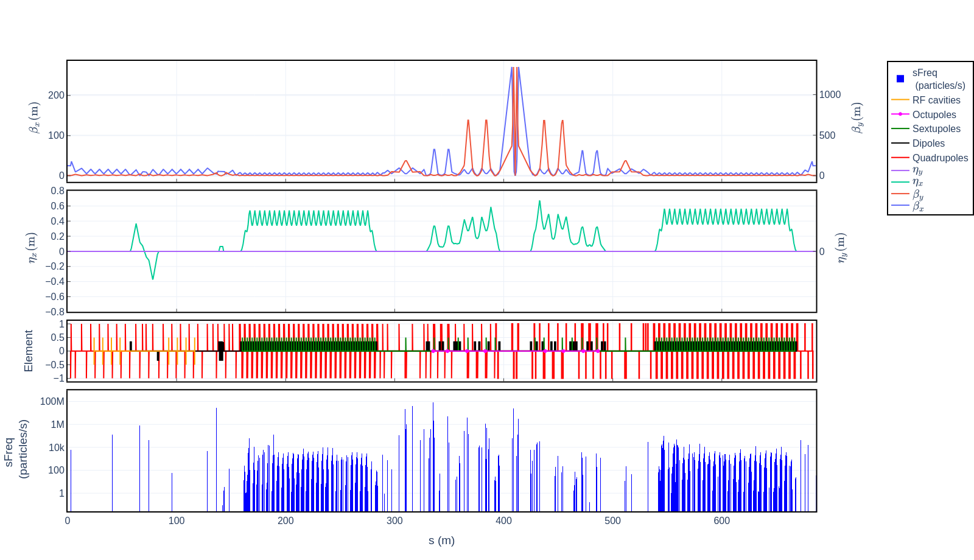
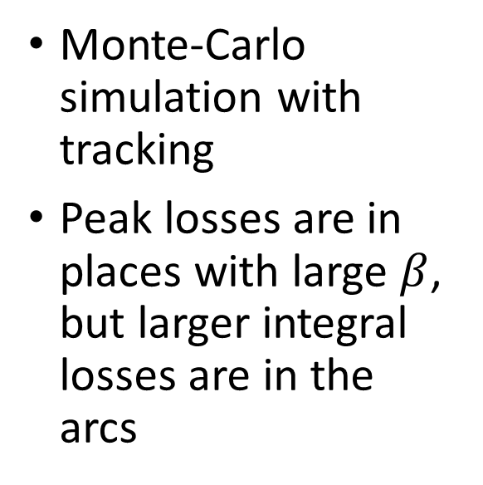
Losses of particles due to Touschek effect
Monte-Carlo simulation with tracking
Peak losses are in places with large $β$, but larger integral losses are in the arcs

Slide 13
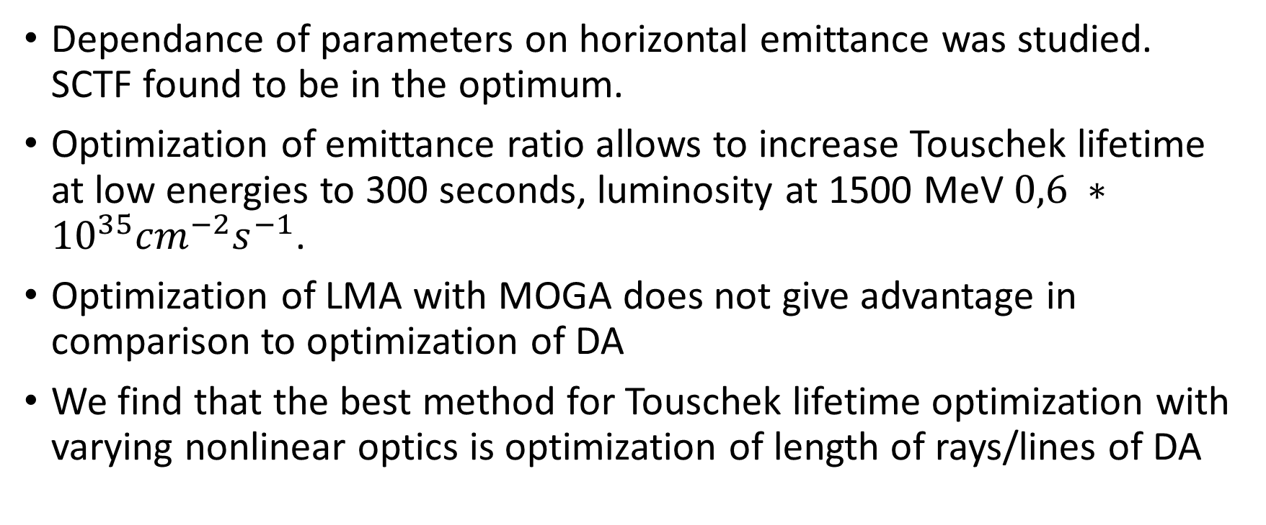
Conclusions
Dependance of parameters on horizontal emittance was studied. SCTF found to be in the optimum.
Optimization of emittance ratio allows to increase Touschek lifetime at low energies to 300 seconds, luminosity at 1500 MeV $0,6 ∗{10}^{35}{cm}^{−2}s^{−1}$.
Optimization of LMA with MOGA does not give advantage in comparison to optimization of DA
We find that the best method for Touschek lifetime optimization with varying nonlinear optics is optimization of length of rays/lines of DA

Slide 14
Emittance optimization in CW colliders for Touschek lifetime enhancement
Mikhail Skamarokha
Budker Institute of Nuclear Physics (BINP SB RAS), Novosibirsk, Russia
November 25th 2025

