Slide 1
Проект прототипа финального фокуса ВЭПП-4К/ВЭПП-6
A.A. Краснов
A.A.Krasnov@inp.nsk.su
В.Г. Ческидов
А.Н. Сафронов
В.М. Сыроватин
Декабрь 19, 2025 ИЯФ СО РАН
Notes:
dsdsd

Slide 2
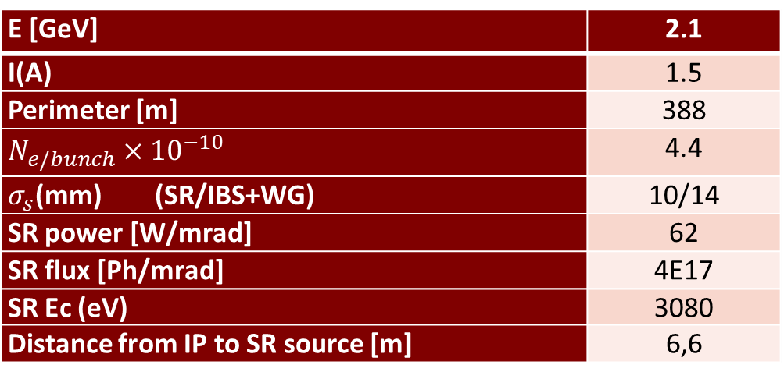
Input conditions and parameters
VEPP-6 parameters which make an influence on FF elements design:
E [GeV] | 2.1
I(A) | 1.5
Perimeter [m] | 388
$N_{e/bunch}×{10}^{−10}$ | 4.4
$σ_{s}$(mm) (SR/IBS+WG) | 10/14
SR power [W/mrad] | 62
SR flux [Ph/mrad] | 4E17
SR Ec (eV) | 3080
Distance from IP to SR source [m] | 6,6
General requirements
1. The average residual gases pressure : < 3 × 10⁻⁷ × Perimeter/FF_length х 0.5 ≈ 1,5 × 10⁻⁵ Pa (lower is better)
2. SR should not directly irradiate IP chamber (detector background)
3. All elements, with the exception of beryllium IP chamber, must be placed inside 2 x10 degree cone with an apex at IP
4. To avoid RF cavity at IP (high mode capture), the diameter of vacuum chambers (in one direction at least) shall not be less that diameter of IP chamber
5. To minimize geometrical impedance, the vacuum chambers must be as smooth as possible (with smooth transitions between elements with deferent cross-section)

Slide 3
  General assembly with detector
We are going to install the both pre-assembled cryostat with IP chambers into detector from one side.

Slide 4
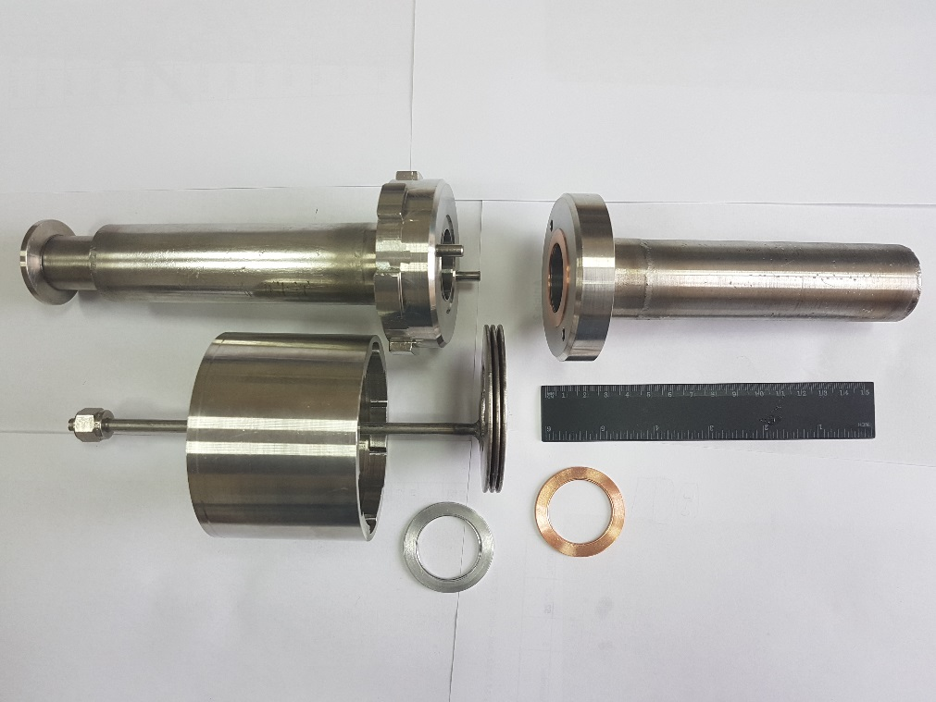
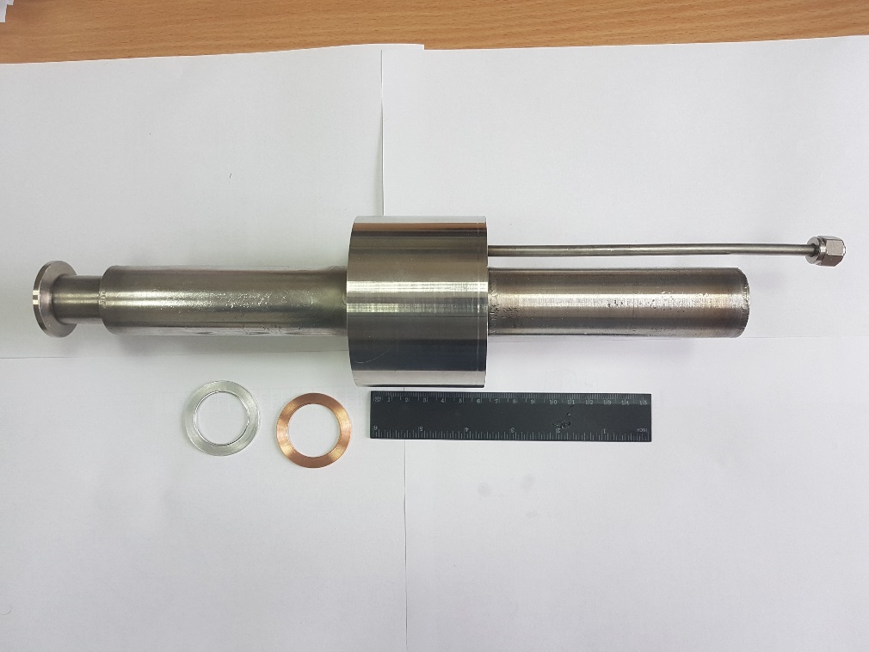
BINP Remote control flange prototype
“Work” vessel
Parts of the flange connection
Assembled connection
Vacuum tightness is reached for both Cu and Al gaskets at pressure 150 atmosphere. Leak rate is less than 1E-10 mbar*L/s.
Note, the connection keeps smoothness of internal surface along beam propagation

Slide 5
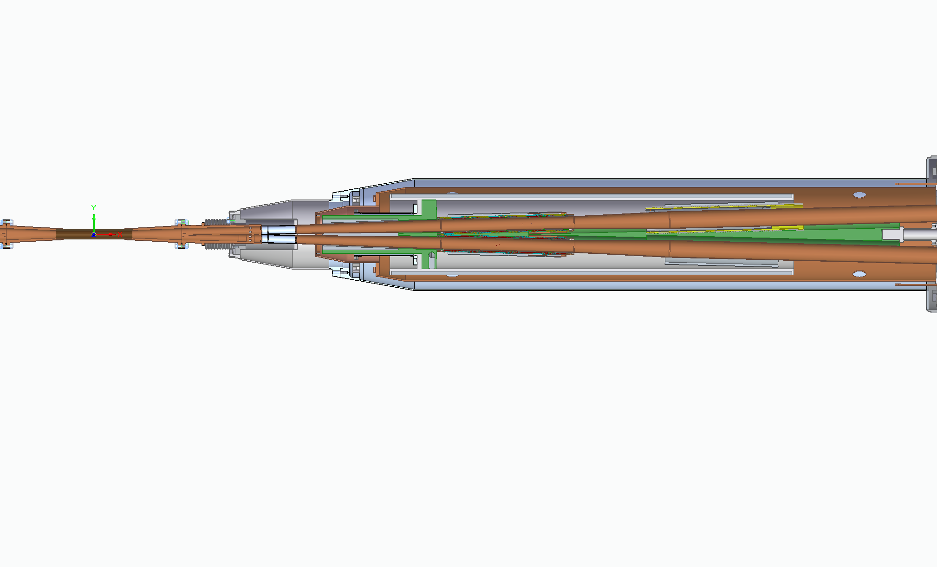
  IP mock-up
Ante-chamber
Double Q0
Screening solenoid
Y-chamber/
SR absorber
Compensating solenoid
Double Q1
Beryllium
chamber
Tubes with pumping slots and RF smooth sliding contacts at the ends
Thermal screen
Common cryostat
We are going to release mock-up installation of half of IP elements including full length beryllium chamber

Slide 6
IP beryllium chamber
Be
Cu
Main heat source – resistive wall loses.
Total power: < 7W
Maximum temperature rise (at middle): < 11°C
Cooling and Internal coatings (Au or others) is not necessary
Y-chambers
Cu, water cooling
Current design:
Length – 160mm
ID - 20mm
Wall thickness – 1mm

Slide 7
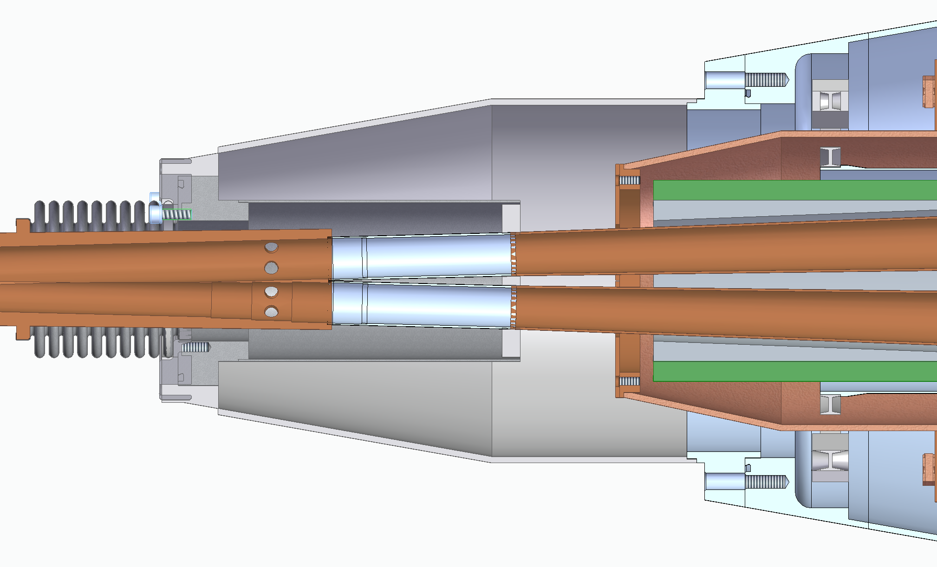
Y chamber connection with cryostat
Thin SS chambers with slots for pumping and
sliding RF contacts at the ends
Advantages:
Simplified assembly
Good thermal insulation
Space for vacuum pumps
Simple BPM electrodes
SR
Ante-chamber
Space for vacuum pump close to IP.
combined ion-getter + getter pump
Steps for SR absorption
BPM electrodes

Slide 8
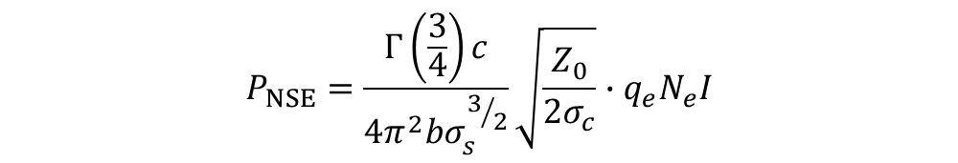
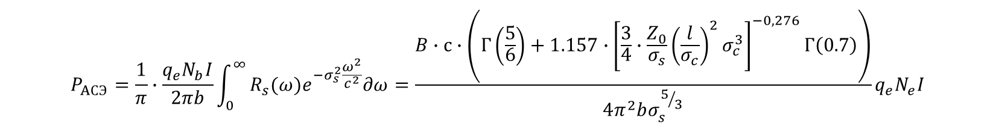
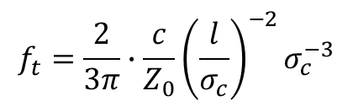
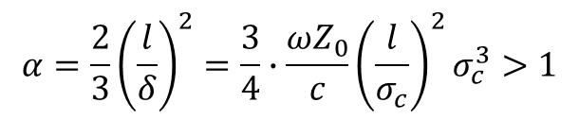
Resistive wall loses
$$P_{NSE}=\frac{Γ\left(\frac{3}{4}\right)c}{4π^{2}bσ_{s}^{3/2}}\sqrt{\frac{Z_{0}}{2σ_{c}}}∙q_{e}N_{e}I$$
At normal skin effect (at RT):
At high frequencies or at low temperatures, when the depth of field penetration becomes less than the mean free path of electrons, the theory of anomalous skin effect is used, which takes into account the scattering of electrons at the interface (surface). A more strict criterion for the region of the anomalous skin effect is written as follows:
Borderline frequency between normal and anomalous skin effect:
$$α=\frac{2}{3}{\left(\frac{l}{δ}\right)}^{2}=\frac{3}{4}∙\frac{ωZ_{0}}{c}{\left(\frac{l}{σ_{c}}\right)}^{2}σ_{c}^{3}>1$$
$$f_{t}=\frac{2}{3π}∙\frac{c}{Z_{0}}{\left(\frac{l}{σ_{c}}\right)}^{−2}σ_{c}^{−3}$$
One of the good approach for surface impedance, which works well for wide frequency region is:
$R_{s}\left(ω\right)={\left(\frac{\sqrt{3}}{16π}∙\frac{l}{σ_{c}}\right)}^{1/3}Z_{0}^{2/3}\frac{ω^{2/3}}{c^{2/3}}\left(1+1.157α^{−0.276}\right)$=B$\frac{ω^{2/3}}{c^{2/3}}\left(1+1.157α^{−0.276}\right)$
Integration over beam frequency spectra for a circular beam pipe gives:
$$P_{AСЭ}=\frac{1}{π}∙\frac{q_{e}N_{b}I}{2πb}\int_{0}^{∞}{R_{s}(ω)e^{−σ_{s}^{2}\frac{ω^{2}}{c^{2}}}∂ω}=\frac{B∙с∙\left(Γ\left(\frac{5}{6}\right)+1.157∙{\left[\frac{3}{4}∙\frac{Z_{0}}{σ_{s}}{\left(\frac{l}{σ_{c}}\right)}^{2}σ_{c}^{3}\right]}^{−0,276}Γ\left(0.7\right)\right)}{4π^{2}bσ_{s}^{5/3}}q_{e}N_{e}I$$
It makes good approach for Cu at temperature from LHe up to 60-80K and beam rms length up to 2 cm

Slide 9
Electron Clouds (for e+ beam only)
e⁻
E_{s} – average energy of secondary electrons (about 2 eV)
The saturations density of electron cloud is 6е6 1/cm³ in the chamber with ID 30mm (Q0) and 2e6 1/cm³ at ID 57mm (Q1).
Taking into account average energy of the electrons 200 eV after bunch propagation and bunch spacing 1m, one can obtain heat load due to EC 40 W/m
It looks like the mitigation of the EC with the use a coating (amorphous carbon for example) is necessary.
Необходимы измерения КЭЭЭ в зависимости от энергии первичных электронов и численное моделирование мультипактора

Slide 10
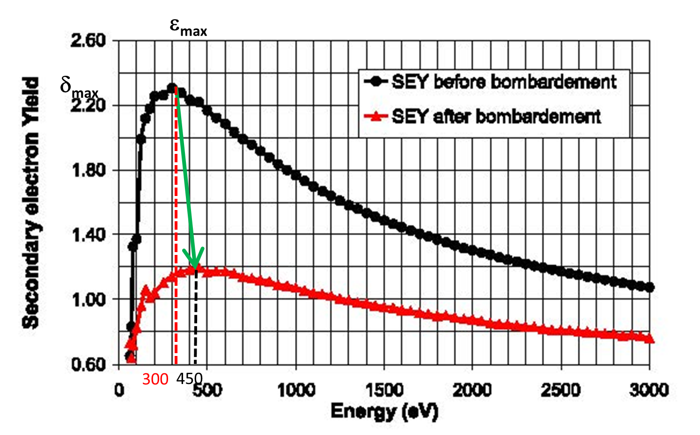
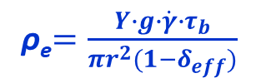
Electron cloud formation
at <1
BINP
Phenomenologically, neglecting space charge, electron density can be estimated as:
For < 0,9
One can obtain:
And heat load 7 W/m
How to reach it:
Amorphous carbon coating
High quality NEG (TiZrV)
Laser treatment
Ti thin film deposited in-situ (!)
- Geometrical solutions with low “g” (groves?)?
ρ_{e}$=\frac{Y∙g∙\dot{γ}∙τ_{b}}{πr^{2}(1−δ_{eff})}$
ρ_{e} about 1E6 cm⁻³
SEY of OFE Copper

Slide 11
Critical heat load
Q0
Cu, d30, L900
40…60К
Q1
Cu, d48, L600
40…60К
Ве, Id20, L160
SR
SR absorber with low “s”!!
SR absorber!!

Slide 12
Heat load. Cu chambers inside Q at 60 – 70 K
Material |  | b [мм] | Length [мм] | σ_{с} [1/(Ом∙м)] | P (RW) [W] | Max deltaT
Be | IP | 10 | 160 | 2.5E7 | 7 | 11
IP
element | b [м] | Length [mm] | σ_{с} [1/(Ом∙м)] | P (RW) [W} | P (SR) [W] | P(EC) [W] s=0.1, σ_{eff}=0.9 | P total [W]
Q0 | 0.015 | 320 | 5,7E8 | 4 | 10 | 2,5 | 16.5
Q1 | 0.027 | 370 | 5,7E8 | 3,5 | 25 | 3 | 31,5
For Cu chambers at 40 - 60K
(for one cryostat)
Total heat load on cryogenic level 40-60K is 100 W about

Slide 13
Заключение
Первая итерация 3D моделирования компонентов ФФ завершена.
Проведены оценки тепловых нагрузок (resistive wall, SR and EC)
Температурный режим вакуумных камер при 60 – 80K выглядит реализуемым
Необходим стенд для измерения проводимости при криогенных температурах
Численное моделирование EC, темппературного режима, профиля давления

Slide 14
Thanks for your attention!

