Slide 1
Исследование динамической апертуры
Структура 28_20

Slide 2
Changes
From version 10
decreased crossing angle from 30 mrad to 20 mrad
increased byip from 2 mm to 3 mm
increased coupling from 0.005 to 0.016875=0.005*(3/2)^3
as a result K2_crab=unchanged, xi_y=unchanged, T_toushek expect to increase (3/2)^3=3 times
From version 11
increased number of cells from 12 to 18
decreased cell phase advance from 1/4 to 1/6
From version 12
increased crossing angle from 0.02 to l1_cross = 0.03;
increased energy to 2 GeV
From version 17
trying to reduce fringes detuning
increased length of QO, Q1 from 0.3 to 0.37,
increased dl1 from 0.13 to 0.185
matched phase in IR arc matching section
From version 18
Increase number of cells from 18 to 24
From version 19
Decreased number of cells from 24 to 18
Full IR with CCYS, CCXS, CRAB, ARC
From version 20
Increased number of cells from 18 to 24
Full IR with CCYS, CCXS, CRAB, ARC
From version 21
Number of cells is 24
Full IR with CCYS, CCXS, CRAB, ARC
Decreases alfa_yx_q in IR
From version 22
Decreased crossing angle to 25e-3
Increased bxip, emit_x by Dx in WIGGLER
bxip = 0.15; byip = 0.003; l1_cross = 0.025; r1_cross = -0.025;
cell: qx=qy=1/6, 24 cells
Save-5 from Save-1 introduced 4 dipoles around wiggler
Adjusted phase in IR MS, chosen 27_5
From version 27
Decreased crossing angle to 25e-3
Increased bxip, emit_x by Dx in WIGGLER
bxip = 0.15; byip = 0.003; l1_cross = 0.025; r1_cross = -0.025;
cell: qx=qy=1/8, Ncells=24
Chosen 28_20

Slide 3
The reasoning (FODO)
$$ε_{x}≈C_{q}γ^{2}φ^{3}\frac{8}{μ^{3}}=C_{q}γ^{2}\frac{1}{ν^{3}}{\left(\frac{L_{cell}}{Π}\right)}^{3}=C_{q}γ^{2}\frac{1}{{\left(ν N_{cell}\right)}^{3}}$$
$$ℋ≈L φ^{2}\frac{8}{μ^{3}}=\frac{1}{πν^{3}}\frac{L_{cell}}{N_{cell}^{2}}$$
$${\left(K_{1}L\right)}_{1,2}≈±\frac{μ}{L}=±{\left(\frac{C_{q}γ^{2}}{ε_{x}}\right)}^{\frac{1}{3}}\frac{4π}{Π}$$
$$ν=\frac{μ}{2π}$$
$$L_{cell}=2L$$
$$Π=N_{cell}L_{cell}$$
$$φ_{cell}=2φ=\frac{2π}{N_{cell}}$$
$${\left(K_{2}L\right)}_{1,2}≈±\frac{1}{L^{2}φ}\frac{μ^{3}}{4}=±\frac{C_{q}γ^{2}}{ε_{x}}\frac{8π^{2}}{Π^{2}}$$
$$β_{x}≈L\left(1+\frac{1}{μ}\right)=\frac{L_{cell}}{2}\left(1+\frac{1}{πν}\right)$$
To increase $N_{cell}$ but keep $ε_{x}=const$
decrease $ν$ keeping $ν×N_{cell}=const$
than $R_{da}∝ε_{x}N_{cell}^{2}L_{cell}$ will increase
$R_{da}∝\frac{1}{K_{2}L β_{x}}∝\frac{ε_{x}}{4π^{2}C_{q}γ^{2}}\frac{Π^{2}}{L_{cell}}$=$\frac{ε_{x}}{4π^{2}C_{q}γ^{2}}N_{cell}^{2}L_{cell}$
$$\frac{R_{da}}{\sqrt{ε_{x}β_{x}}}∝\frac{\sqrt{ε_{x}}}{C_{q}γ^{2}}N_{cell}^{2}\sqrt{L_{cell}}∝\sqrt{N_{cell}L_{cell}}$$

Slide 4
The reasoning (beam-beam, luminosity)
$$K_{2}L=\frac{1}{2θ}\sqrt{\frac{β_{x}^{∗}}{β_{x}}}\frac{1}{β_{y}^{∗}β_{y}}$$
$$μ_{x}=πm, μ_{y}=\frac{π}{2}(2n+1)$$
$$ξ_{y}=\frac{N_{p}r_{e}}{2πγ}\sqrt{\frac{β_{y}^{∗}}{ε_{y}}}\frac{1}{σ_{z}\tan{θ}}$$
$$ℒ=\frac{γ}{2er_{e}} J\frac{ξ_{y}}{β_{y}^{∗}}$$
$$L_{int}=\sqrt{\frac{π}{2}}\frac{σ_{x}}{\tan{θ}}$$
$$\frac{1}{T_{Touschek}}∝ξ_{y}\frac{\tan{θ}}{ε_{x}\sqrt{ε_{y}β_{y}^{∗}}}$$
$$ξ_{x}=\frac{N_{p}r_{e}}{2πγ}\frac{β_{x}^{∗}}{{\left(σ_{z}\tan{θ}\right)}^{2}}$$
With respect to 22_11
Decrease $θ→×\frac{5}{6}$ , increase $β_{x}^{∗}→×\frac{3}{2}$, increase $ε_{x}→×3$ leads to $L_{int}→×2.5=2.6mm≈β_{y}^{∗}=3mm$. Good!
$σ_{z}=const$
Increase $ε_{x}→×3$. Good for $T_{Touschek}$!
Decrease of coupling $ε_{y}=κε_{x}→×\frac{0.006}{0.02}×3≈const$. Acceptable.
Increase $ξ_{y}→×2$ by increasing $N_{p}→×2$
Resulting in $ℒ→×2$. Good!
Resulting in $\frac{1}{T_{Touschek}}∝×2×\frac{5}{6}×\frac{1}{3}≈\frac{1}{2}$. Good!
Resulting in $ξ_{x}→×2×\frac{3}{2}×{\left(\frac{6}{5}\right)}^{2}≈4.3$. Acceptable.

Slide 5
Optics: IR
Q0
Q1
Q2
Q3
Q4
Q5
Q6
Q6
Q7
Q8
Q8
Q9
Q10
Q10
d0
d1
d2a
b0
d2
d3
d4b
d4
d5a
b2
d5
d6a
b3
d6
d7
d8a
b4
d8
d8
b5
d8a
d10
Y5
Y1
Y3
Q11
X5
Q12
Q13
Q14
Q15
X1
Q15
Q16
Q17
Q18
Q19
X3
Q19
d11
d12a
b6
d12b
d12
d13a
b7
d13
d14a
b8
d14
d15
d16
d17a
b9
d17
d18a
b10
d18
d19
Q20
Q21
Q22
Q23
Q24
Q25
Q26
Q26
Q27
Q28
Q29
Q30
Q31
Q32
Q33
d20
d21a
b11
d21
d22a
b12
d22
d23
d24
d25
d26
d27
d28
d29
d30
d31
d32
d33
d34
CR
$K_{2}L=\frac{1}{2θ}\sqrt{\frac{β_{0x}}{β_{x}}}\frac{\cos{μ_{x}}}{\cos{2μ_{y}}}\frac{1}{β_{0y}β_{y}}$ incoming
$K_{2}L=−\frac{1}{2θ}\sqrt{\frac{β_{0x}}{β_{x}}}\frac{\cos{μ_{x}}}{\cos{2μ_{y}}}\frac{1}{β_{0y}β_{y}}$ outgoing

Slide 6
Optics: cell
Qds3
Qds2
Qds2
Qds1
Qc1
Qc2
Qc2
Qc1
bds2
bds1
X1
bc1
bc1
X2
dds2
dds1
dds1
dds2
dds2
dds1
dds1
dds2
dc2
dc1
dc1
dc2
dc2
dc1
dc1
dc2
Y1
$$ψ$$
$$3ψ$$
3
2nd order achromat
24 cells with $μ_{x,y}=\frac{π}{3}$
Not large chromaticity.
Expected large DA.
Possible 24 cells with $μ$
$μ=\frac{π}{3}$: $24\frac{4π}{12}=8π$
$μ=\frac{π}{2}$: $24\frac{6π}{12}=12π$
2
$$4$$
$$1$$
$$4$$
2
6
$$5$$
3
$$1$$
$$5$$
6

Slide 7
Optics tech
Q1
Q2
Q3
Q4
Q5
Q6
Q7
Q8
Q9
Q10
d1
d2
d3
d4
d9
d10
d11
d8a
b1
d8
d9
d10
d11
INJ
Q1
Q2
Q3
Q4
Q5
Q6
Q7
Q8
Q9
Q10
Q11
Q12
Q13
Q14
d1
d2
d3
d4
d5
d6
d7
d8
d9
d10
d11
d12a
b1
d12
d13
d14
d15
WIG
Q1
Q2
Q3
Q4
Q5
Q6
Q7
Q8
Q9
Q10
Q11
Q12
Q13
Q14
d1
d2
d3
d4
b5
b4
d5
b3
b2
d6
d7
d8
d9
d10
d11
d12a
b1
d12
d13
d14
d15
WIG

Slide 8
Design parameters ultimate
E(MeV) | 500 | 1000 | 1550 | 2100
$Π$(m) | 388.742337640177
$F_{RF}$(MHz) | 350.118202616599
$2θ$(mrad) | 50
$β_{x}^{∗}/β_{y}^{∗}$ (mm) | 150/3
I(A) | 0.4 | 0.78 | 1.5 | 1.5
$N_{e/bunch}×{10}^{−10}$ | 0.8 | 1.55 | 5.7 | 9
$N_{b}$ / q | 408/454 | 408/454 | 213/454 | 134/454
$U_{0}$(keV) / $V_{RF}$(kV) | 1.57/590 | 24.8/1160 | 137/1800 | 401/2650
$ν_{s}$ | 0.0226 | 0.00225 | 0.0225 | 0.0234
$δ_{RF}$(%) | 1.6 | 1.6 | 1.54 | 1.5
$σ_{e}×{10}^{3}$ (SR/IBS+WG) | 0.1/0.8 | 0.3/0.6 | 0.5/0.8 | 0.7/0.9
$σ_{s}$(mm) (SR/IBS+WG) | 2.7/13 | 5/9.8 | 8.4/13 | 13/15
$ε_{x}$(nm) (SR/IBS+WG) | 2/66 | 8/34 | 19/31 | 35/31
$${ε_{y}/ε}_{x}$$ | 0.006 | 0.006 | 0.006 | 0.006
$L_{HG}×{10}^{−34}\left(cm^{−2}s^{−1}\right)$ | 0.03 | 0.26 | 1.4 | 2
$ξ_{x}/ξ_{y}$ | 0.005/0.03 | 0.008/0.05 | 0.01/0.1 | 0.01/0.1
$τ_{Touschek}$ (s) | 909 | 910 | 1146 | 2090
$$N_{cells}\left(μ\right)$$ | $$24\left(π/4\right)$$
$$ℒ=\frac{γ}{2er_{e}} J\frac{ξ_{y}}{β_{y}^{∗}}$$
$β_{y}^{∗}$ wants to decrease to 2.5 mm,
because
$L_{int}=2.65 mm$ at 2.1 GeV
$L_{int}=2.66 mm$ at 1.55 GeV
$L_{int}=2.71 mm$ at 1.0 GeV
$L_{int}=2.6 mm$ at 0.5 GeV
Limitation due to $ε_{x}\sim 30nm$
Notes:
I(e+)=3.2 A PEPII, I(e-)=2.45A DAFNE, L=2.1e34 KEKB

Slide 9
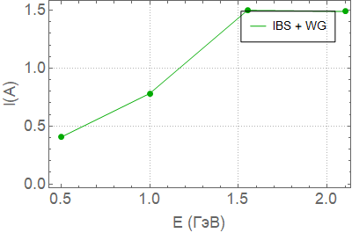
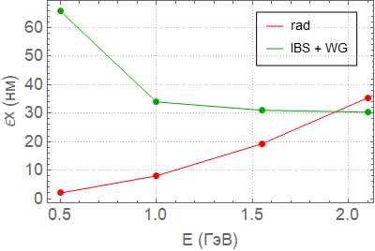
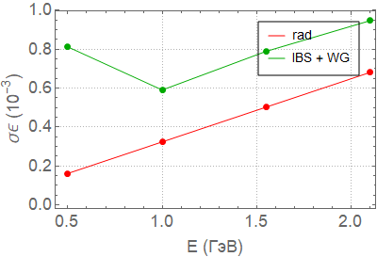
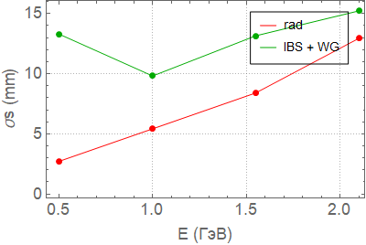
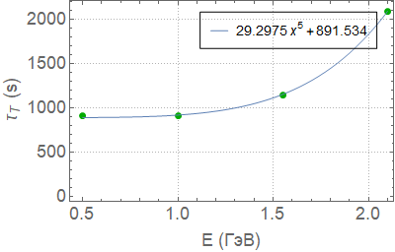
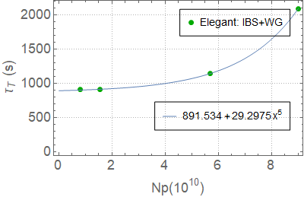
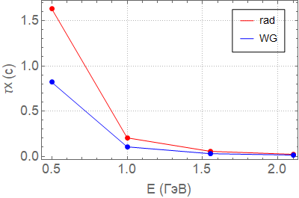
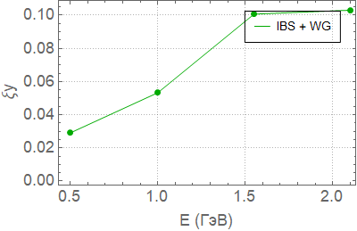
Touschek and total analysis, ultimate

Slide 10
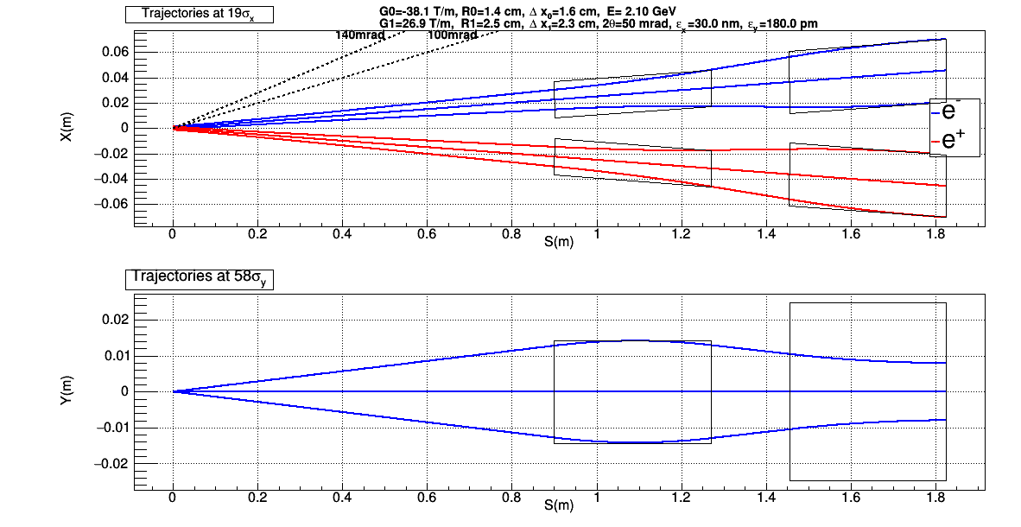
Trajectory at E=2.1 GeV, $ε_{x}=30$ nm
Q0 pole field is -0.545734 T
Aperture Q0 (R): x=0.014333
Aperture Q0 (R): y=0.0141642
Length Q0: L=0.37 m
Q1 pole field is 0.667722 T
Aperture Q1 (R): x=0.0247954
Aperture Q1 (R): y=0.0141642
Length Q1: L=0.37 m
Dx0=0.0163383
Dx1=0.0231671
Sigma_x IP(m)=6.7082e-05
Sigma_y IP(m)=7.34847e-07

Slide 11
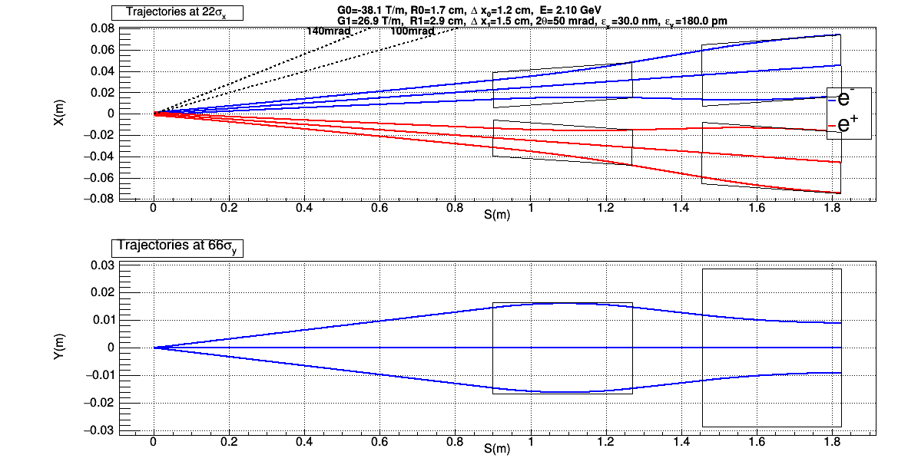
Trajectory at E=2.1 GeV, $ε_{x}=30$ nm
Q0 pole field is -0.631902 T
Aperture Q0 (R): x=0.0165961
Aperture Q0 (R): y=0.0161179
Length Q0: L=0.37 m
Q1 pole field is 0.773151 T
Aperture Q1 (R): x=0.0287105
Aperture Q1 (R): y=0.0161179
Length Q1: L=0.37 m
Dx0=0.0118136
Dx1=0.0153394
Sigma_x IP(m)=6.7082e-05
Sigma_y IP(m)=7.34847e-07

Slide 12
Trajectory at E=2.1 GeV, $ε_{x}=60$ nm
Q0 pole field is -0.609303 T
Aperture Q0 (R): x=0.0160025
Aperture Q0 (R): y=0.0158868
Length Q0: L=0.37 m
Q1 pole field is 0.745501 T
Aperture Q1 (R): x=0.0276837
Aperture Q1 (R): y=0.0158868
Length Q1: L=0.37 m
Dx0=0.0130003
Dx1=0.0173923
Sigma_x IP(m)=6.7082e-05
Sigma_y IP(m)=7.34847e-07

Slide 13
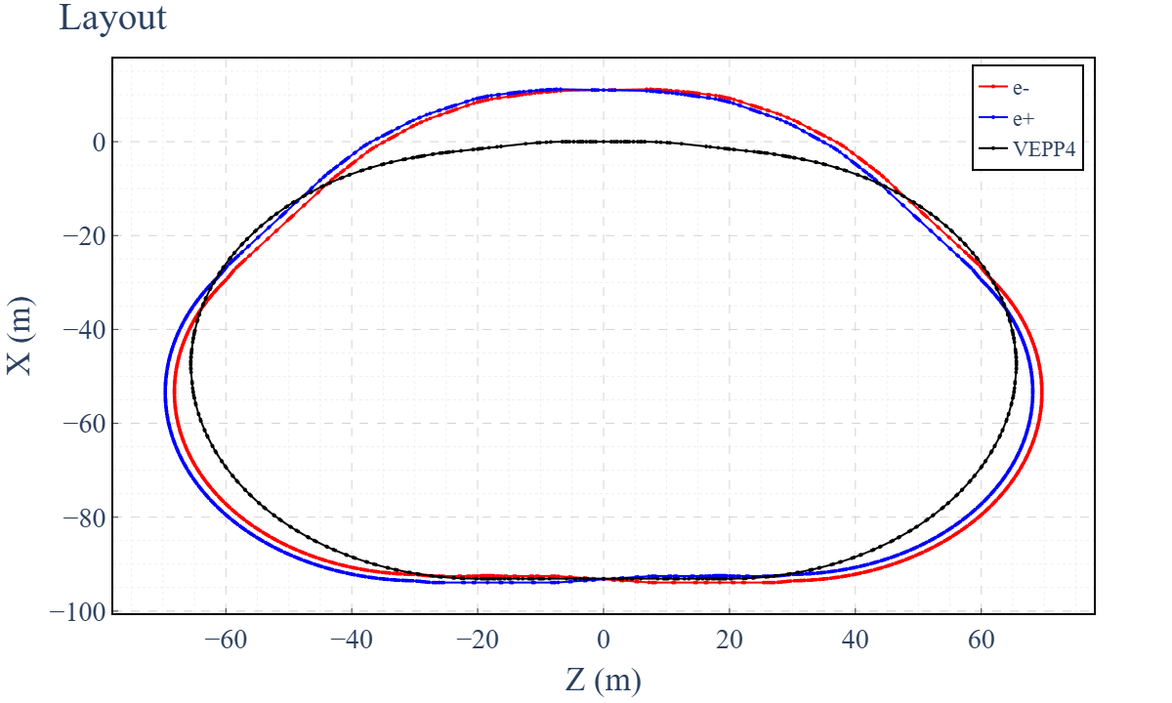
Layout
Distance between the beam lines $ΔR=1.364$ m

Slide 14
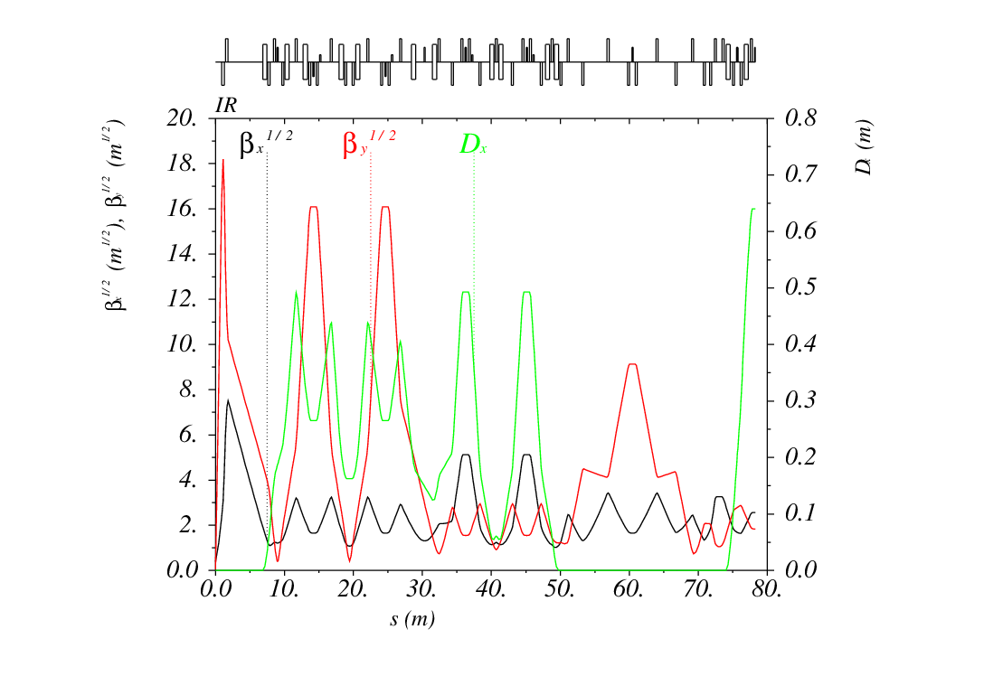
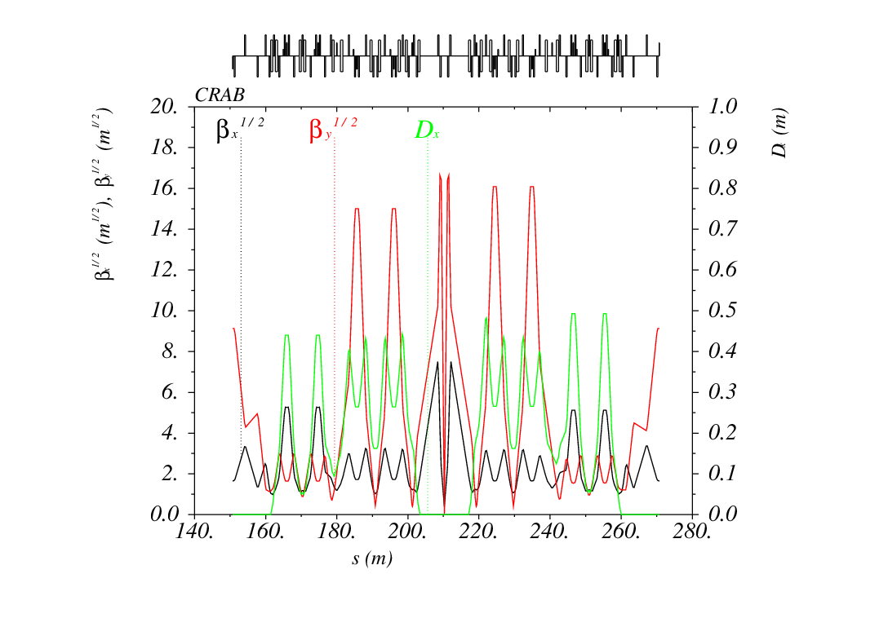
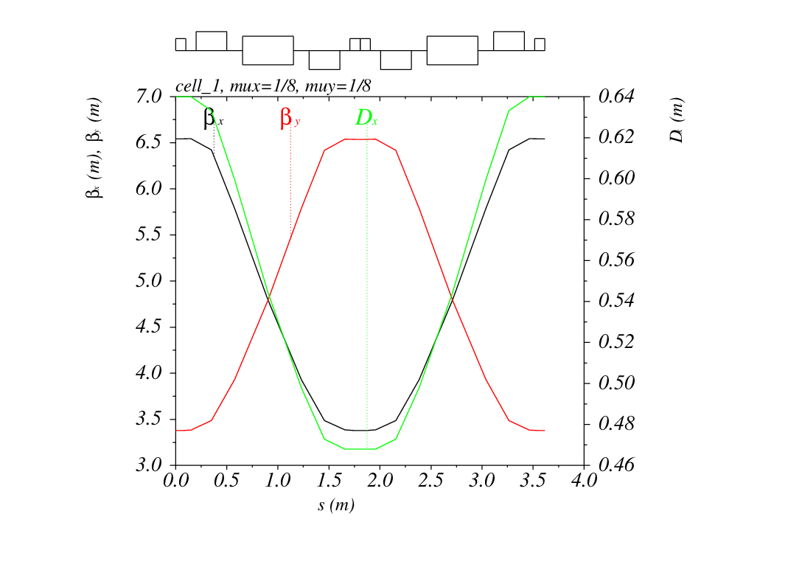
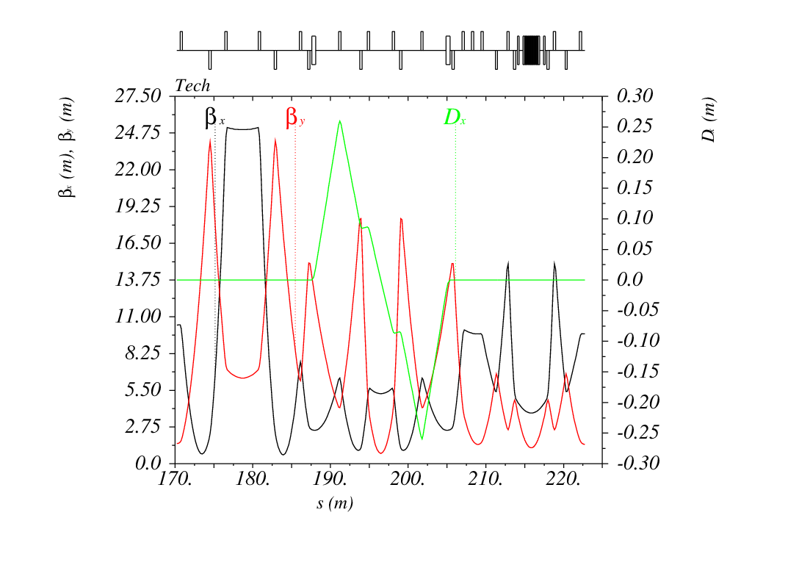
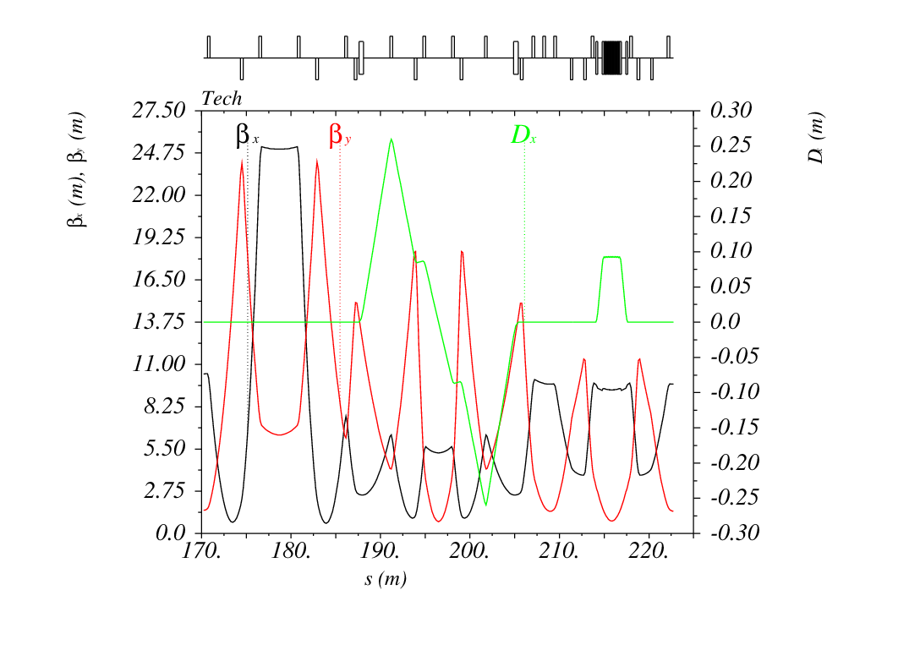
IR, CRAB, cell
CRAB: $β_{x}=2.73750890915102$, $β_{y}=83.3304580816544$, $K2_{crab}=93.6359961185022$
Wiggler is OFF
Wiggler is ON
Notes:
19

Slide 15
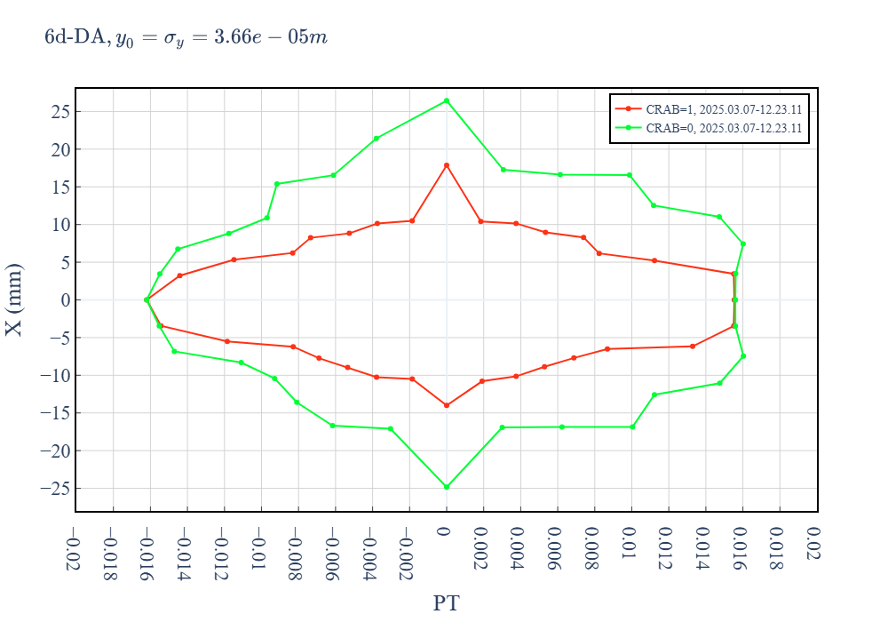
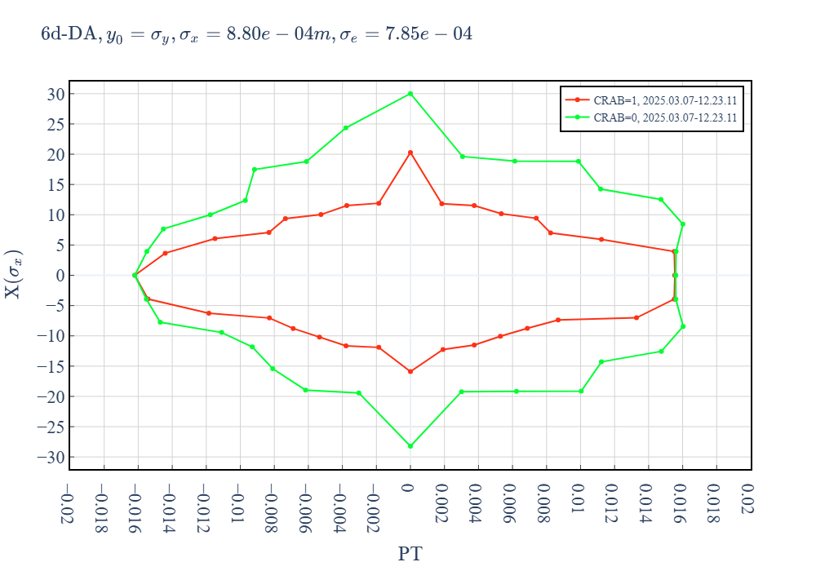
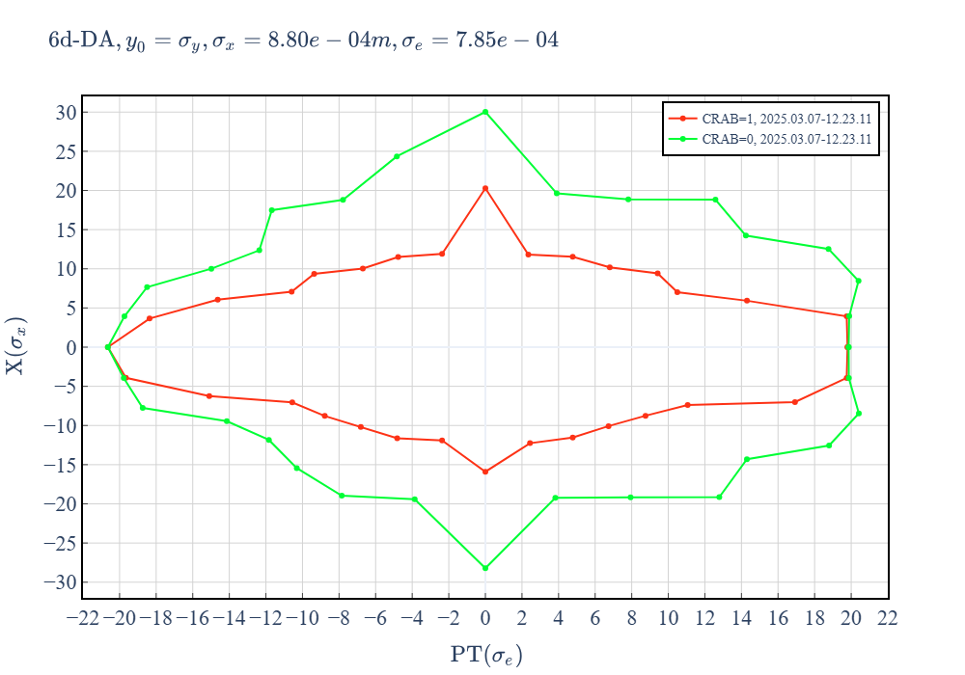
6d dynamic aperture
 | CRAB | $$τ_{Touschek}$$ | $$N_{p}$$
2025.03.07-12.23.11 | 1 | 2281 | $$2.8×{10}^{10}$$
2025.03.07-12.23.11 | 0 |  | $$2.8×{10}^{10}$$
2025.03.07-12.23.11 | 1 | 1691 | $$3.8×{10}^{10}$$
2025.03.07-12.23.11 | 0 |  | $$4.1×{10}^{10}$$

Slide 16
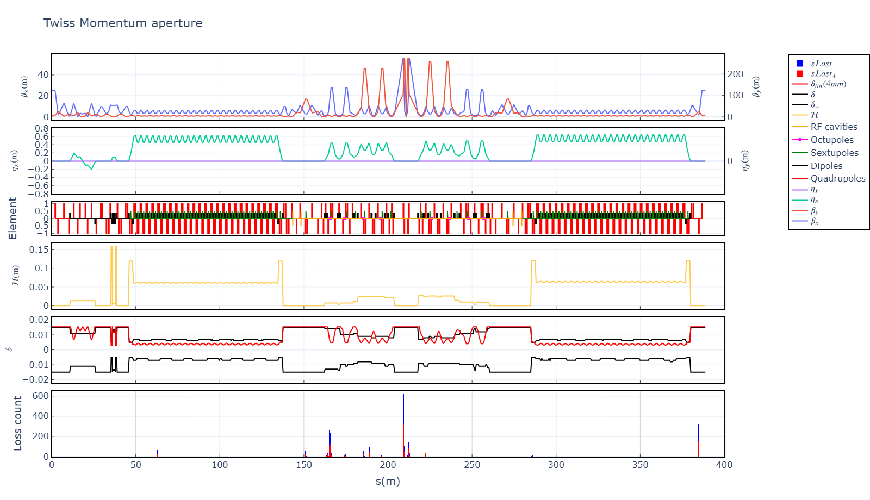
LMA (ring-2025.03.07-12.23.11_1.0crab_sextupole-1.55GeV-4cav.lte ) CRAB=1
Optimize DS
+1.5%
+0.5%
+0.6%
-0.5%
-0.6%
-1.5%
$τ_{Touschek}$=1691 s
$$N_{p}=3.8×{10}^{10}$$

Slide 17
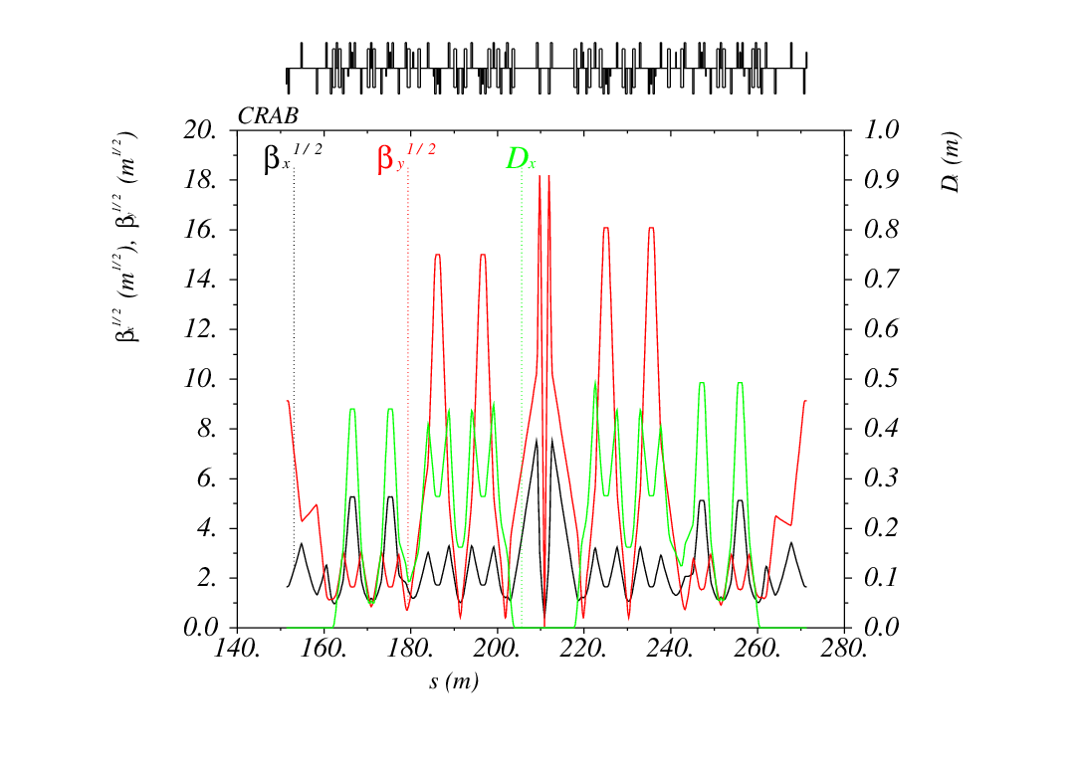
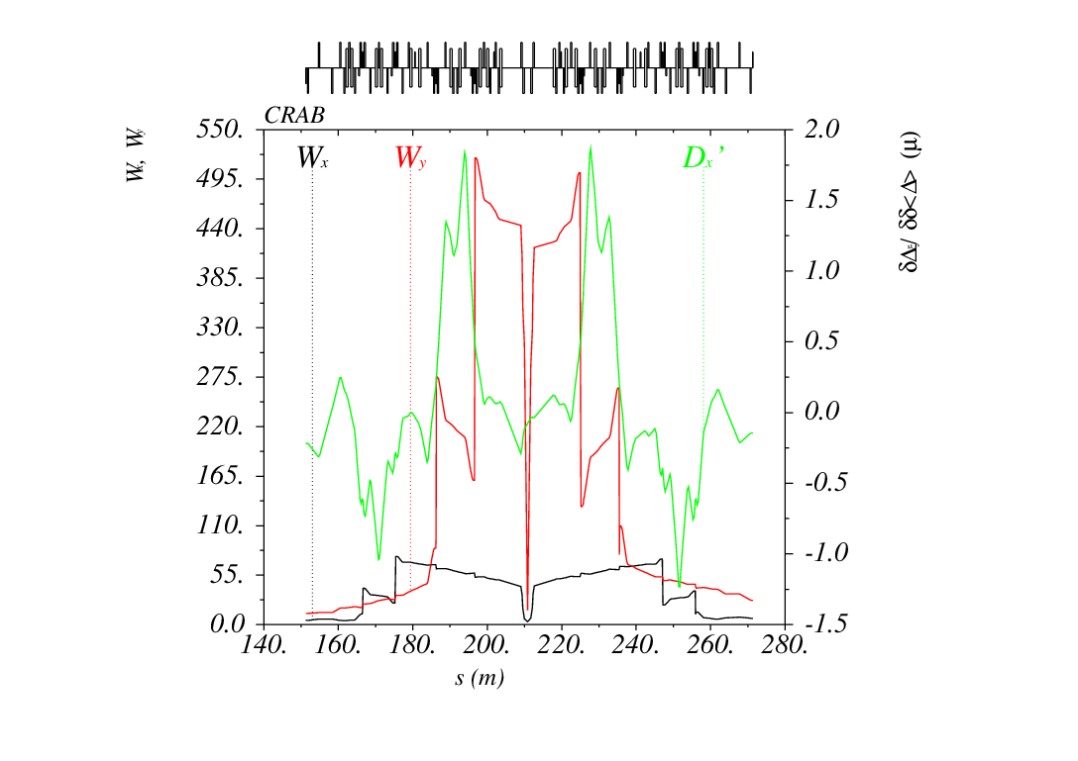
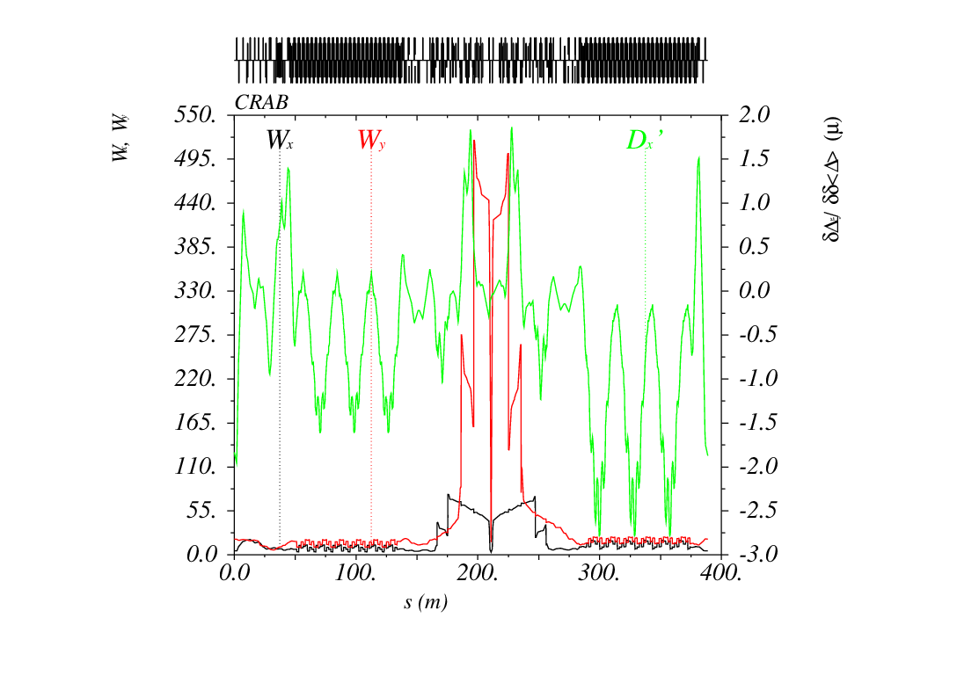
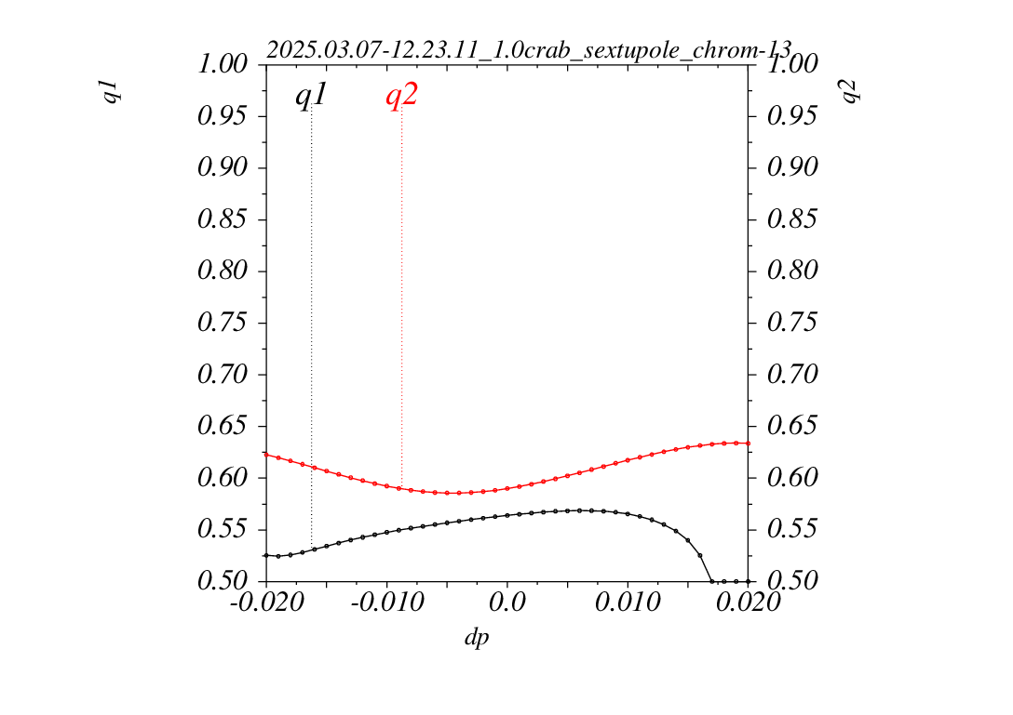
Left to Right CRAB (2025.03.07-12.23.11_1.0crab_sextupole_chrom-13.str)

Slide 18
Секступоли и октуполи промежутка встречи
Схема названий:
“.” – разделитель
L1 или R1 – левая или правая часть IR
M – магнит
S или O – секступоль или октуполь
X или Y – направление
Номер
_1 или _2 – первая или вторая половина
L1.MSY5_1+L1.MSY5_2
L1.MSY1_1+L1.MSY1_2 = L1.MSY3_1+L1.MSY3_2 | CCSY, пара через –I хроматических сеступолей
L1.MOY1 = L1.MOY2 | CCSY, пара через –I хроматических октуполей
L1.MSX1_1 + L1.MSX1_1 = L1.MSX3_1+L1.MSX3_2 | CCSX, пара через –I хроматических сеступолей
L1.MSX5
L1.MOX1 = L1.MOX2 | CCSX, пара через –I хроматических октуполей
L1.MSCRAB_1 + L1.MSCRAB_2 = -(R1.MSCRAB_1 + R1.MSCRAB_2) | Крабовые секступоли, не крутить

Slide 19
Секступоли и октуполи арок
Схема названий:
“.” – разделитель
A1 или A2 – левая или правая арка
M – магнит
S или O – секступоль или октуполь
X или Y – направление
Номер
A1.MSX1 = A1.MSX4 … A1.MSX19 = A1.MSX22 A1.MSX2 = A1.MSX5 … A1.MSX20 = A1.MSX23 A1.MSX3 = A1.MSX6 … A1.MSX21 = A1.MSX24 A1.MSX25 | Секступоли арок, должны быть объедены в –I пары через 4 ячейки
A1.MSY1 = A1.MSY4 … A1.MSY19 = A1.MSY22 A1.MSY2 = A1.MSY5 … A1.MSY20 = A1.MSY23 A1.MSY3 = A1.MSY6 … A1.MSY21 = A1.MSY24 | Секступоли арок, объедены в –I пары через три ячейки
A1.MSYDS1, A1.MSYDS2, A2.MSYDS1, A2.MSYDS2 | Секступоли в секции подавления дисперсии

Slide 20
Explanation: detuning from quad fringe
$$Δν_{y}=α_{yy}j_{y}+α_{yx}j_{x}, Δν_{yy}=α_{yy}j_{y}, Δν_{yx}=α_{yx}j_{x}$$
For $\left\{x=n_{x}σ_{x}, y=n_{y}σ_{y}\right\}$ actions are $\left\{j_{x}=\frac{n_{x}^{2}ε_{x}}{2},j_{y}=\frac{n_{y}^{2}ε_{y}}{2}\right\}$
$$α_{yy}=\frac{1}{32π} ∮K_{1}^{′′}β_{y}^{2}ds ≈\frac{K_{1}}{8π}\left(α_{1,y}β_{1,y}−α_{2,y}β_{2,y}\right)$$
$$α_{yx}=\frac{1}{8π}∮K_{1}^{′}\left(α_{y}β_{x}−α_{x}β_{y}\right)ds≈\frac{K_{1}}{8π}\left(α_{1,y}β_{1,x}−α_{1,x}β_{1,y}−\left(α_{2,y}β_{2,x}−α_{2,x}β_{2,y}\right)\right)$$
First
edge
Second
edge
First
edge
Second
edge

Slide 21
Explanation: detuning from quad fringe
$$Δν_{y}=α_{yy}j_{y}+α_{yx}j_{x}, Δν_{yy}=α_{yy}j_{y}, Δν_{yx}=α_{yx}j_{x}$$
For $\left\{x=n_{x}σ_{x}, y=n_{y}σ_{y}\right\}$ actions are $\left\{j_{x}=\frac{n_{x}^{2}ε_{x}}{2},j_{y}=\frac{n_{y}^{2}ε_{y}}{2}\right\}$
For first final focus quadrupole
$$Δν_{yy}=α_{yy}j_{y}=\frac{1}{π}\frac{{L^{∗}}^{3}}{{β_{0,y}^{2}L}_{q}^{2}\left(1+\frac{2L^{∗}}{L_{q}}\right)}×\frac{n_{y}^{2}ε_{y}}{2}$$
$$Δν_{yx}=α_{yx}j_{x}=\frac{1}{π}\frac{L^{∗}}{β_{0,x}β_{0,y}}\left(2+\frac{L^{∗}}{L_{q}}\right)×\frac{n_{x}^{2}ε_{x}}{2}$$
With $L_{q}$ increase $α_{yy}→0$, $α_{yx}→const$

Slide 22
Explanation: detuning from quad fringe
Starting from IP
$$\begin{aligned}α_{yx}\left(Q0\right)&≈\frac{K_{1}}{8π}\left(α_{1,y}β_{1,x}−α_{1,x}β_{1,y}−\left(α_{2,y}β_{2,x}−α_{2,x}β_{2,y}\right)\right) \\ &= 11 − \left(−9487\right) \\ α_{yx}\left(Q1\right)&≈\frac{K_{1}}{8π}\left(α_{1,y}β_{1,x}−α_{1,x}β_{1,y}−\left(α_{2,y}β_{2,x}−α_{2,x}β_{2,y}\right)\right) \\ &= 6966 − \left(−235\right)\end{aligned}$$
First edge
from IP
Second edge from IP

Slide 23
Замечания
Окунев. И.: можно ли в ячейках заменить магниты на диполи с градиентом, и убрать линзы.
Богомягков А.: уменьшить $ℋ$ в секциях подавления дисперсии.

