Slide 1
Polarization issues in c-tau factories
I.A.Koop, E.V.Bedarev, A.V.Bogomyagkov and A.V.Otboev
BINP, 630090 Novosibirsk, Russia
November 24 - 27 , 2025
Huangshan, USTC, China

Slide 2
Outline
Introduction to the longitudinal polarization schemes. Spin rotators, Siberian Snakes, Spin Transparency, DK formulae.
Novosibirsk SCTF polarization parameters with 1, 3 and 5 snakes.
Hefei’s STCF polarized electron beam option – possible solutions.
Optimized Siberian Snake optics and parameters.
What can be studied with the longitudinally polarized beams?
Requirements to the polarized electron source.
Conclusion.

Slide 3
Longitudinal polarization scheme with 3 snakes
(arc 120⁰ + 2 damping wigglers in the arc’s middle point)
IP
snake2
snake3
Idea of Siberian snake proposed in 70-th
by Derbenev, Kondratenko and Skrinsky
damping
wiggler2
damping
wiggler1
snake1

Slide 4
The Novosibirsk c-tau factory parameters
Energy | 1.0 – 2.5 | GeV
Circumference | 765 | m
Crossing angle | 60 | mr
Emittances, ε_{x} / ε_{y} | 8 / 0.04 | nm
Number of bunches | 390
Number of particles/bunch | 7·10¹⁰
Total current | 1.7 | A
Beta function, β_{x} / β_{y} | 4 / 0.08 | cm
Sigma, σ_{x} / σ_{y} | 18 / 0.18 | mkm
Luminosity | 0.6 -1.0 · 10³⁵ | cm⁻²s⁻¹

Slide 5
Transparent spin rotator (partial snake)
(Litvinenko, Zholentz,1980)
( Koop et al., SPIN2006)
In case $φ=π$ will get $T_{x}=\left(\begin{matrix}1 & 0 \\ 0 & 1\end{matrix}\right)$, while $T_{x}=\left(\begin{matrix}0 & −2r \\ {2r}^{−1} & 0\end{matrix}\right)$ for $φ=π/2$
Advantage to place quads between two solenoids: they don’t need to be skewed!

Slide 6


Depolarization time in presence of snakes
E=1 GeV
$$n_{snk}=1$$
$$d^{2}\left(\tilde{θ}\right)=d^{2}\left(0\right)+{ν^{2}{\tilde{θ}}^{2}}/{{n_{snk}}^{2}}$$
Placing damping wigglers
in minimum of |d| weakens
depolarizing effects of SR

Slide 7
Self-polarization in presence of snakes
Symmetric wigglers do not
contribute to the nominator,
but asymmetric will do. That
can be used to polarize the
positron beam.

Slide 8
Polarization degree overview for Novosibirsk SCTF
5 snakes
3 snakes
1 snake

Slide 9
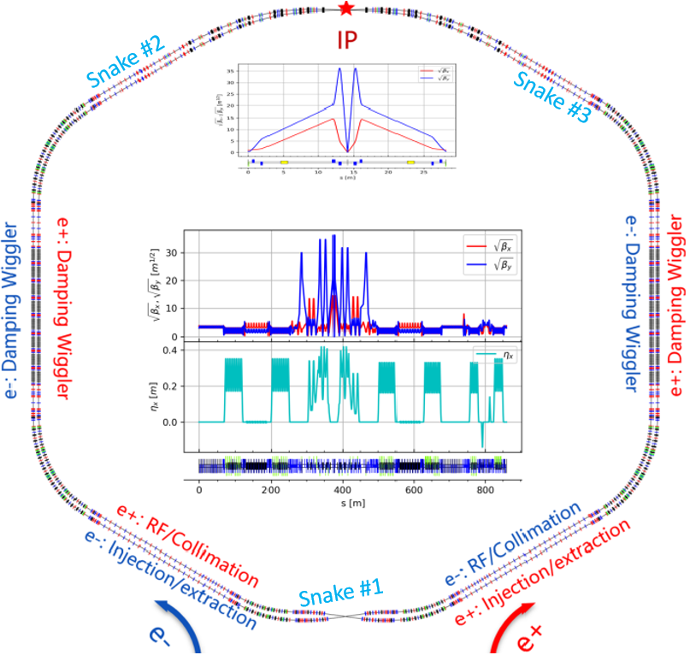
Hefei’s STCF factory layout with 3 Siberian Snakes

Slide 10
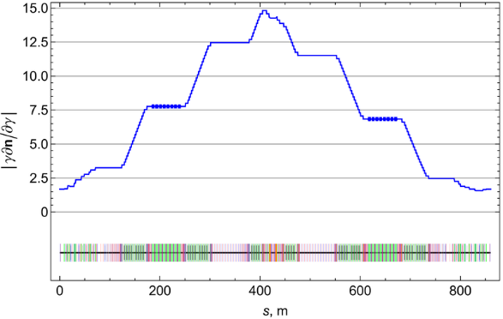
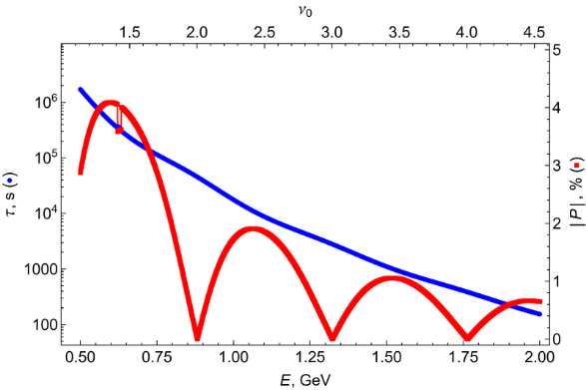
$\left|{γ∂\vec{n}}/{∂γ}\right|$ with single snake and depolarization time

Slide 11
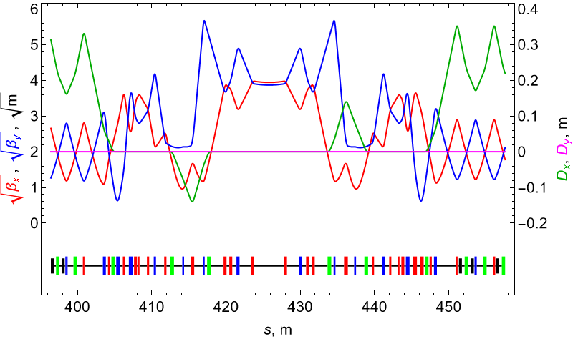
STCF optics around the point opposite to IP

Slide 12
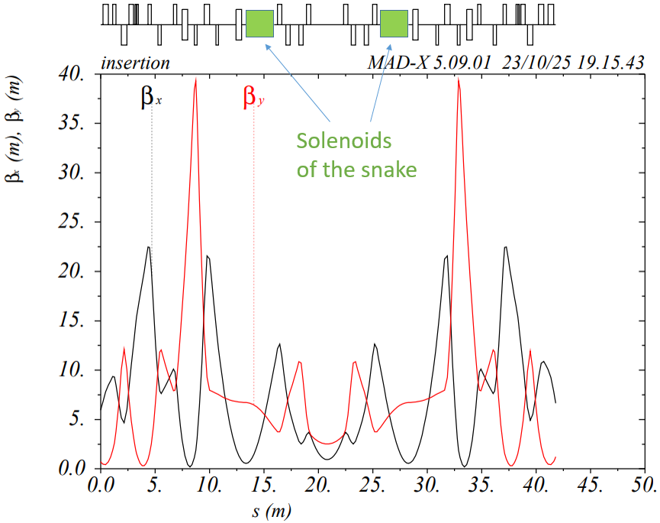
Beta-functions of a snake insertion in the tech-straight

Slide 13
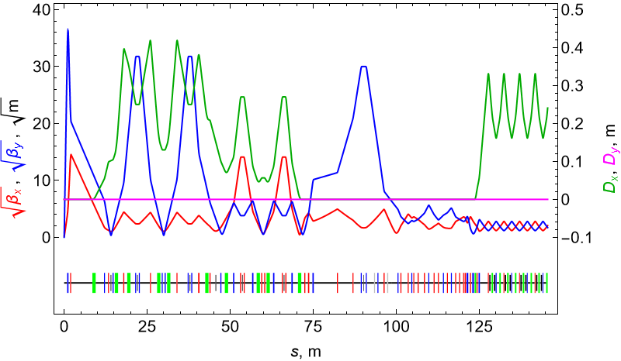
Floquet functions of the final focus region

Slide 14
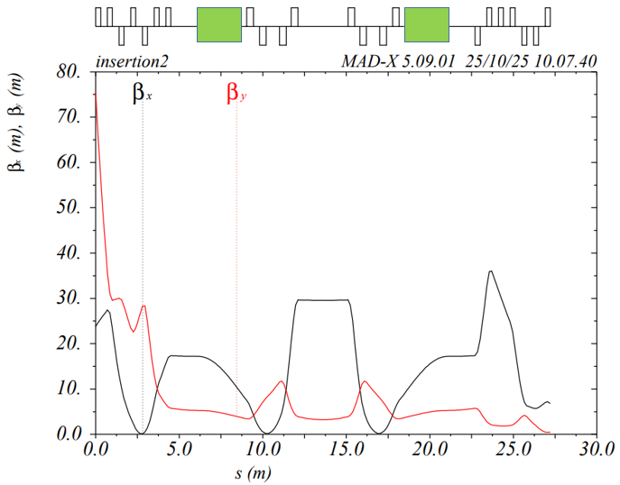
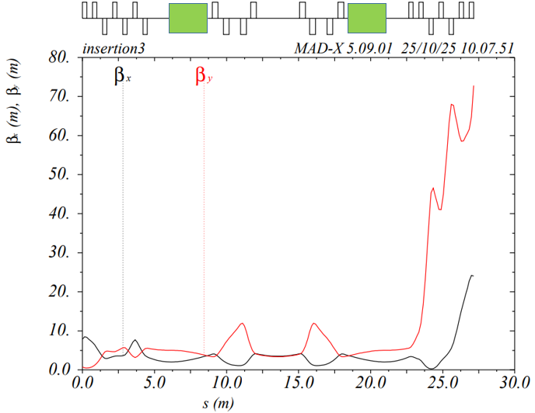
Beta-functions of the final focus regions with snakes
The left plot refer to the matching region located after crab-waist sextupole.
And the right plot refer to the region after an arc. Crab sextupole is located at the right edge of this region.
Some asymmetry of these two optics is due to asymmetry of the original lattices.

Slide 15
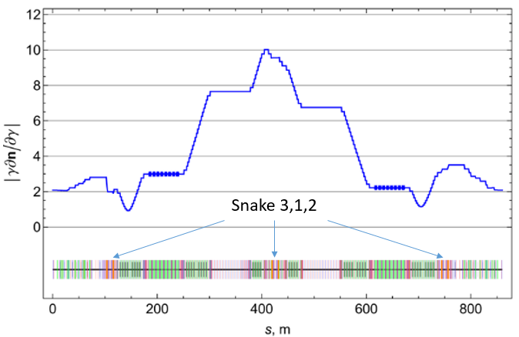
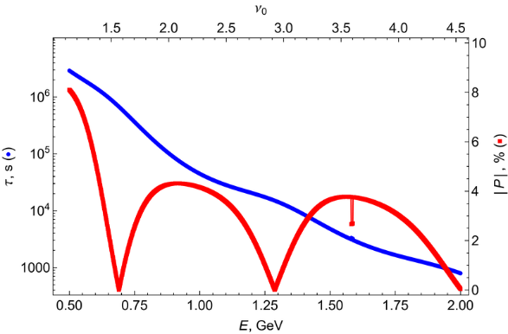
$\left|{γ∂\vec{n}}/{∂γ}\right|$ and depolarization time with 3 snakes
When using 1 or 3 Siberian snakes, the polarization at the IP point is aligned exactly along the longitudinal axis at any beam energy! This is the main advantage of using not a partial, but a complete Siberian snake.
The depolarization time is calculated taking into account the effects of damping wigglers, assuming their strength is proportional to the beam energy. 2 GeV was chosen as the reference energy.

Slide 16
Self-polarization degree and time with 3 snakes and with wigglers
Energy (GeV) | Pol-degree (%) | Tpol (s) | U0 (keV) | dE/E (0.001) | emit_x (m*rad) | tau_x (s) | B_wigl (T)
1.0 | -0.16 | 1731.4 | 271.7 | 0.736 | 1.958e-08 | 0.021 | 5.29
1.5 | 1.01 | 1323.3 | 407.5 | 0.771 | 6.175e-09 | 0.021 | 4.12
2.0 | 0.04 | 792.8 | 543.3 | 0.757 | 4.172e-09 | 0.021 | 3.2
2.5 | -2.26 | 317.7 | 679.2 | 0.736 | 8.175e-09 | 0.021 | 2.23
3.0 | -2.76 | 113.6 | 815.0 | 0.852 | 1.983e-08 | 0.021 | 0.34
3.5 | 2.23 | 41.5 | 1493.8 | 0.998 | 2.732e-08 | 0.014 | 0
The Wiggler field is tuned to provide constant damping at all energies below 3 GeV. At 3.5 GeV the wigglers turn off.
The degree of self-polarization is small enough and will not introduce significant asymmetry into the average value of polarization with the opposite sign.

Slide 17
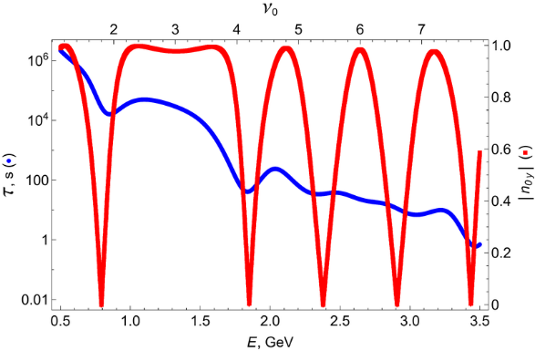
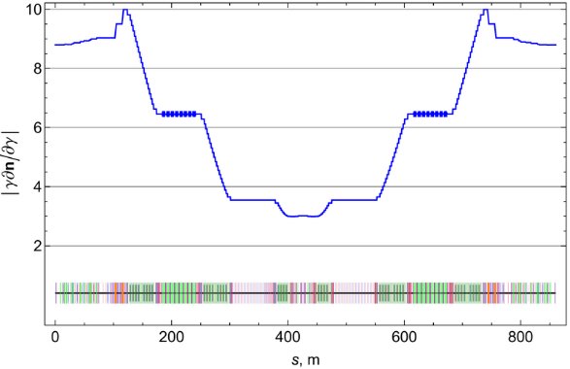
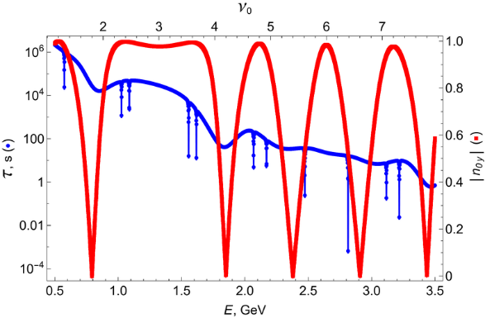
$\left|{γ∂\vec{n}}/{∂γ}\right|$ and depolarization time with 2 half-snakes
In the left graph, the matrices of the two 90-degree half-snakes are chosen with plus or minus I, i.e. not spin transparent to betatron oscillations. Therefore, narrow dips are visible here at energies corresponding to spin-betatron resonances. The top graph shows a clearer picture, without such dips, since the spin-rotators there are chosen to be spin-transparent.

Slide 18
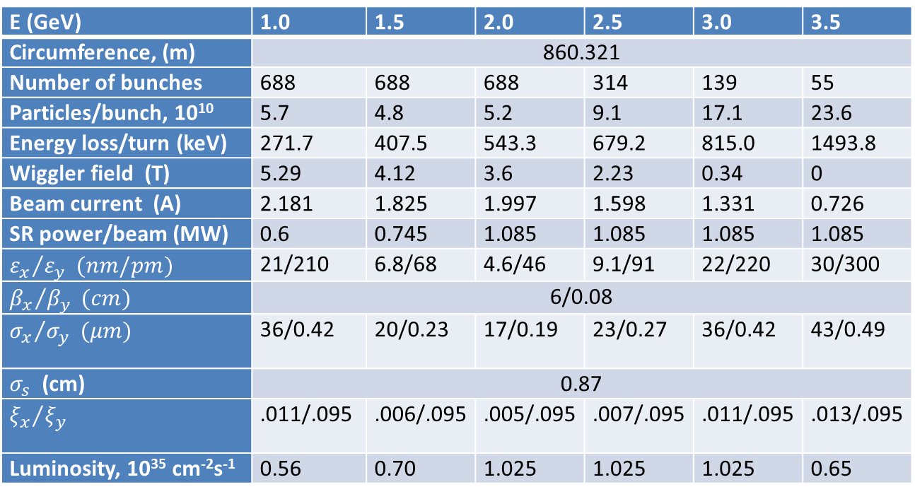
Energy scaling of luminosity and beam parameters, 3 snakes + wigglers
E (GeV) | 1.0 | 1.5 | 2.0 | 2.5 | 3.0 | 3.5
Circumference, (m) | 860.321
Number of bunches | 688 | 688 | 688 | 314 | 139 | 55
Particles/bunch, 10¹⁰ | 5.7 | 4.8 | 5.2 | 9.1 | 17.1 | 23.6
Energy loss/turn (keV) | 271.7 | 407.5 | 543.3 | 679.2 | 815.0 | 1493.8
Wiggler field (T) | 5.29 | 4.12 | 3.6 | 2.23 | 0.34 | 0
Beam current (A) | 2.181 | 1.825 | 1.997 | 1.598 | 1.331 | 0.726
SR power/beam (MW) | 0.6 | 0.745 | 1.085 | 1.085 | 1.085 | 1.085
$${ε_{x}}/{ε_{y}} (nm/pm)$$ | 21/210 | 6.8/68 | 4.6/46 | 9.1/91 | 22/220 | 30/300
$${β_{x}}/{β_{y}} (cm)$$ | 6/0.08
$${σ_{x}}/{σ_{y}} (μm)$$ | 36/0.42 | 20/0.23 | 17/0.19 | 23/0.27 | 36/0.42 | 43/0.49
$σ_{s}$ (cm) | 0.87
$${ξ_{x}}/{ξ_{y}}$$ | .011/.095 | .006/.095 | .005/.095 | .007/.095 | .011/.095 | .013/.095
Luminosity, 10³⁵ cm⁻²s⁻¹ | 0.56 | 0.70 | 1.025 | 1.025 | 1.025 | 0.65
It is assumed that the beam current and luminosity are limited by 1.085 MW of SR losses or by the beam-beam limit at the level of $ξ_{y}=\text{0.095}$.

Slide 19
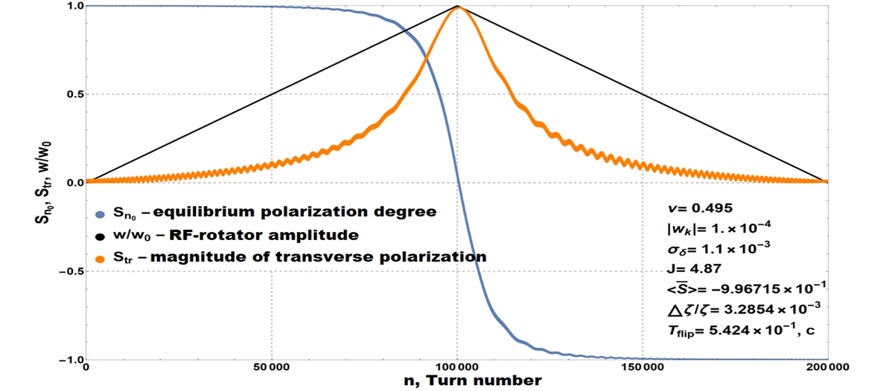
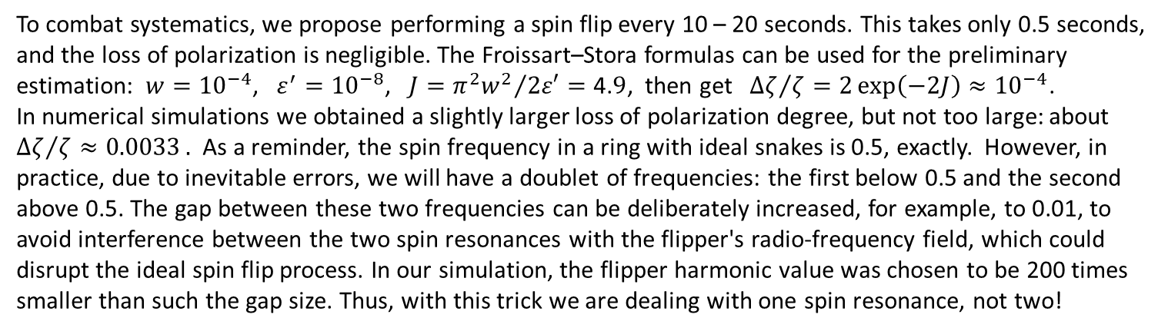
Polarization spin flips for measurement of the Weinberg's “running” weak angle at $J/Ψ$
E.V. Bedarev, A.E. Bondar, I.A. Koop, A.V. Otboev, Yu.M. Shatunov, BINP SB RAS, talk given at FTCF 2024, Guangzhou
To combat systematics, we propose performing a spin flip every 10 – 20 seconds. This takes only 0.5 seconds, and the loss of polarization is negligible. The Froissart–Stora formulas can be used for the preliminary estimation: $w={10}^{−4}$, $ε^{′}={10}^{−8}$, $J={π^{2}w^{2}}/{2ε′=\text{4.}9}$, then get ${Δζ}/{ζ=2\exp\left(−2J\right)≈{10}^{−4}}$.
In numerical simulations we obtained a slightly larger loss of polarization degree, but not too large: about ${Δζ}/{ζ≈0.0033}.$ As a reminder, the spin frequency in a ring with ideal snakes is 0.5, exactly. However, in practice, due to inevitable errors, we will have a doublet of frequencies: the first below 0.5 and the second above 0.5. The gap between these two frequencies can be deliberately increased, for example, to 0.01, to avoid interference between the two spin resonances with the flipper's radio-frequency field, which could disrupt the ideal spin flip process. In our simulation, the flipper harmonic value was chosen to be 200 times smaller than such the gap size. Thus, with this trick we are dealing with one spin resonance, not two!

Slide 20
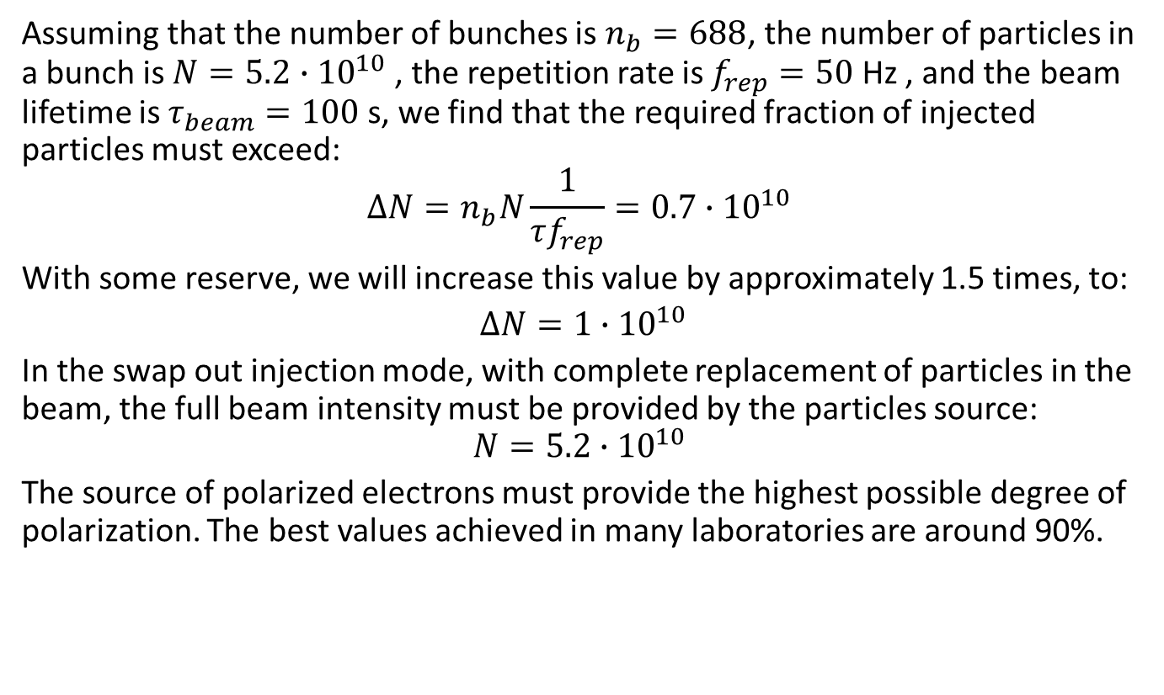
Requirements to the polarized electron source
Assuming that the number of bunches is $n_{b}=688$, the number of particles in a bunch is $N=5.2{∙10}^{10}$ , the repetition rate is $f_{rep}=50$ Hz , and the beam lifetime is $τ_{beam}=100$ s, we find that the required fraction of injected particles must exceed:
$$∆N=n_{b}N\frac{1}{τf_{rep}}=0.7∙{10}^{10}$$
With some reserve, we will increase this value by approximately 1.5 times, to:
$∆N=1∙{10}^{10}$
In the swap out injection mode, with complete replacement of particles in the beam, the full beam intensity must be provided by the particles source:
$$N=5.2{∙10}^{10}$$
The source of polarized electrons must provide the highest possible degree of polarization. The best values ​​achieved in many laboratories are around 90%.

Slide 21
Conclusion
We have found optical solutions for one or three Siberian Snakes that match the original STCF collider lattice and do not require changes to the collider ring layout.
We calculated the beam depolarization time and the equilibrium degree of polarization for all the options presented here.
1 snake provides up to 80% of the longitudinal polarization at E < 1.5 GeV.
3 snakes could provide sufficiently high polarization degree, about 70-80% in the energy range 1.5 < E < 2.5 GeV and only about 50% at 3.0 GeV. At 3.5 GeV the depolarization time is too small, about 40 s.
The swap out injection can help to significantly increase the average degree of polarization.
There is no preferred polarization sign. This helps combat systematic errors caused by detection efficiency asymmetry.

