Slide 1
The 7th International Workshop on Future Tau Charm Facilities
Preliminary design of the BINP CW collider final focus
A.A. Krasnov
A.A.Krasnov@inp.nsk.su
Superconducting double-aperture quadrupole lens of final
focus for the crab-waist type collider based on CST technology
N.A. Mezentsev
N.A.Mezentsev@inp.nsk.su
Nov 23 – 27, 2025 FTCF2025, Huangshan,China Hefei
Notes:
dsdsd

Slide 2
Content
Input conditions and parameters
General assembly with detector
Design and common assembly of IP, Y chambers and cryostat
SR flux and power distribution
Electron clouds
Resistive wall loses. Heat load on beryllium chamber
Temperature of vacuum chambers inside superconducting quadrupoles
Superconducting double-aperture quadrupole lens
Conclusion

Slide 3
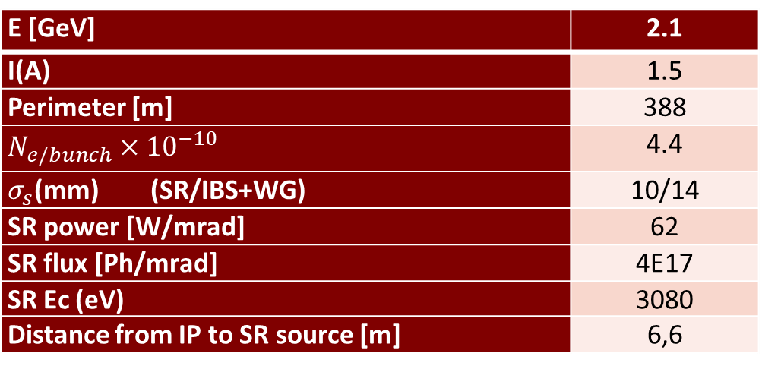
Input conditions and parameters
VEPP-6 parameters which make an influence on FF elements design:
E [GeV] | 2.1
I(A) | 1.5
Perimeter [m] | 388
$N_{e/bunch}×{10}^{−10}$ | 4.4
$σ_{s}$(mm) (SR/IBS+WG) | 10/14
SR power [W/mrad] | 62
SR flux [Ph/mrad] | 4E17
SR Ec (eV) | 3080
Distance from IP to SR source [m] | 6,6
General requirements
1. The average residual gases pressure : < 3 × 10⁻⁷ × Perimeter/FF_length х 0.5 ≈ 1,5 × 10⁻⁵ Pa (lower is better)
2. SR should not directly irradiate IP chamber (detector background)
3. All elements, with the exception of beryllium IP chamber, must be placed inside 2 x10 degree cone with an apex at IP
4. To avoid RF cavity at IP (high mode capture), the diameter of vacuum chambers (in one direction at least) shall not be less that diameter of IP chamber
5. To minimize geometrical impedance, the vacuum chambers must be as smooth as possible (with smooth transitions between elements with deferent cross-section)

Slide 4
General assembly with detector
We are going to install the both pre-assembled cryostat with IP chambers into detector from one side.
In principle, the assembly from both sides (Super KEKB variant) with the use remote control vacuum flange is also possible

Slide 5
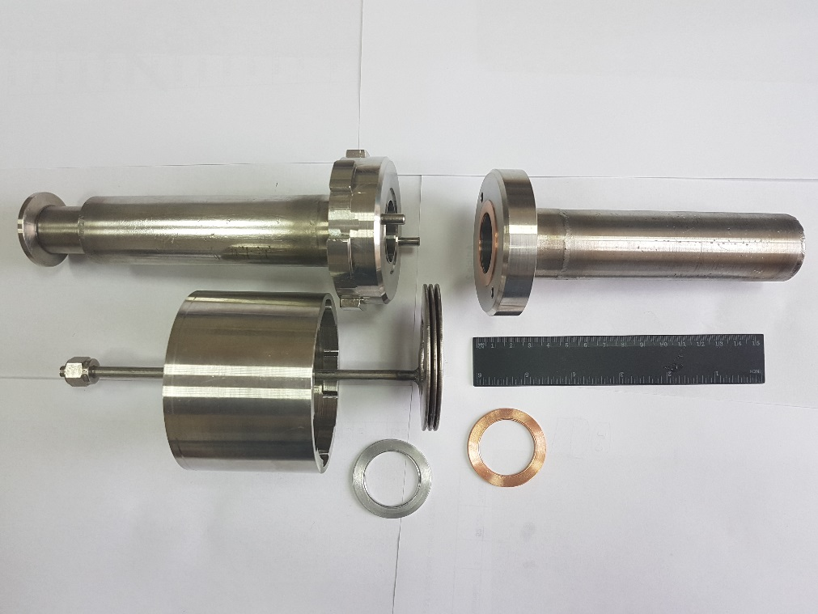
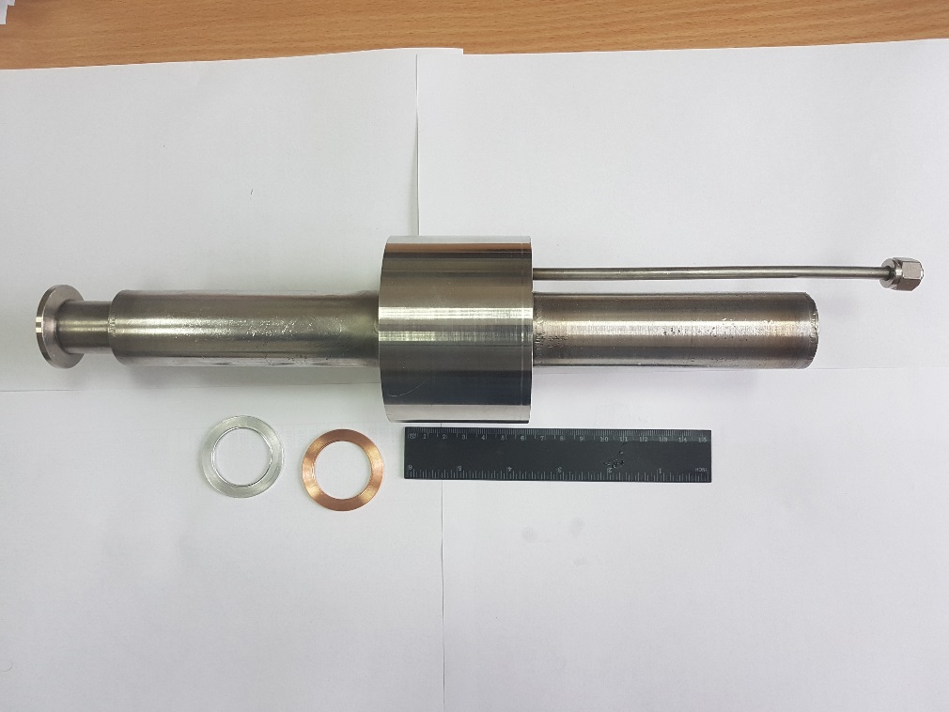
BINP Remote control flange prototype
“Work” vessel
Parts of the flange connection
Assembled connection
Vacuum tightness is reached for both Cu and Al gaskets at pressure 150 atmosphere. Leak rate is less than 1E-10 mbar*L/s.
Note, the connection keeps smoothness of internal surface along beam propagation

Slide 6
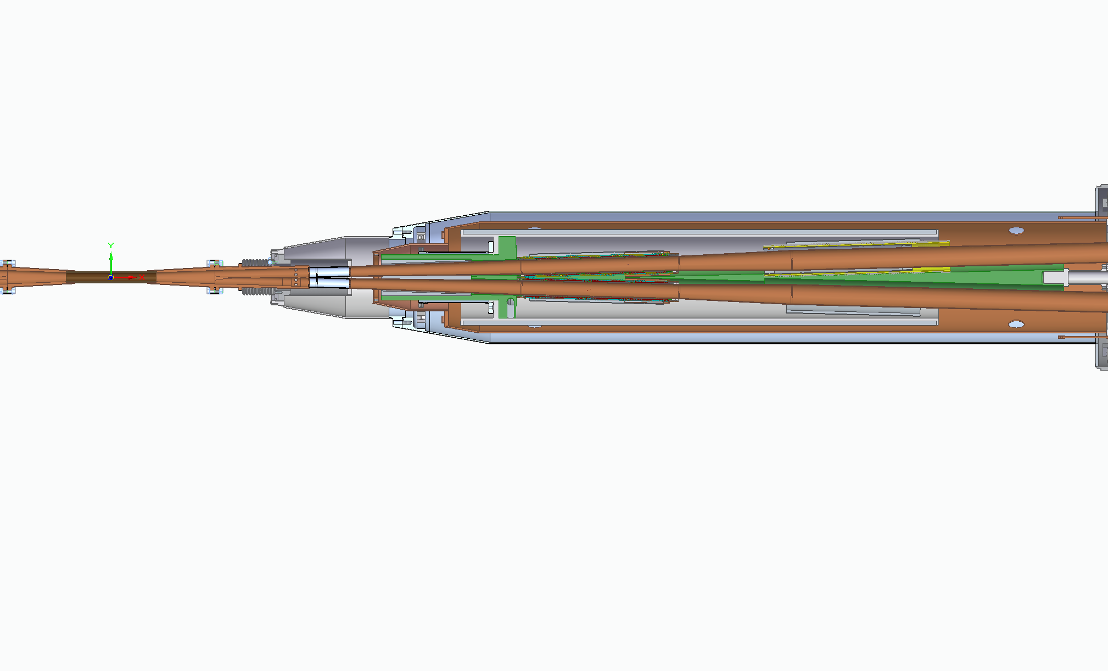
IP mock-up
Ante-chamber
Double Q0
Screening solenoid
Y-chamber/
SR absorber
Compensating solenoid
Double Q1
Beryllium
chamber
Tubes with pumping slots and RF smooth sliding contacts at the ends
Thermal screen
Common cryostat
We are going to release mock-up installation of half of IP elements including full length beryllium chamber

Slide 7
IP beryllium chamber
Be
Main heat source – resistive wall loses.
Total power: < 7W
Maximum temperature rise (at middle): < 11°C
Cooling and Internal coatings (Au or others) is not necessary
Y-chambers
Cu, water cooling
Current design:
Length – 160mm
ID - 20mm
Wall thickness – 1mm

Slide 8
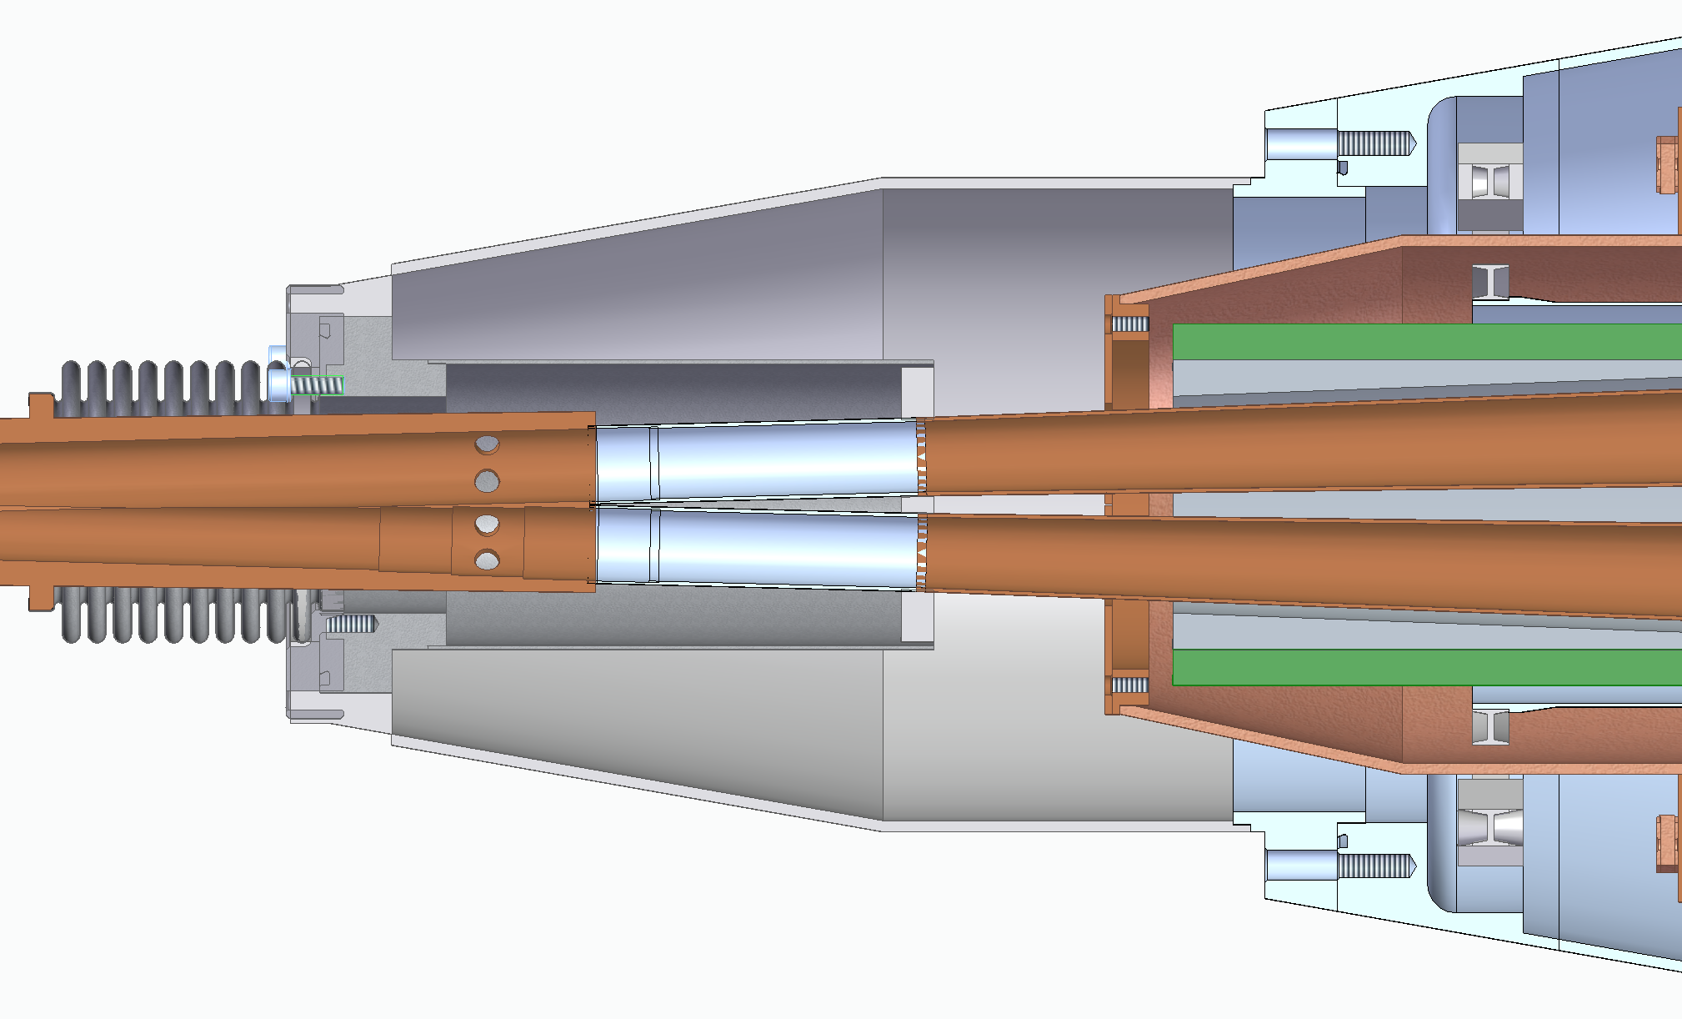
Y chamber connection with cryostat
Thin SS chambers with slots for pumping and
sliding RF contacts at the ends
Advantages:
Simplified assembly
Good thermal insulation
Space for vacuum pumps
Simple BPM electrodes
SR
Ante-chamber
Space for vacuum pump close to IP.
combined ion-getter + getter pump
Steps for SR absorption
BPM electrodes

Slide 9
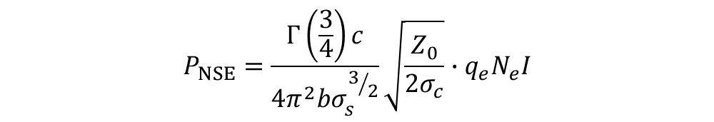
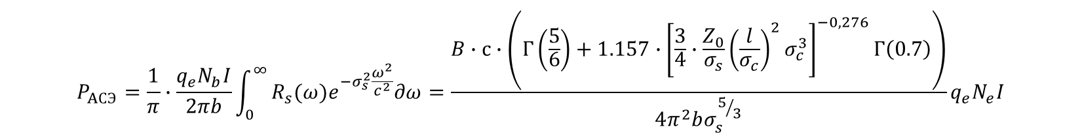
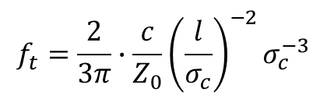
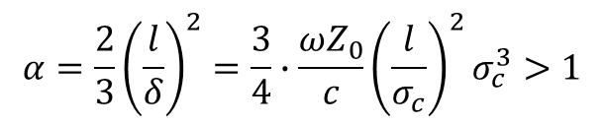
Resistive wall loses
$$P_{NSE}=\frac{Γ\left(\frac{3}{4}\right)c}{4π^{2}bσ_{s}^{3/2}}\sqrt{\frac{Z_{0}}{2σ_{c}}}∙q_{e}N_{e}I$$
At normal skin effect (at RT):
At high frequencies or at low temperatures, when the depth of field penetration becomes less than the mean free path of electrons, the theory of anomalous skin effect is used, which takes into account the scattering of electrons at the interface (surface). A more strict criterion for the region of the anomalous skin effect is written as follows:
Borderline frequency between normal and anomalous skin effect:
$$α=\frac{2}{3}{\left(\frac{l}{δ}\right)}^{2}=\frac{3}{4}∙\frac{ωZ_{0}}{c}{\left(\frac{l}{σ_{c}}\right)}^{2}σ_{c}^{3}>1$$
$$f_{t}=\frac{2}{3π}∙\frac{c}{Z_{0}}{\left(\frac{l}{σ_{c}}\right)}^{−2}σ_{c}^{−3}$$
One of the good approach for surface impedance, which works well for wide frequency region is:
$R_{s}\left(ω\right)={\left(\frac{\sqrt{3}}{16π}∙\frac{l}{σ_{c}}\right)}^{1/3}Z_{0}^{2/3}\frac{ω^{2/3}}{c^{2/3}}\left(1+1.157α^{−0.276}\right)$=B$\frac{ω^{2/3}}{c^{2/3}}\left(1+1.157α^{−0.276}\right)$
Integration over beam frequency spectra for a circular beam pipe gives:
$$P_{AСЭ}=\frac{1}{π}∙\frac{q_{e}N_{b}I}{2πb}\int_{0}^{∞}{R_{s}(ω)e^{−σ_{s}^{2}\frac{ω^{2}}{c^{2}}}∂ω}=\frac{B∙с∙\left(Γ\left(\frac{5}{6}\right)+1.157∙{\left[\frac{3}{4}∙\frac{Z_{0}}{σ_{s}}{\left(\frac{l}{σ_{c}}\right)}^{2}σ_{c}^{3}\right]}^{−0,276}Γ\left(0.7\right)\right)}{4π^{2}bσ_{s}^{5/3}}q_{e}N_{e}I$$
It makes good approach for Cu at temperature from LHe up to 60-80K and beam rms length up to 2 cm

Slide 10
Electron Clouds (for e+ beam only)
e⁻
E_{s} – average energy of secondary electrons (about 2 eV)
The saturations density of electron cloud is 6е6 1/cm³ in the chamber with ID 30mm (Q0) and 2e6 1/cm³ at ID 57mm (Q1).
Taking into account average energy of the electrons 200 eV after bunch propagation and bunch spacing 1m, one can obtain heat load due to EC 40 W/m
It looks like the mitigation of the EC with the use a coating (amorphous carbon for example) is necessary. Otherwise, the vacuum chamber operation inside quads is possible at RT only.

Slide 11
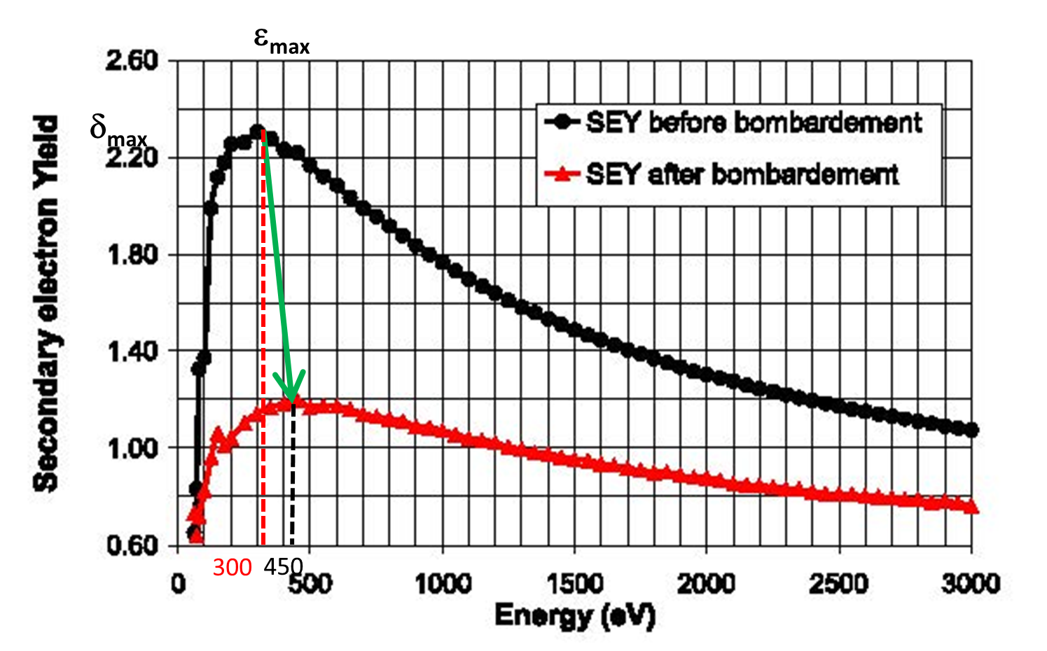
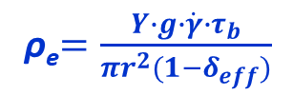
Electron cloud formation
at <1
BINP
Phenomenologically, neglecting space charge, electron density can be estimated as:
For < 0,9
One can obtain:
And heat load 7 W/m
How to reach it:
Amorphous carbon coating
High quality NEG (TiZrV)
Laser treatment
Ti thin film deposited in-situ (!)
- Geometrical solutions with low “g” (groves?)?
ρ_{e}$=\frac{Y∙g∙\dot{γ}∙τ_{b}}{πr^{2}(1−δ_{eff})}$
ρ_{e} about 1E6 cm⁻³
SEY of OFE Copper

Slide 12
Critical heat load
Q0
Cu, d30, L900
40…60К
Q1
Cu, d48, L600
40…60К
Ве, Id20, L160
SR
SR absorber with low “s”!!
SR absorber!!

Slide 13
Heat load. Cu chambers inside Q at 60 – 70 K
Material |  | b [мм] | Length [мм] | σ_{с} [1/(Ом∙м)] | P (RW) [W] | Max deltaT
Be | IP | 10 | 160 | 2.5E7 | 7 | 11
IP
element | b [м] | Length [mm] | σ_{с} [1/(Ом∙м)] | P (RW) [W} | P (SR) [W] | P(EC) [W] s=0.1, σ_{eff}=0.9 | P total [W]
Q0 | 0.015 | 320 | 5,7E8 | 4 | 10 | 2,5 | 16.5
Q1 | 0.027 | 370 | 5,7E8 | 3,5 | 25 | 3 | 31,5
For Cu chambers at 40 - 60K
(for one cryostat)
Total heat load on cryogenic level 40-60K is 100 W about

Slide 14
The final focus is a very important and complex element for electron-positron colliders, the quality of which primarily determines the luminosity of the collider, as well as the lifetime of the beams and the stability of operation.
The key elements of the final focus are quadrupole lenses, which should create a high-quality magnetic field in the orbit of the beams with minimal additions from higher multipole harmonics and at the same time have a high level of magnetic field gradient and compact dimensions.
Superconducting quadrupole lenses manufactured using CCT (Canted Cosine Theta) technology meet these requirements well.
Budker Institute of Nuclear Physics has created a prototype of a two-aperture quadrupole lens of final focus with a gradient of 40 Tl/m, having an internal aperture of 24 mm and a length of 160 mm.

Slide 15
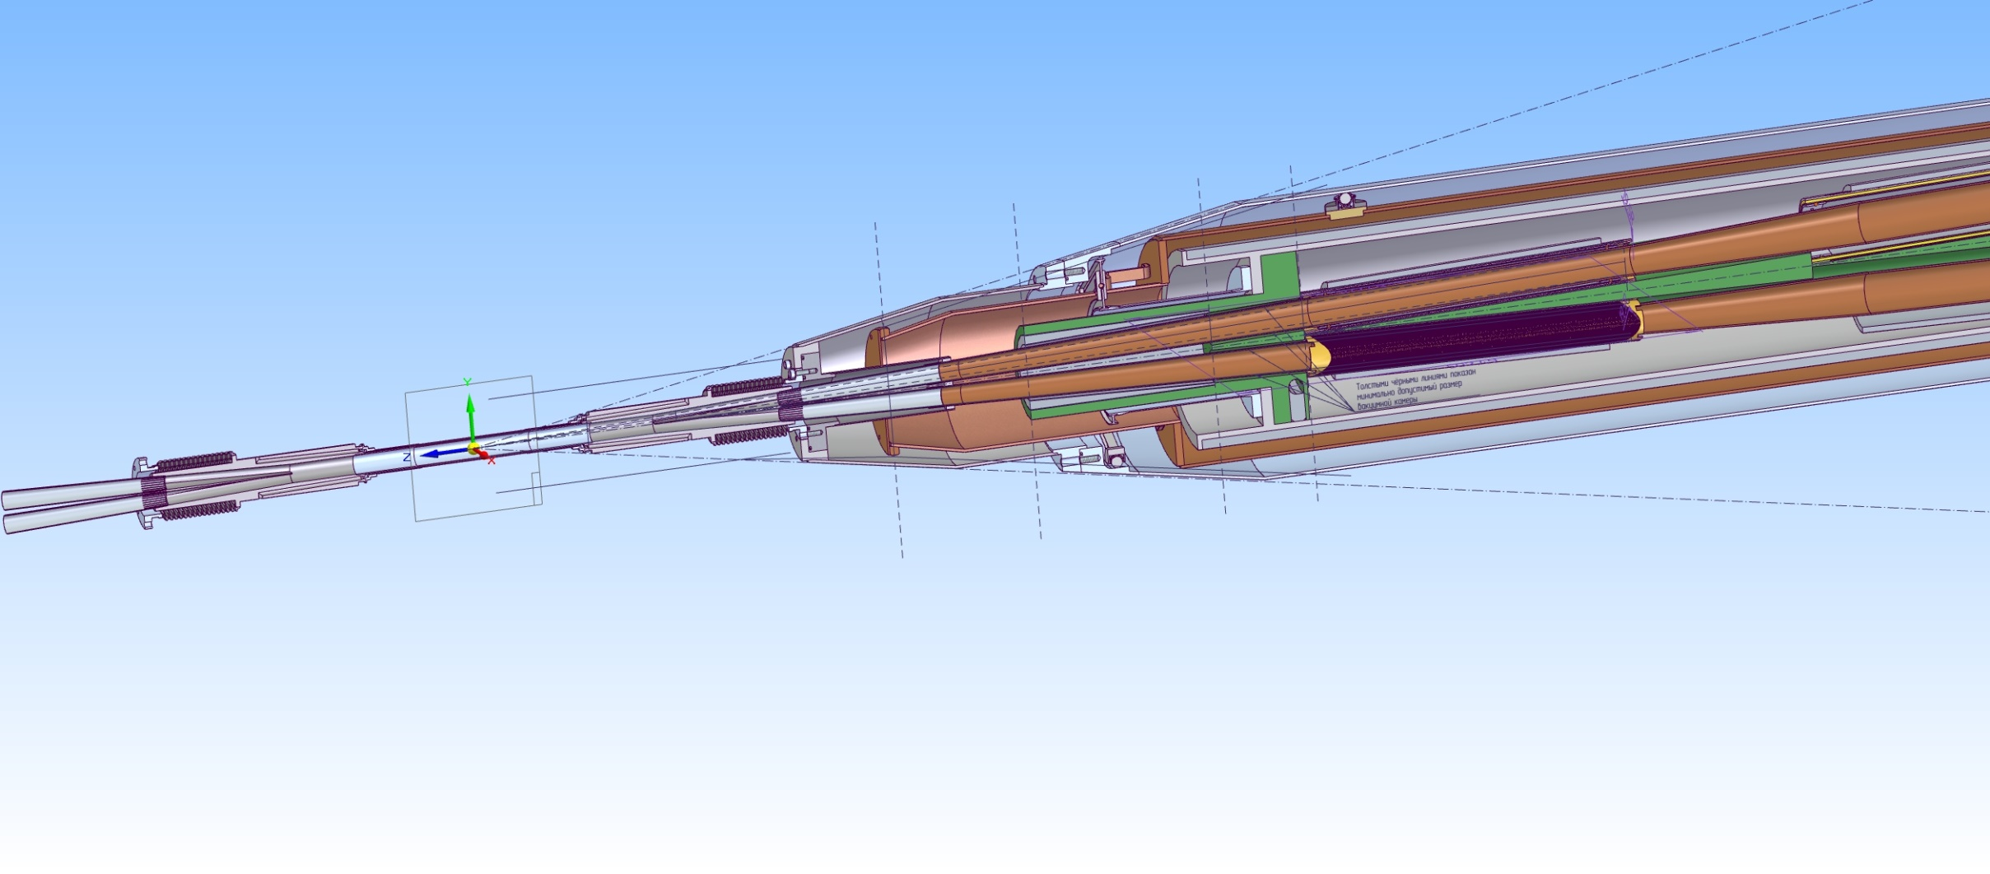
Top view of final
The horizontal angle between the equilibrium paths of the beams is ± 0.025 mrad
The distance from the meeting point to the beginning of the quadrupoles is ≈ 950 mm
Cryostat shell
Heat shield
Meeting point
Superconducting quadrupole

Slide 16
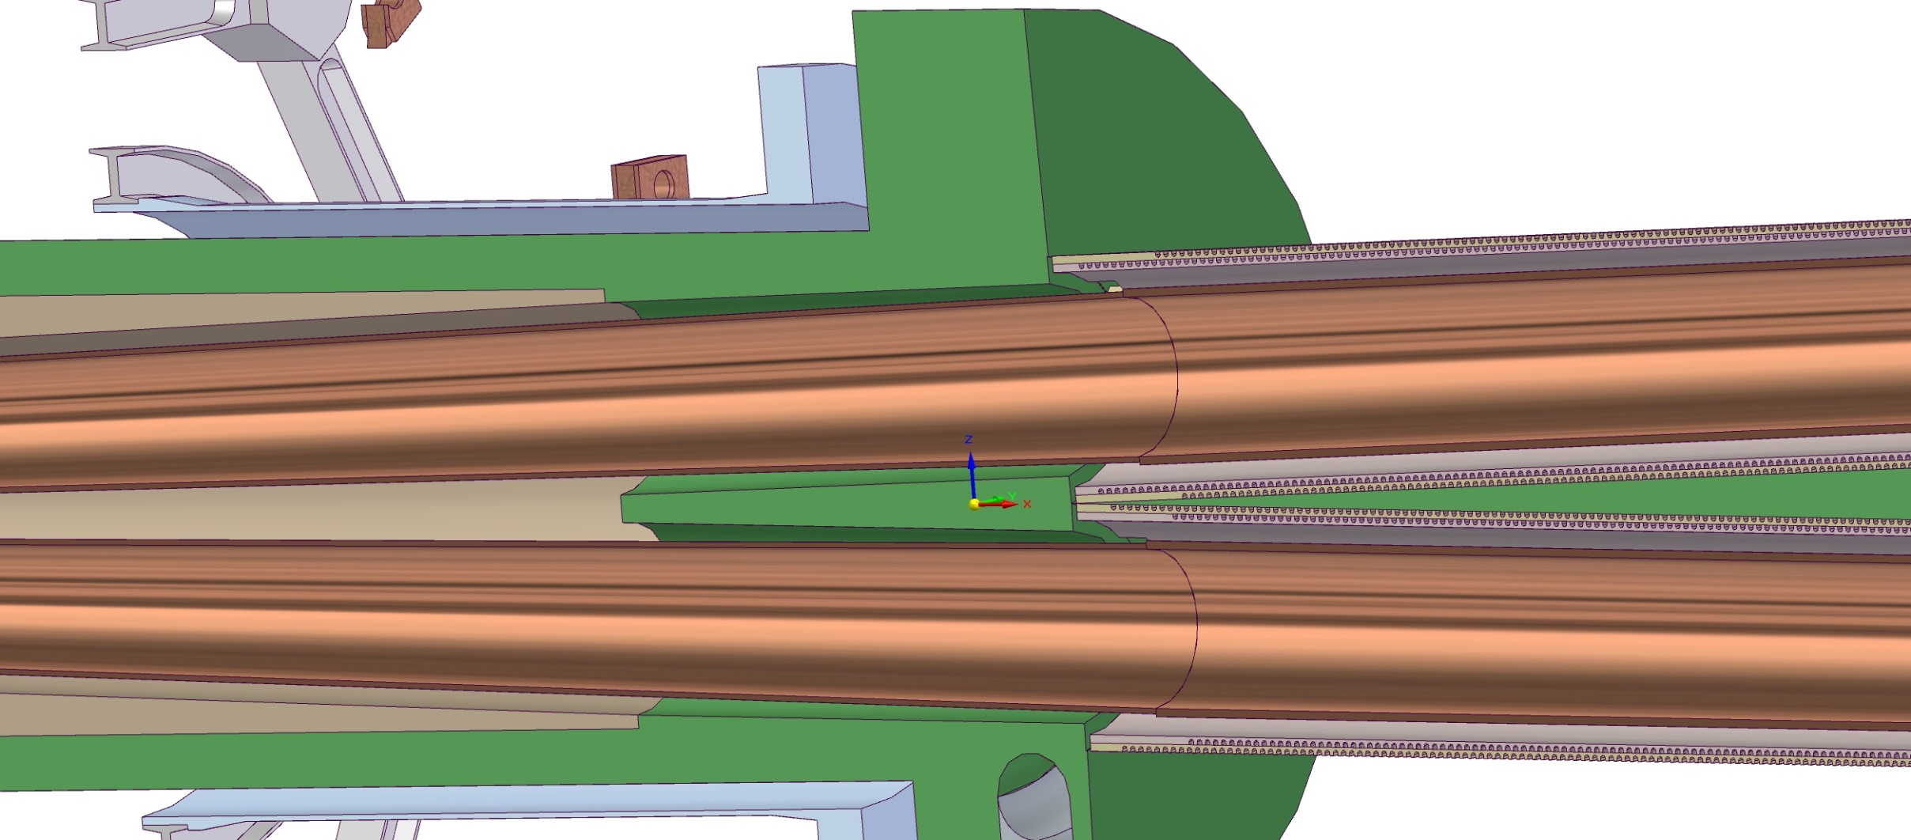
Top view of the meeting point
Left quadruple
Right quadrupole

Slide 17
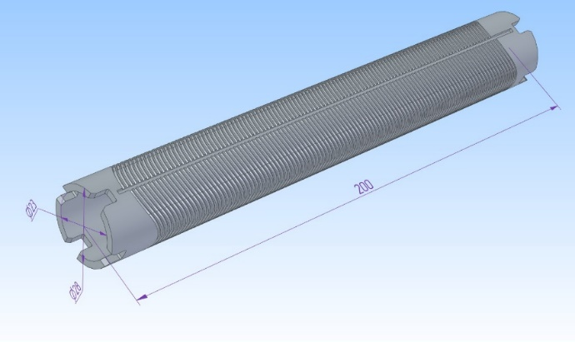
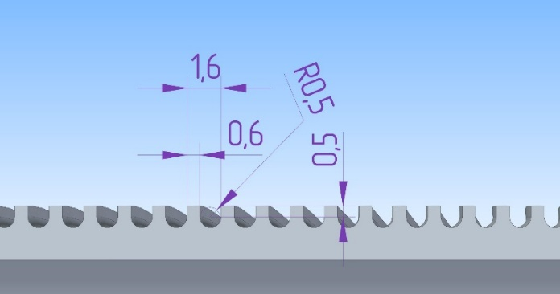
Superconducting CCT quadrupole
CCT Quadrupole Lens design:
The wire is wound into grooves on the surface of the inner cylinder and mechanically pressed by the outer cylinder, which is continuously applied to the inner cylinder during the winding process.
Then, during the winding of the outer cylinder, the coils are pressed by the outer mandrel.
The outer mandrel is made of copper to ensure good thermal conductivity, as cooling will take place inside the indirect cooling cryostat in vacuum.
The wire is wound continuously in one piece.
Three-dimensional model of a CCT quadrupole lens
The shape of the groove for the wire

Slide 18
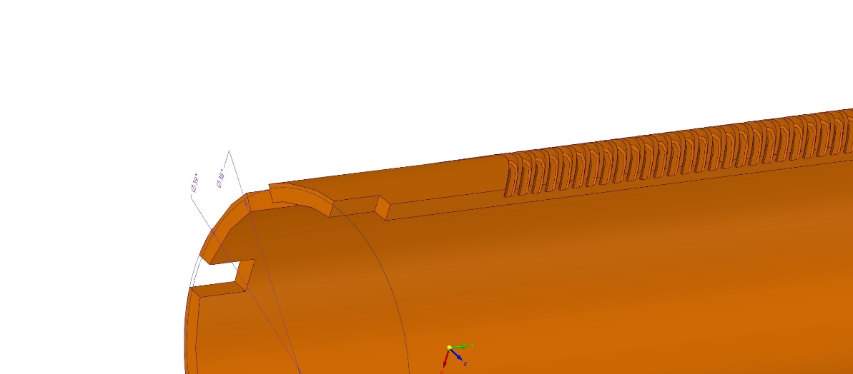
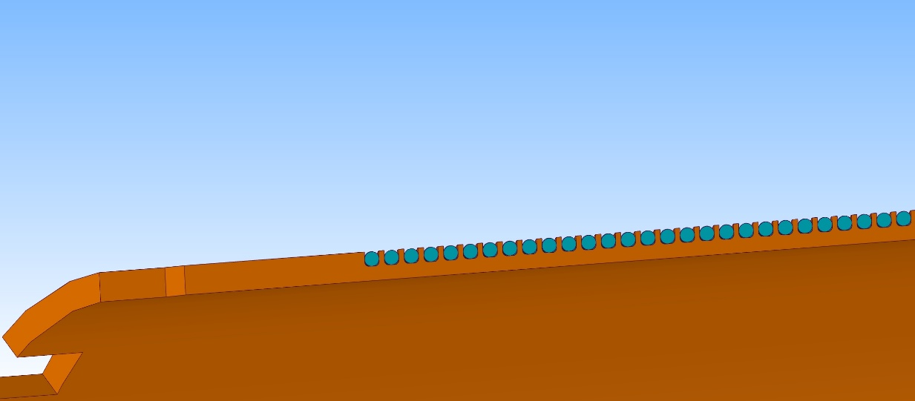
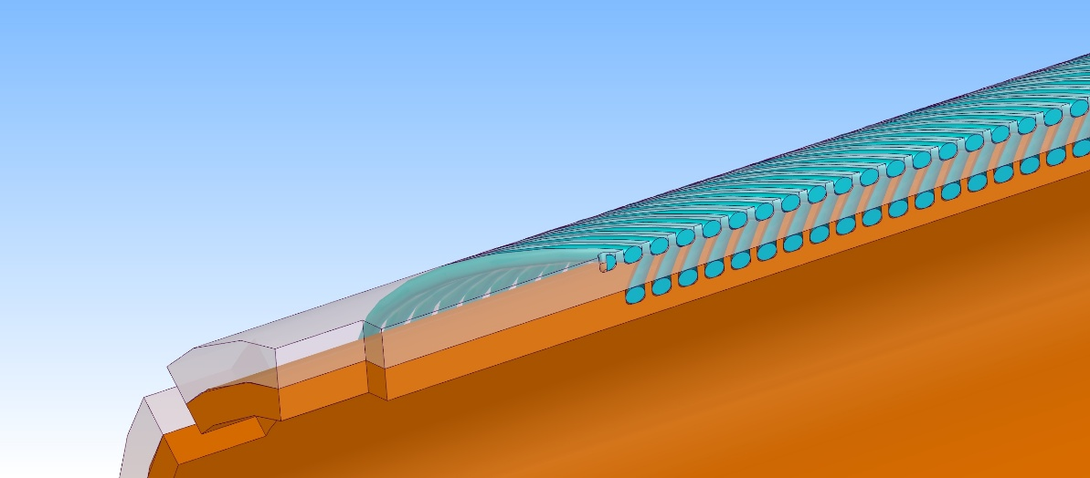
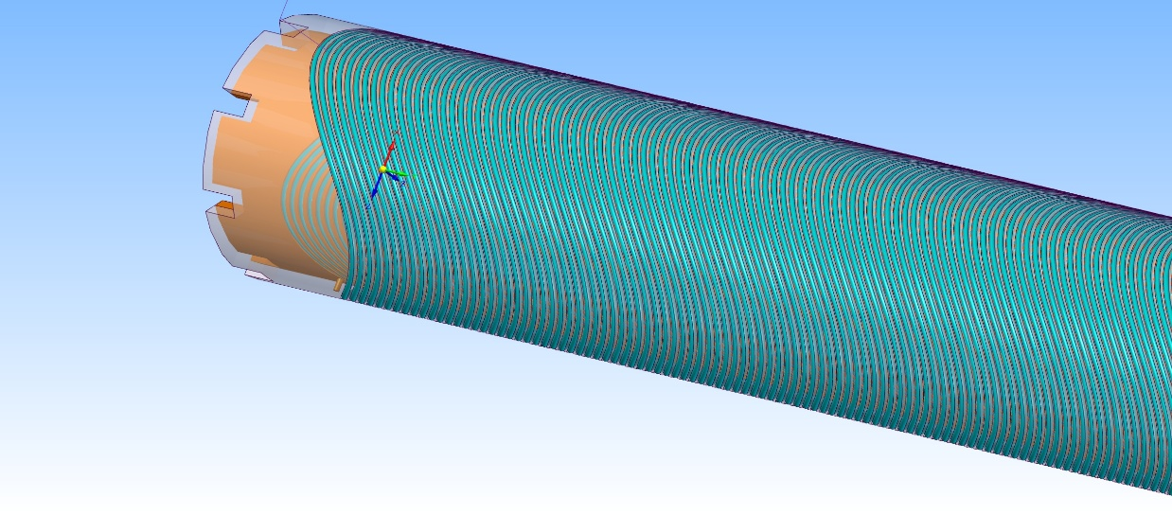
Quadrupole details
Aluminum alloy base for superconducting wire winding (cut)
Laying the first layer of superconducting wire in the groove
Laying the second layer of superconducting wire
View of the finished quadrupole

Slide 19
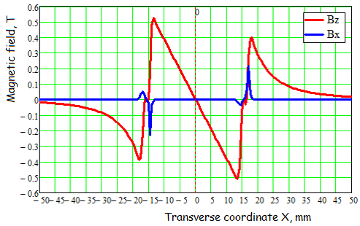
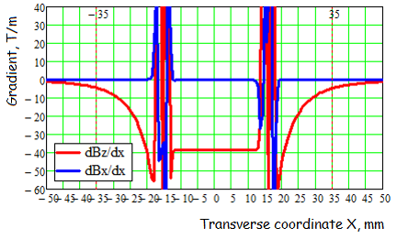
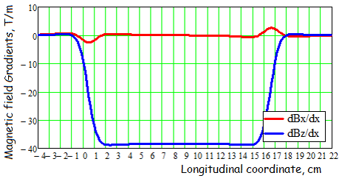
Single Superconducting CCT quadrupole
Calculation of the magnetic field for a single quadrupole
quadrupole
Dependence of the field components Bx and Bz on the transverse X coordinate
Dependence of the dBx/dx and dBz/dx gradients on the transverse X coordinate
Distribution of the dBx/dx and dBz/dx field gradients along the longitudinal coordinate

Slide 20
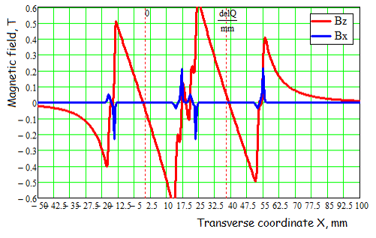
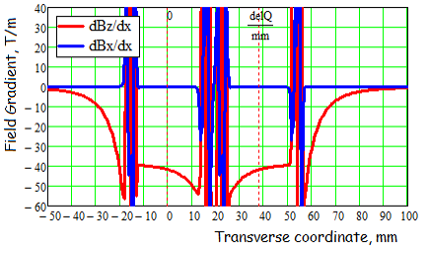
Calculation of the magnetic field for two adjacent quadrupoles powered by a current of 1500 A
Right quadrupole
Left qudrupole
The dependence of the field components Bx and Bz on the transverse X coordinate. Red is the total field from two quadrupoles powered by a current of 1500 A. The centers of the lenses are indicated by a dotted line.
The behavior of dBx/dx and dBz/dx gradients from the transverse X coordinate with two activated quadrupoles.

Slide 21
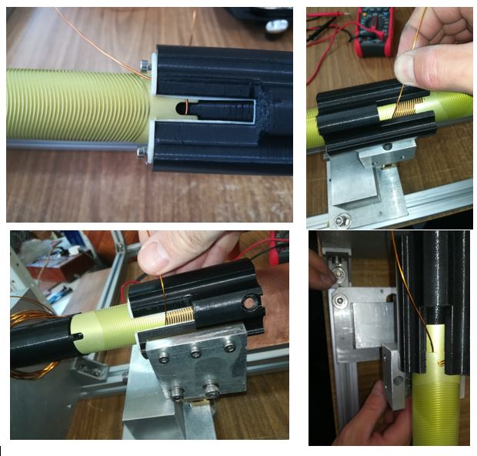
Production of a CCT quadrupole prototype
Two aluminum blanks for winding the quadrupole and a copper low-temperature shield
Two ready-made, side-by-side superconducting quadrupoles prepared for testing.
The quadrupole manufacturing process

Slide 22
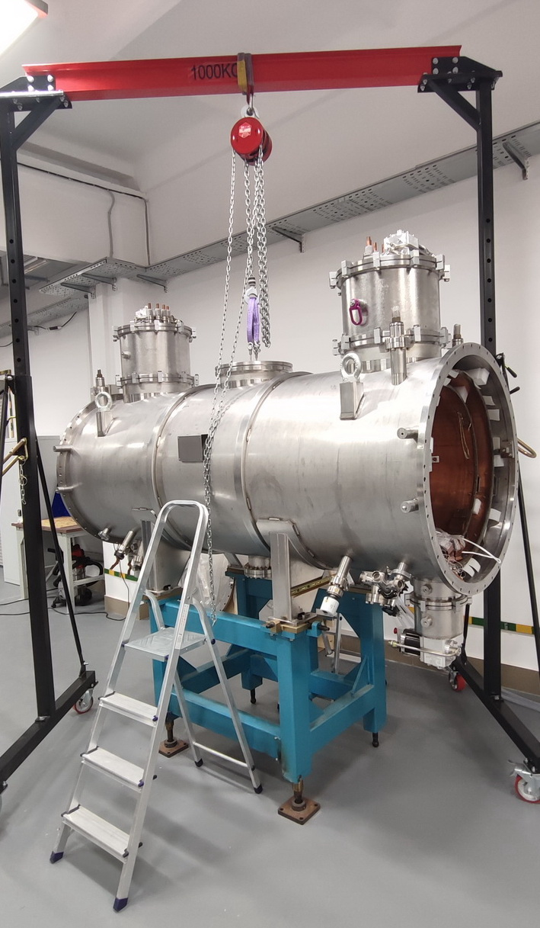
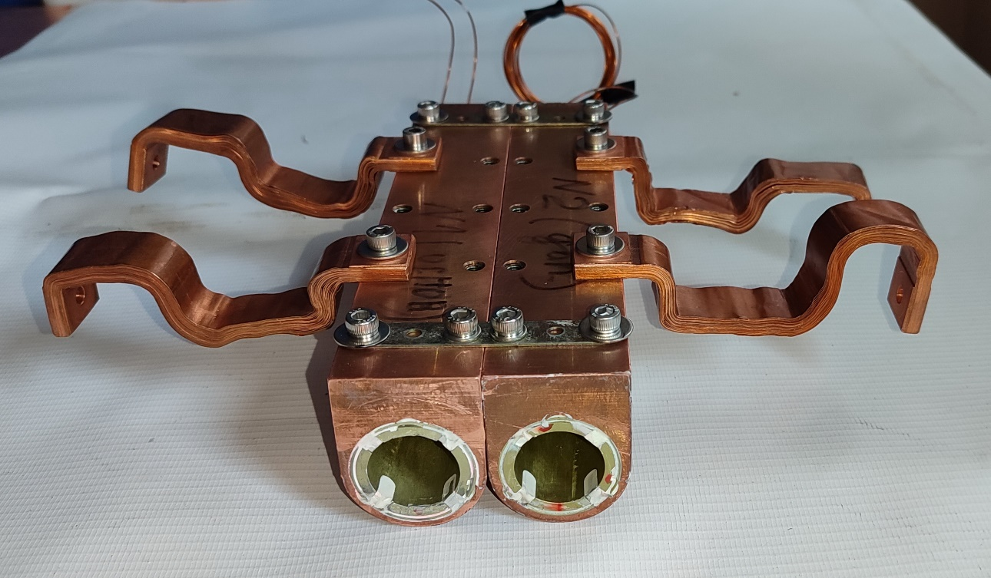
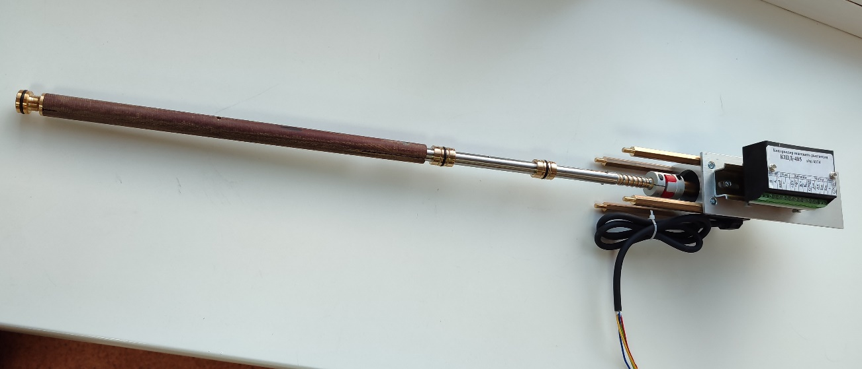
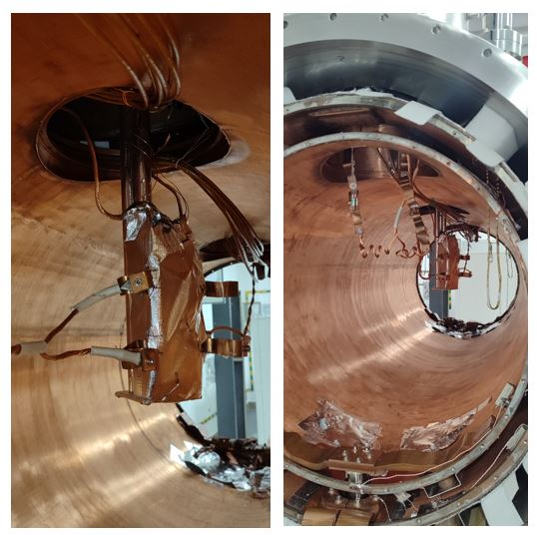
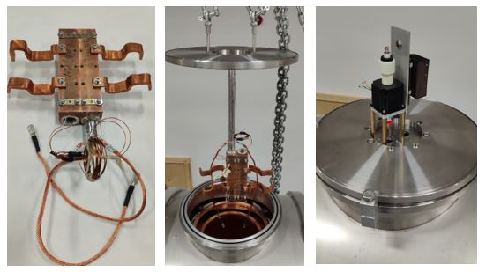
Magnetic measurements of the CCT quadrupole in an indirect cooling cryostat
The ”cold“ tests of the CCT lens prototype were carried out in a ”dry" cryostat using cryocoolers in a vacuum cooled by copper heat sinks.
The 1000A power supply was connected to only one quadrupole and magnetic measurements were carried out by a rotating coil:
- the field in the quadrupole in which the current was passed was measured , -
- the field in the neighboring quadrupole was measured, in which there was no current
Measuring frame with stepper motor
Indirect cooling cryostat
A block of quadrupoles assembled for magnetic measurements
The process of installing a quadrupole lens unit in an indirectly cooled cryostat

Slide 23
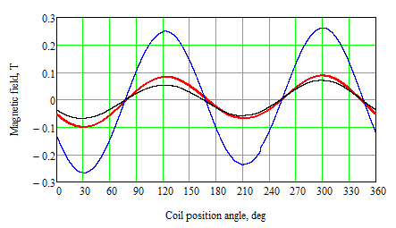
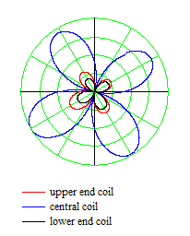
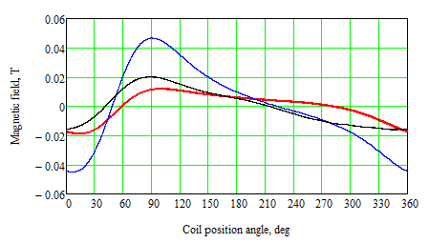
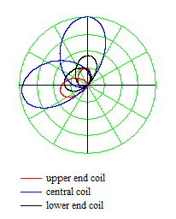
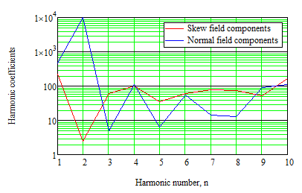
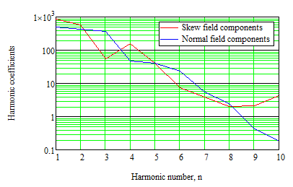
Results of magnetic measurements
The measuring coil consisted of two parts: a central long coil and two side coils for measuring the field at the ends of the quadrupole.
Field measurements in a quadrupole with current
Measurements of the induced field in a neighboring quadrupole without current
Signals from rotating coils : black and red – from the end coils,
blue - from the central coil.
The relative coefficients of the field expansion, measured by the central coil. The relative coefficients of the field expansion, measured by the end coils.

Slide 24
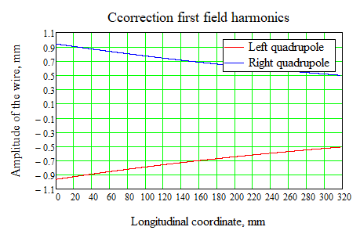
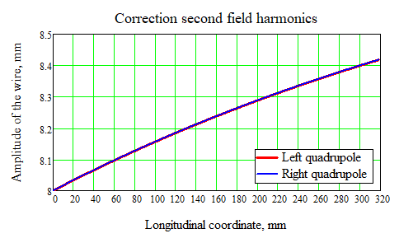
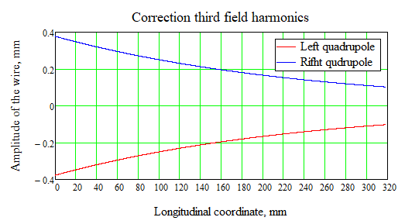
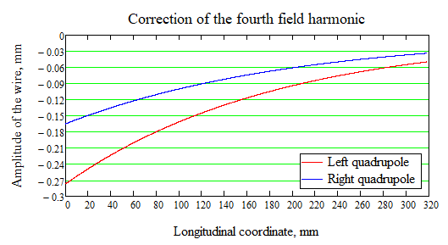
Simulation results of corrections with variable distance between quadrupoles
Since the quadrupoles are located at an angle to each other, the effect on each other will vary with length.

Slide 25
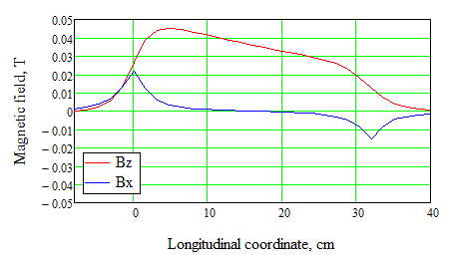
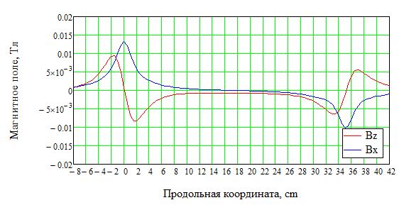




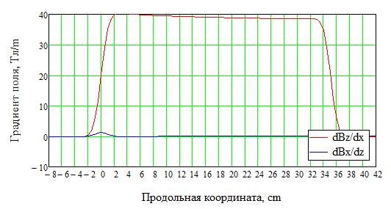
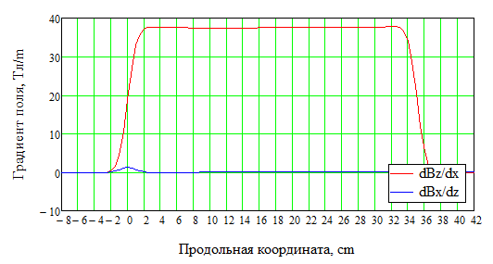



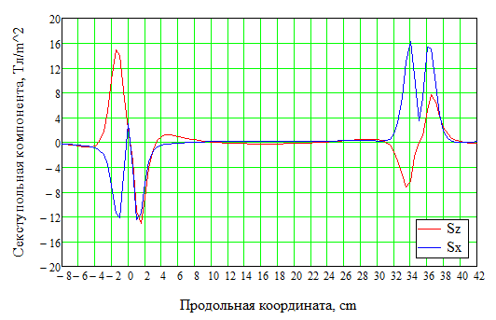

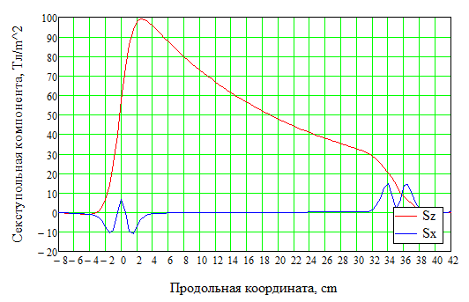



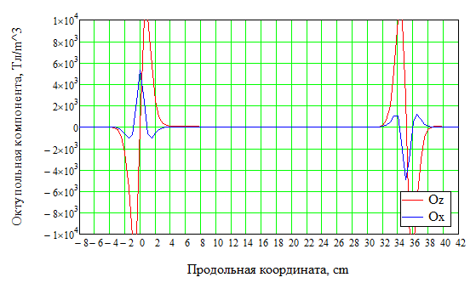


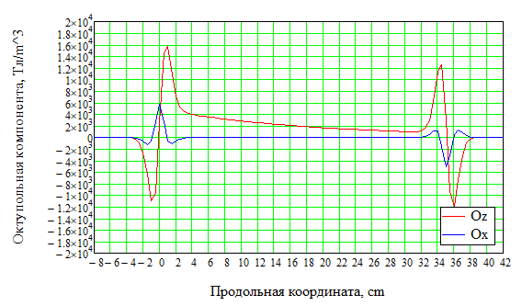


Результаты моделирования
Quadruples without correction
Quadruples with correction

Slide 26
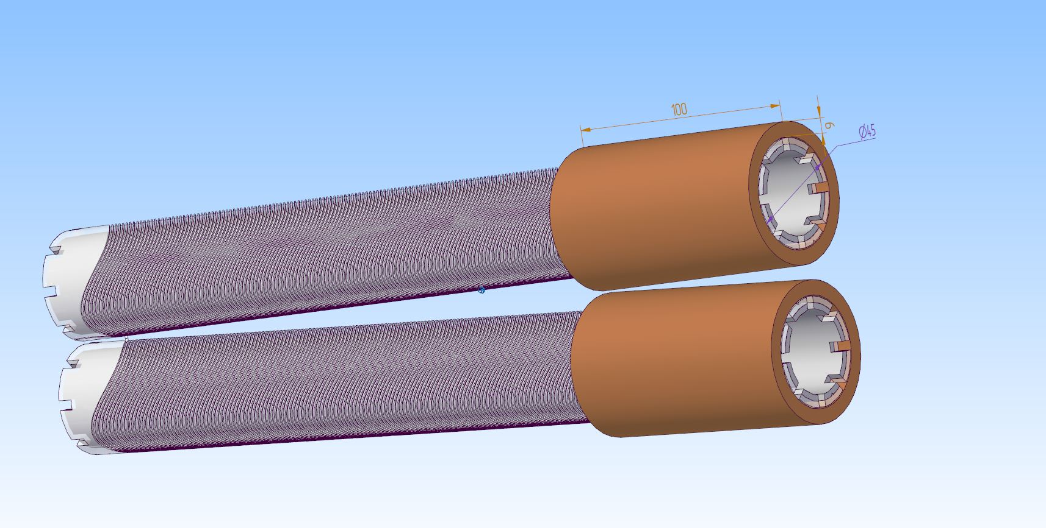
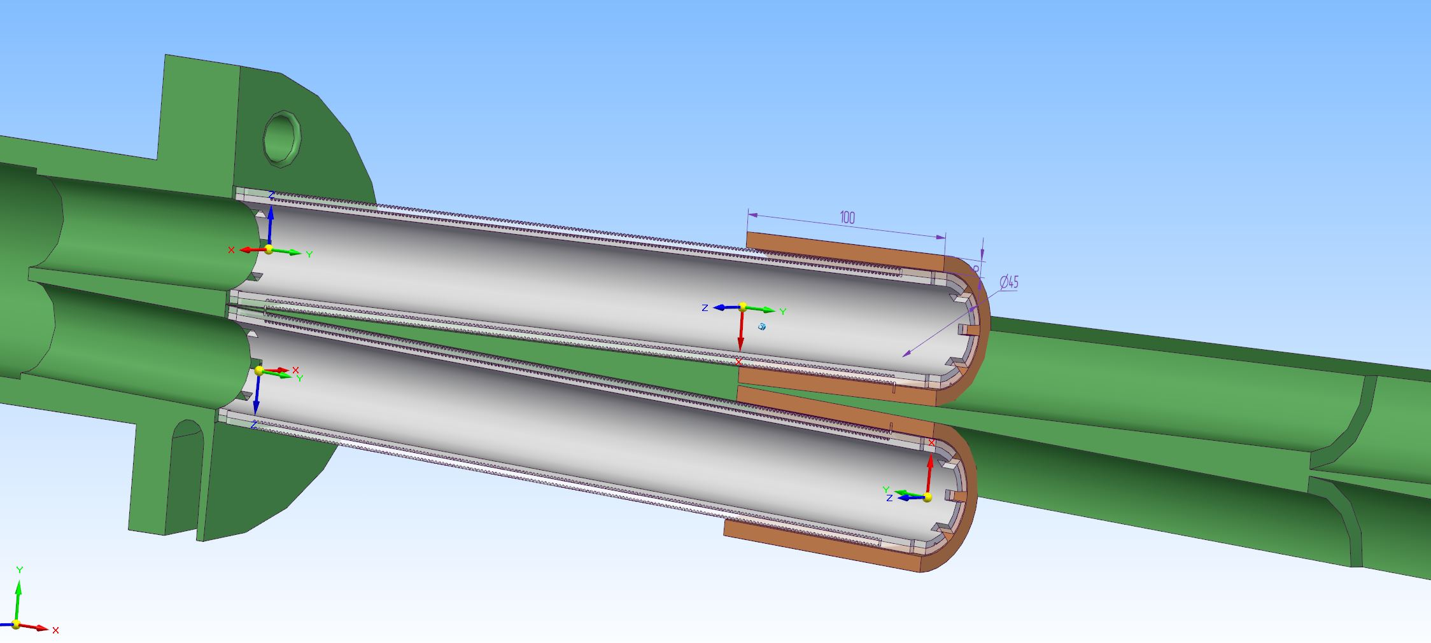
Correctors of dipole, skew quadrupole, sextupole and octupole fields are put on top of the quadrupoles

Slide 27
Conclusion
The first iteration of the FF elements layout has been completed
The first CCT quads is manufactured. Filed quality and each other influence on the field are calculated and measured.
The quads field correction with the use winding harmonics in the CCT technology is proposed.
Estimations of resistive, SR and EC heat loads have been carried out
Operation at 60 – 80K of the chambers inside quads looks possible
All manufacturing technologies and assembly concepts can be tested at the BINP mock-up installation.
А resistive heating of vacuum chambers is necessary to simulate heat losses
To make a decision on the temperature regime of the vacuum chambers inside quads, it is necessary to carry out numerical modeling of electron clouds and calculate the pressure of residual gases taking into account the SR and EC

Slide 28
Thanks for your attention!

