Slide 2
Introduction
Project | Beam charge | Normalized Injector emittans | Energy spread
SuperKEKB | 5 nC | ~20 mm mrad | 1%
C-τ Factory | 1 nC | ~10 mm mrad | 0.1%
FCC | 6.5 nC | ~6 mm mrad | 0.08%
1. Beam charge, normalized beam emittance and energy spread are depended on the electron gun design.
2. High beam charge is needed => large area of the photocathode => beam emittance increasing
3. Ultra low energy spread is necessary => short beam longitudinal size
4. Normalized emittance of the injector is not too low, but taking into account the lengths of the linacs and possible errors of the real devices, low beam emittance of the e-gun can be useful.
The new ideas of the e-gun design and the cathodes material are required
A. Levichev, A.E.Levichev@inp.nsk.su 2018 Workshop on the Circular Electron-Positron Collider 2

Slide 3
Possible candidates for high efficiency and long life time photocathodes
Cathode type | Quantum efficiency | Vacuum | Advantages | Disadvantages
Cs2Te | 20%-0.5% | 10^-11 Torr (>1000Hrs) | Good QE. Available for high acceleration gradient. High charge production | Very sensitive to vacuum conditions and breakdowns. Complicate installation.
Ir5Ce | 5*10^-5 (before laser cleaning) 1.2*10^-4 (after laser cleaning) @266 nm, [1] | 10^-9 Torr | Acceptable QE and very good life time. Available for high acceleration gradient. High charge production. Not so sensitive to vacuum conditions, low work function – 2.64 eV, [2] (copper – 4.7 eV) – acceptable green laser. | Need to investigate
Mg | 0,1% | 10^-9 Torr | Very good QE for metal photocathode. Not so sensitive to vacuum conditions, it does not require something special equipment. | Apparently sensitive to very high acceleration gradients. (need to investigate)
[1]- D. Satoh and et. al. DEVELOPMENT OF BETTER QUANTUM EFFICIENCY AND LONG LIFETIME IRIDIUM CERIUM
PHOTOCATHODE FOR HIGH CHARGE ELECTRON RF GUN. Proceedings of IPAC2013, Shanghai, China
[2]-G.I.Kuznetsov, “IrCe Cathodes For EBIS”, Journal of Physics: Conference Series 2 (2004) 35–41.
A. Levichev, A.E.Levichev@inp.nsk.su 2018 Workshop on the Circular Electron-Positron Collider 17

Slide 4
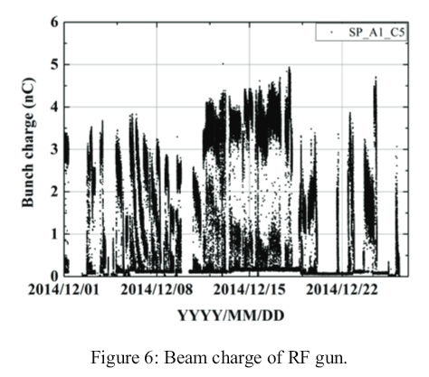
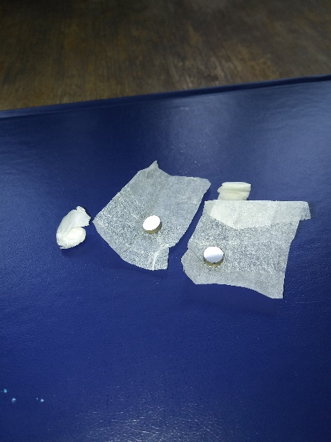
Ir5Ce Preliminarily Results
Ir5Ce photocathode in Super KEKb RF gun
T. Miura. Progress of SuperKEKB. IPAC2015. Oral presentation
In order to measure the quantum efficiency and ablation resistance of this alloy, several samples of photocathodes in the form of tablets with a diameter of 6 mm and a thickness of about 2 mm were manufactured at the INP SB RAS.

Slide 5
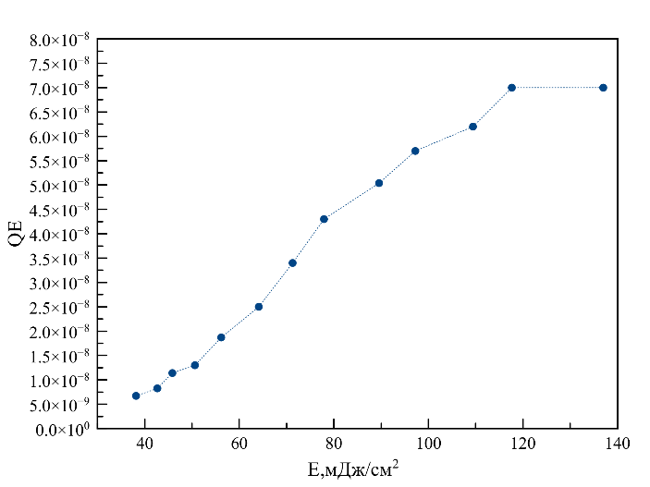
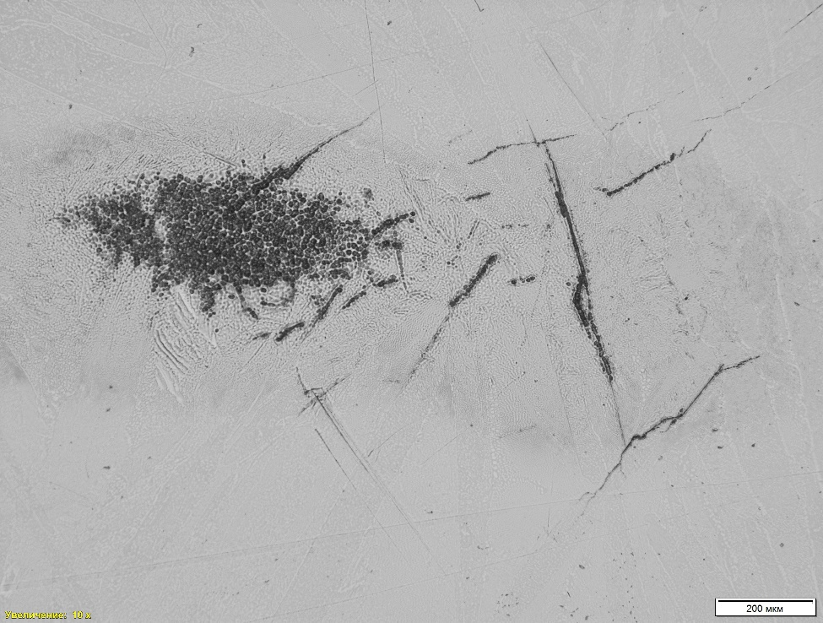
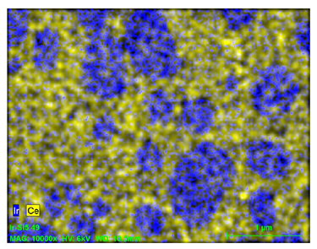
Ir5Ce Preliminarily Results
 | Wave length | Pulse duration | Pulsed energy | Repetition rate
Solid-state laser Solar LS | 355 nm | 6 ns | Up 80 mJ | 10 Hz
Max extracted charge~ 400 pC
Surface microanalysis shows
partial evaporation of cerium from the surface

Slide 6
Conclusion
At BINP we have a good experience of production and exploiting of high quality IrCe, LaB6 e.t.c cathode with high current density and long lifetime.
But…
For further testing of such a perspective cathodes the full blown test stand with laser system (266 nm) are needed.

