Slide 1
Options of the Inner Tracker for SCTF Detector
Lev Shekhtman
Budker INP
Novosibirsk State University

Slide 2
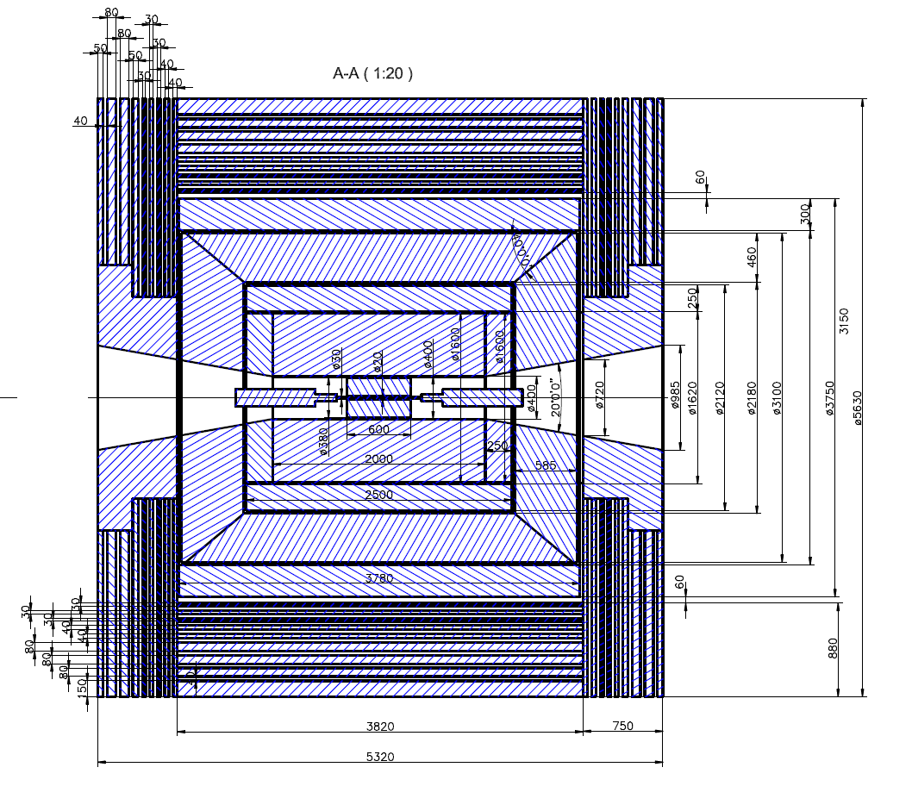
Inner Tracker:
10 mm < R < 200 mm
-300 mm < Z < 300 mm

Slide 3
Main purpose of the Inner Tracker:
Continue tracks from the Drift Chamber to Inner region
Tracking of low momentum particles
IT options
 | Material budjet | Resolution | Number of channels | Electronics | Collaboration
TPC | 1%X0 | 100-150 μm | 3x10⁵ | CSA+shaper+an.memory for 10-30 μs+buffer & on-line tracking | TUM (ALICE TPC)
Si-strips | 0.6%X0 per layer = 2.4% X0 | 10-20 μm | 2x10⁴ | CSA+shaper+an.memory for ~1μs | ?
Cyl.GEM | 0.3%X0 per layer = 1.2%X0 | 100μm | 5x10⁴-10⁵ | CSA+shaper+an.memory for ~1μs | INFN Frascatti+… (CGEM KHLOE2)

Slide 4
Estimates of p_{t} threshold with different IT options
VP – 3mm Be + 0.5 mm parafin
TPC – 1mm glass fiber (G10) + 0.1 mm teflon +15 μm copper
Si- strips – 0.32 mm Si + 0.4 mm carbon fiber
CGEM – 0.25 mm kapton + 40 μm copper

Slide 5
Estimates of p_{t} threshold with different IT options

Slide 6
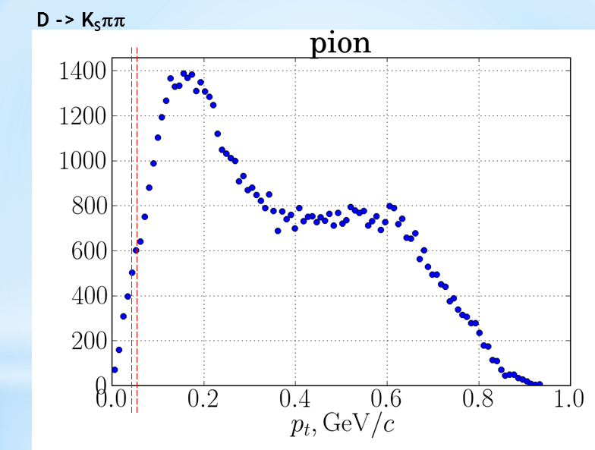
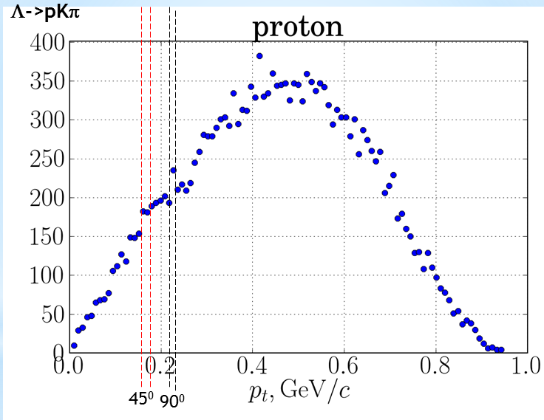
Estimates of p_{t} threshold with different IT options

Slide 7
Budker INP IT group
2 senior scientists (detector design, mounting, measurements, final analysis)
1 young scientist (software and firmware design, design of front-end and
data processing electronics, measurements, data analysis)
2 students (measurements, data analysis, simulations)
More students will be involved…
Infrastructure:
Clean room
“Grey” room with bonding machine, probe station and microscopes
Laboratory equipped for detector testing
Extracted electron beam facility (electrons 0.1 – 3 GeV with magnet,
trigger and DAQ system)

Slide 8
Experience:
Cascaded GEMs, recently micro-RWELL, micro-RWELL+GEM, Si-strips
8 detectors for KEDR TS (128x100mm, 256x100 mm, 70 um resolution)
in operation since 2010;
4 detectors for DEUTERON photon tagging system (160x40 mm,
50 um resolution), in operation since 2016;
4 detectors for Extracted beam facility (128 x 64 mm, 250 um strip pitch,
30 um resolution), 1 in operation since 2017, 3 in production;
1 detector for VEPP-4 polarimeter (128x40 mm pixel structure) mounted,
electronics in production;
Upgrade of the tracking system of CMD-3 (50 cm diameter discs and 63 cm
diameter 75 cm long cylinder) based on muRWELL technology
Single-side Si-strip detector for fast X-ray imaging at SR beam (55x35 mm,
1024 channels, 50 um pitch

Slide 9
Summary
All considered options of the IT (TPC, Si-strips, CGEM)
are almost equivalent from physics point
Other criteria should be applied (robustness, complexity,
electronics, cost, experience etc.)
We are opened for all possible (reasonable) ideas

