Slide 1
Status update of the CREMLIN+ Detector School
Sergey Kononov
Budker Institute of Nuclear Physics
International Organizing Committee meeting
August 27, 2021
Notes:
Hello everyone,
Thank you for joining us today for the CREMLIN+ Detector School Org. Comm. Meeting.
I would like to update you on the status of the school. It’s not so much happened since our last meeting in November.

Slide 2
Organizational plan
Hold first LOC and IOC meetings and make them regular
Gather ideas for the school
Compile preliminary list of lectures and hands-on experiments
Define max number of participants: about 50
Determine the scope and format: Ion/nuclear physics, Particle physics, Neutron physics; lectures and elective hands-on exercises
Define the date and duration: July 4-15, 2022 (12 days)
Set up Indico
Find lecturers
Announce and advertise
Organize student admission and selection
Prepare the hands-on experiments
Hold the school
Notes:
Here is our plan of the school organization activities. Current activities are marked by red.
I set up the Indico page with a preliminary timetable. It is a question for discussion if we need a separate website for the event. If you have a candidate who could develop an attractive web site please let me know.
I would like to urge you to look for good lecturers. It becomes even more important in the light of unfortunate overlap with other detector schools in 2022. We will come back to this issue later. I think we should do most of the work of filling lecturer vacancies by Summer, a year before the actual event.

Slide 3
Web resources
Wiki-page for organizers: https://ctd.inp.nsk.su/wiki/index.php/Detector_school_CREMLINplus
Indico page of the School: https://indico.inp.nsk.su/event/41/
Planning spreadsheet: https://docs.google.com/spreadsheets/d/1GhG-1pajMyffXE6BPpqz_VzSh1T-qbjMA-s3MtKKdoI/edit?usp=sharing
Hands-on exercises
Lectures
Social events
Notes:
I would like to remind you we have the following resources for planning the school. First of all it is the wiki page whether I gather all relevant information including the presentations where we release the info about school status.
As I said we already have an Indico page for the school that will be gradually filled. I drew a preliminary schedule of the sessions splitting them between lectures and practical courses giving more time for the latter. I think we can define exact time for lectures and practical courses later when we find actual speakers and find out their considerations for lecture durations and dates. Hands-on exercises should be scheduled when we have signed-up students and know their preferences. Then we could break students in groups and plan the practical courses in detail.
Finally, we have Google spreadsheets for hands-on exercises, lectures and social events.

Slide 4
Current expenses
2 FPGA kits for exercise “Introduction to FPGA”. (L.Epshtein), ~3900 Euro
Desktop HVS for exercise “Large area scintillation counters for TAIGA experiment” (E.Kravchenko), ~6900 Euro
GEMs for exercise “Time projection chamber” (A.Sokolov), ~1000 Euro
Furniture for the BINP Computer class, 1200 Euro

Slide 5
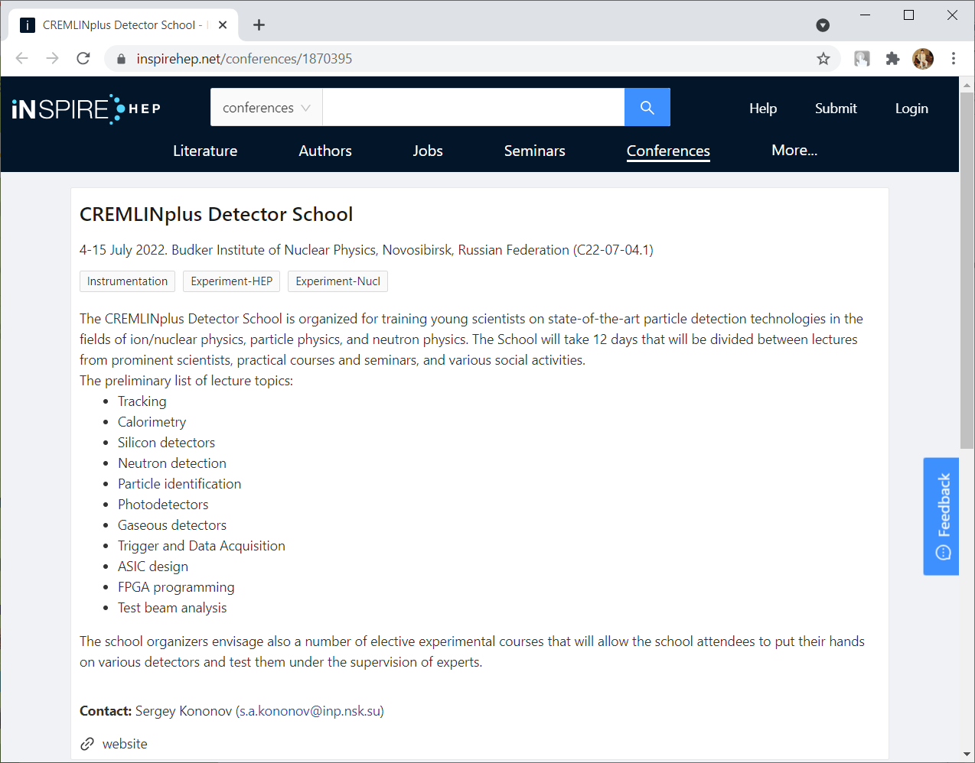
Announcements
iNSPIREhep https://inspirehep.net/conferences/1870395
Submitted to CERN Courier
TO DO: mailing lists, news (please advise)

Slide 6
Meeting with EDIT-2022 school organizer on 25/05/2021
EDIT-2022 detector school will take place on July 04 – 15, 2022 at IHEP (Beijing, China) with physical presence
Main organiser: ICFA Instrumentation Innovation and Development Panel
Local organizer: Hongbo Zhu (IHEP)
Approx. 60 students, with approx. 2/3 from China
Lectures will cover 10 topics (particle physics (in China), silicon detectors, gaseous detectors, scintillator detectors, tracking, calorimetry, particle identification, electronics and signal processing, trigger and DAQ, quantum sensors)
3 lectures per topic
Hands-on exercises
Test beam work at IHEP accelerator
Evening talks by experts (e.g. future colliders, neutrino experiments, quantum sensors, ...)

Slide 7
Meeting with EDIT-2022 school organizer on 25/05/2021 (cont’d 1)
Preliminary agreements
Share the speaker candidate lists
Each school settles on speakers by September 15th, 2021,
Agree to work towards a common registration of applicants
Can be set up on a common Indico page
Common announcements for the two schools (mailing lists, iNSPIRE-hep, news articles, etc.)
Announcements and opening of registration by end of September 2021

Slide 8
Meeting with EDIT-2022 school organizer on 25/05/2021 (cont’d 2)
Preparations to announcement
Web site of the school
Publicity poster of the school
Scientific focus of the school
Lecture programme and speakers, and other relevant info about the programme
Registration fee
Is accommodation covered in the fee?
Are meals covered in fee?
Is there special financial support for some students?
if yes, does it cover travel expenses?
separate application form for requesting support needed?
Information requested for the selection process of applicants (common to both schools)
E.g. CV, motivation letter, 2 letters of referees (templates, page limits, etc...)
Will there be a student poster session at the school?
If yes, do we ask for abstracts already at registration?
Information for applicants about visa requirements (provide relevant government links on the registration page)
Deadline for application (common to both schools)

